Slide 1
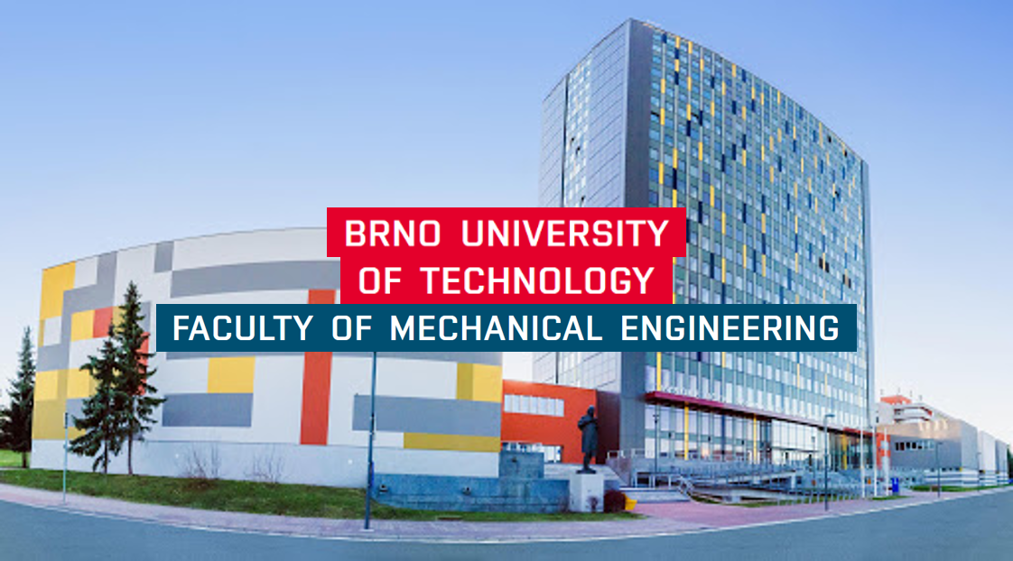
BRNO
Czech Republic
LUND UNIVERSITY, Department of Mechanical Engineering Sciences, September 2024
Notes:
My name is Tomáš Profant, I am an assistant professor at the BUT, Faculty of Mechanical Engineering and the Institute of Body Mechanics, Mechatronics and Biomechanics. BUT is historically the second oldest technical university in the Czech Republic with more than 17,000 students, it has seven faculties – mechanical, civil and electrical engineering, chemistry, architecture, informatics, management and fine arts. BUT was founded in 1873 as the German Technical University in Brno, but after more than twenty years, in September 1899, it was declared as Imperial Czech Technical School of Franz Joseph in Brno.

Slide 2
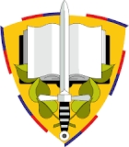
BRNO
Czech Republic
Brno University of Technology
Masaryk University
University of Defense
Central European Institute of Technology
Mendel University in Brno
LUND UNIVERSITY, Department of Mechanical Engineering Sciences, September 2024
Notes:
In addition to BUT, there are other universities in Brno, especially MUNI, which is not technical, but focused on the humanities and natural sciences. BUT and MUNI cooperate within the CEITEC project. Brno is also home to the University of Defense or the Mendel University of Agriculture.

Slide 3
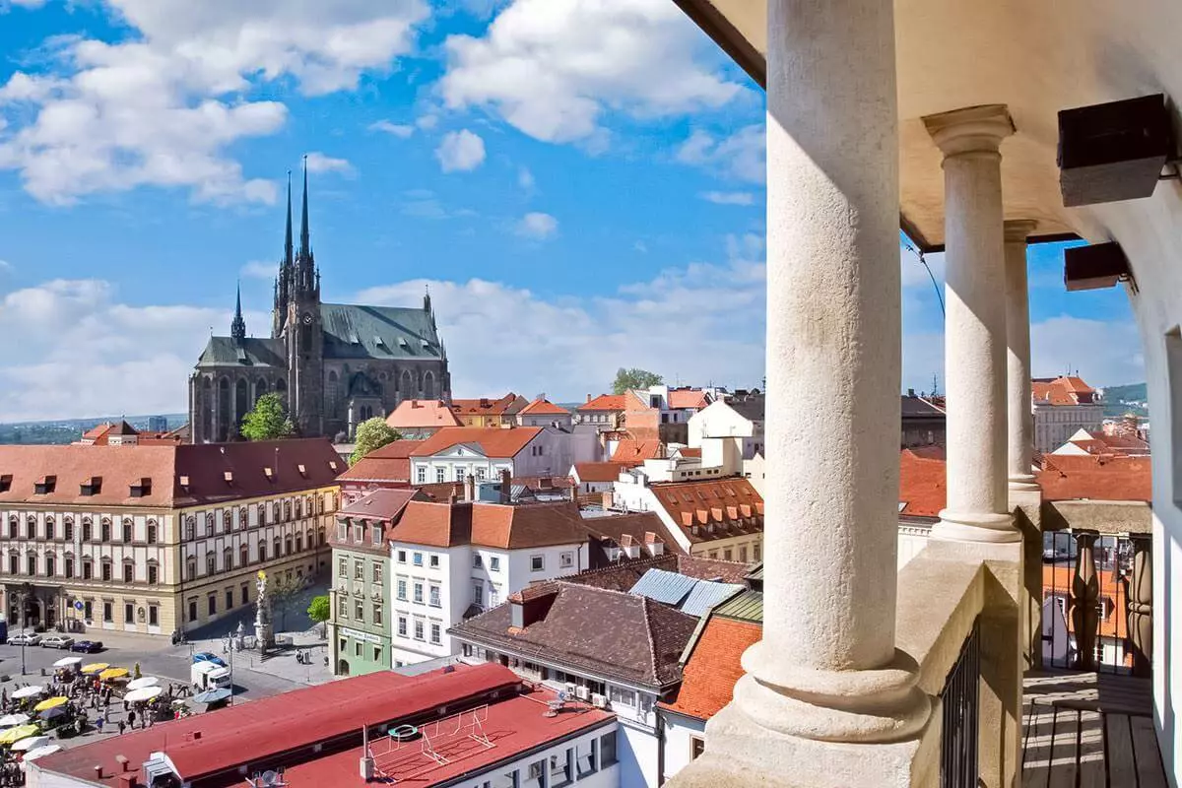
BRNO
Czech Republic
Petrov, 12th century, historical center
LUND UNIVERSITY, Department of Mechanical Engineering Sciences, September 2024
Notes:
Brno was founded at the beginning of the 11th century in the south of the region called Morava. Today, approximately 400,000 inhabitants live here and it is the second largest city in the Czech Republic. Brno has a small historical center dominated by the Cathedral of Saints Peter and Paul.

Slide 4
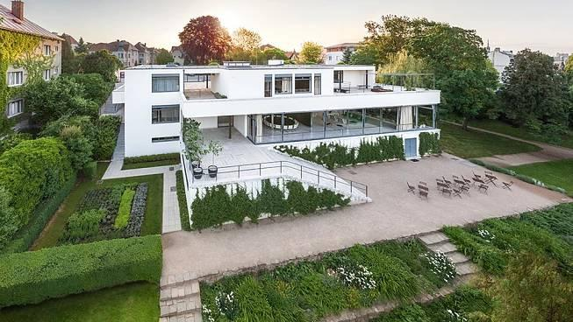
BRNO
Czech Republic
Villa Tugendhat, 1929–1930
LUND UNIVERSITY, Department of Mechanical Engineering Sciences, September 2024
Notes:
Brno can also boast of many famous modern architectural gems such as art nouveau villas or functionalist buildings, which are among the best of their kind in the world. For example, the legendary Villa Tugendhat in the picture.

Slide 5
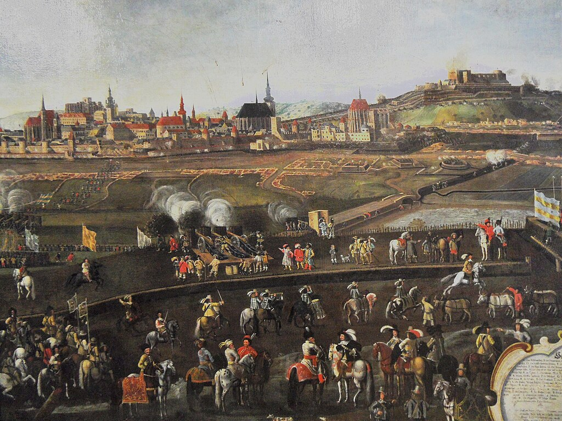
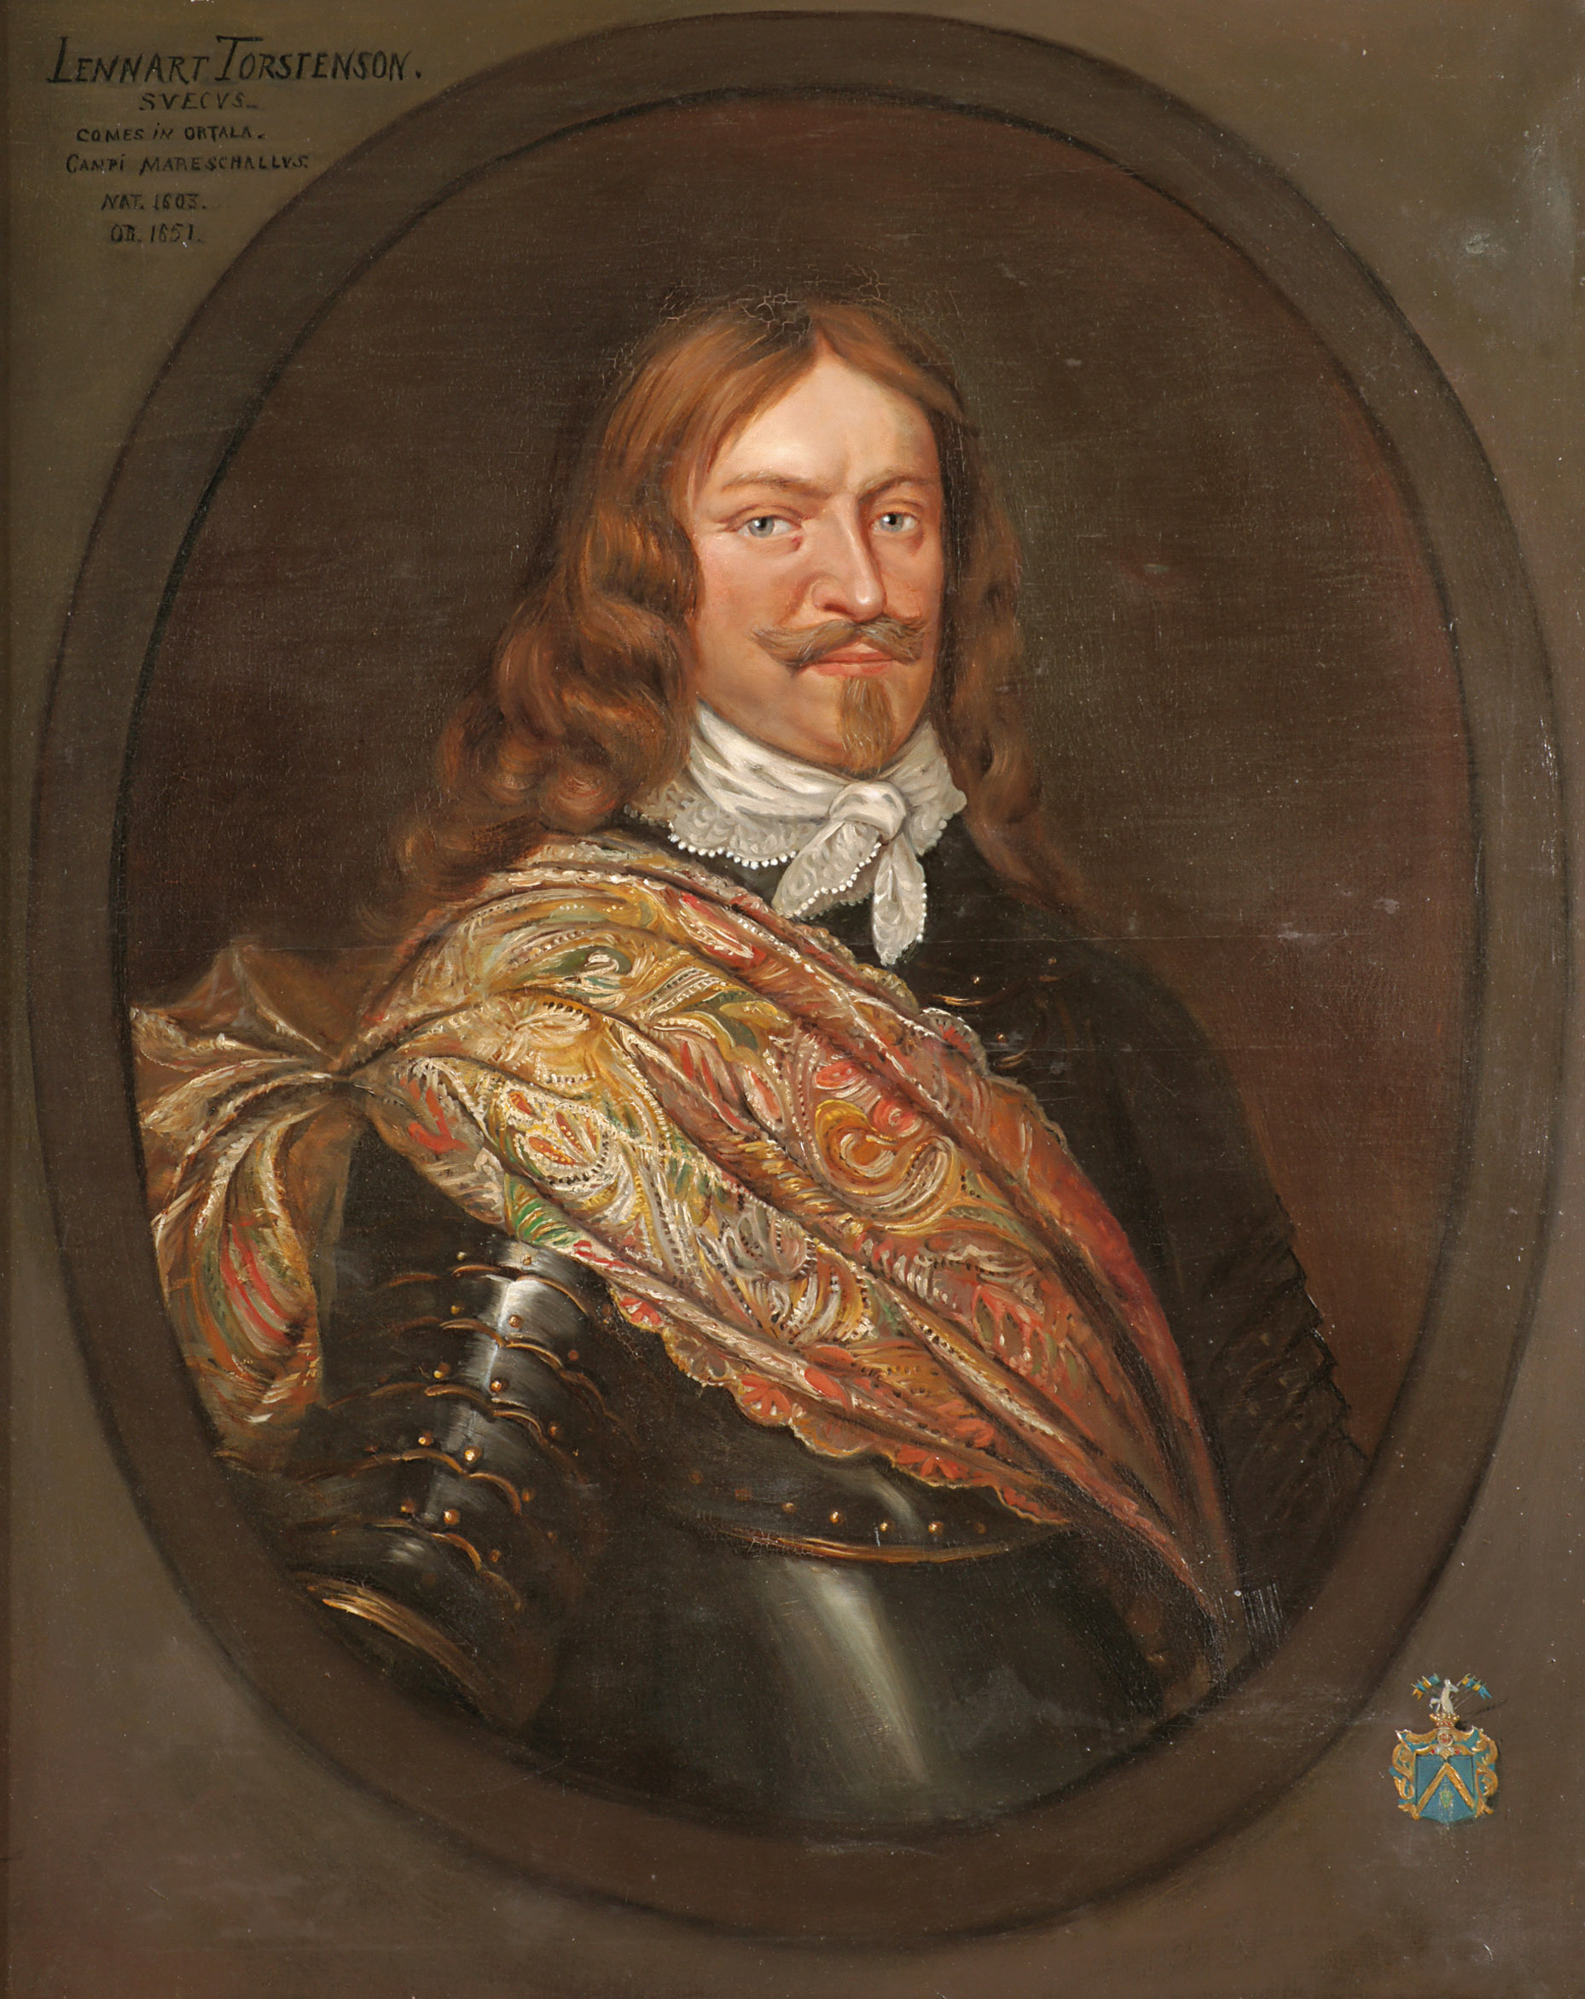
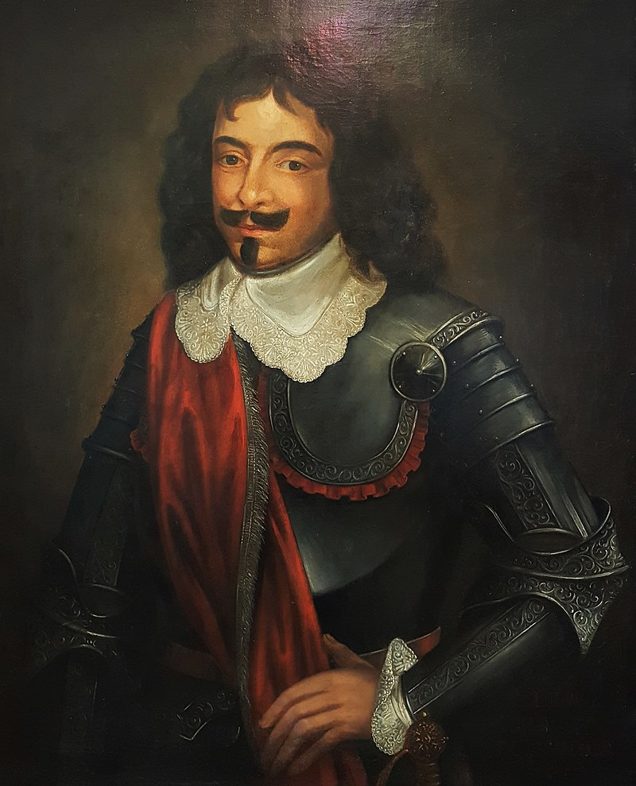
BRNO
Czech Republic
Lennart Torstenson
1603, Forstena – 1651, Stockholm
Siege of Brno, May – August 1645
Louis Raduit de Souches
1608, La Rochelle – 1682, Jevišovice
LUND UNIVERSITY, Department of Mechanical Engineering Sciences, September 2024
Notes:
Brno made history twice. The first, the most important event for Brno, was the siege of Brno at the end of the Thirty Years' War. It was a three-month battle between the brilliant general of the Swedish army, Lennart Torstensson, and the French commander of the Brno people and soldiers, Jean-Louis Raduit de Souches. Brno defended itself. It was a turning point in the history of Brno, because it definitively became the center and capital of Moravia

Slide 6
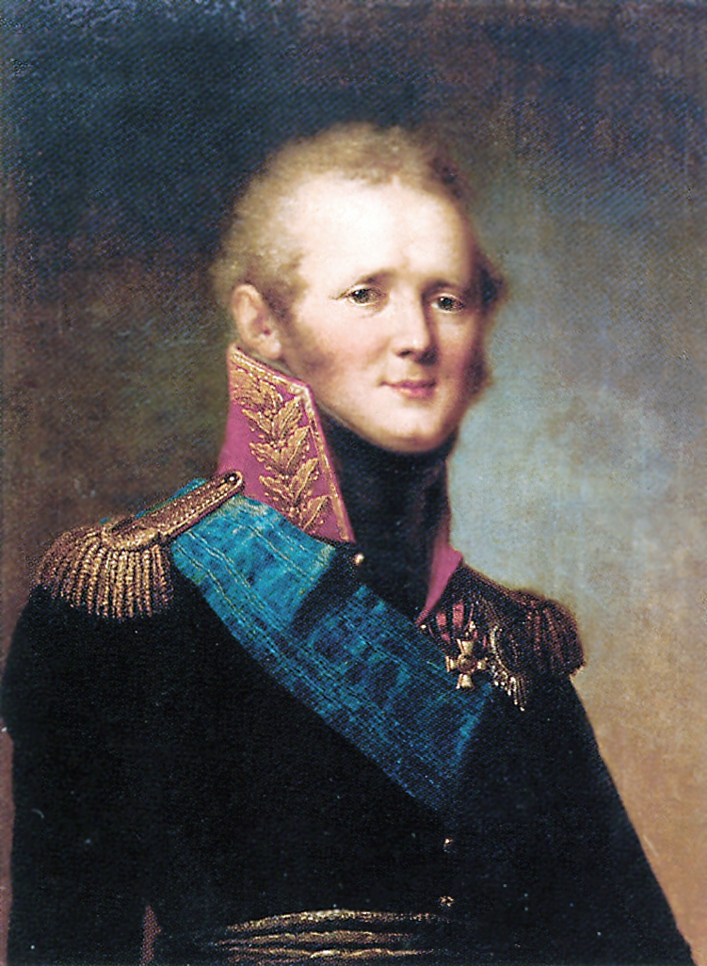
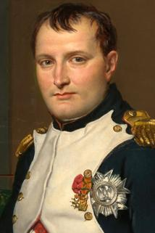
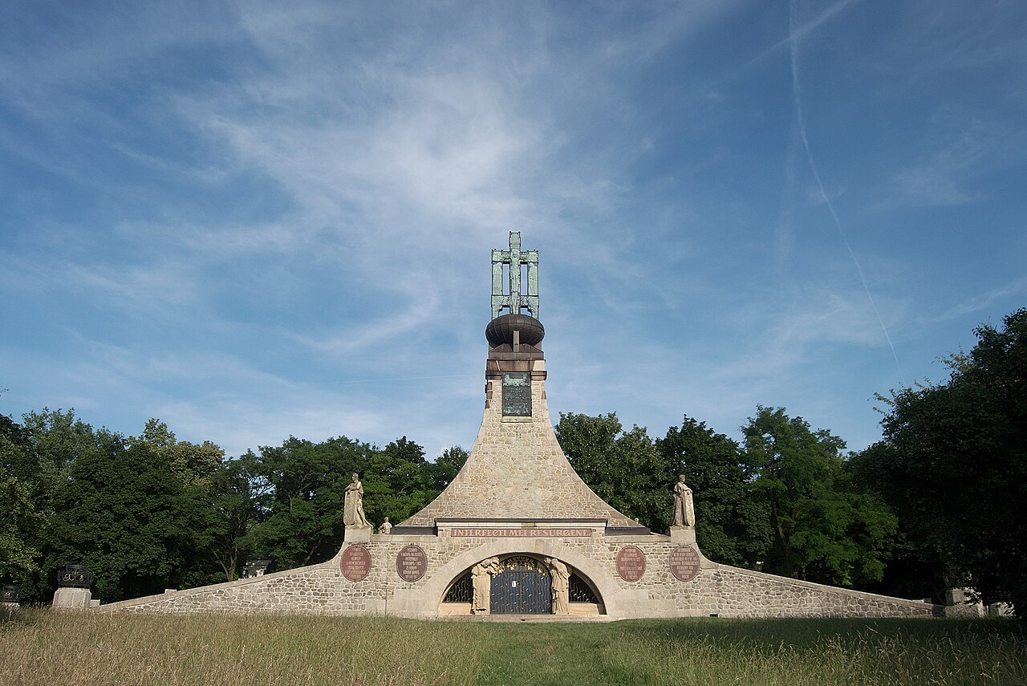
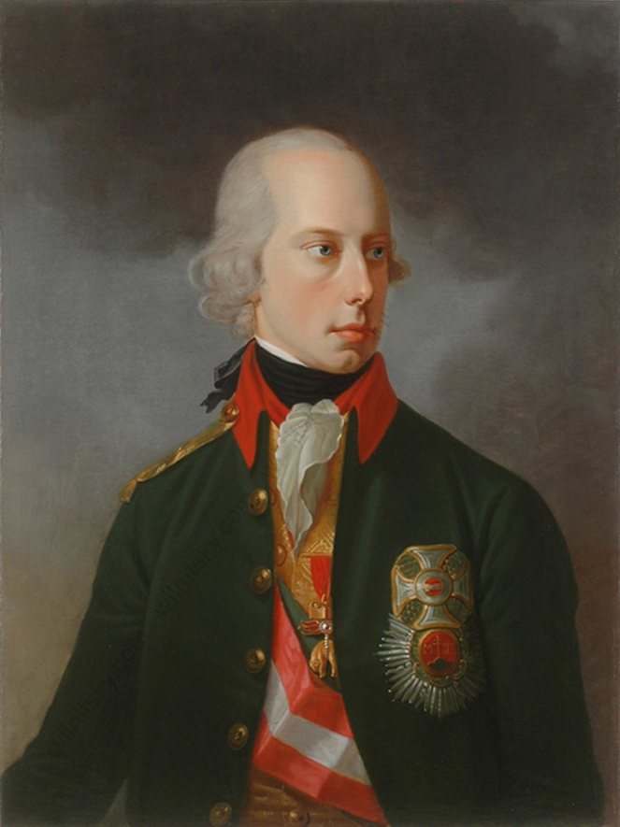
BRNO
Czech Republic
Alexander I 1777 – 1825
Napoleon Bonaparte
1769, Corsica – 1821, Saint Helena
Cairn of Peace Memorial, 1910 – 1912
Battle of Austerlitz, 2 December 1805
Francis II
1768 – 1835
LUND UNIVERSITY, Department of Mechanical Engineering Sciences, September 2024
Notes:
The second significant event in Brno's history was the Battle of Austerlitz, the battle between the French Emperor Napoleon and the Russian and Holy Roman Emperors Alexander I and Francis II. It was a famous Napoleon’s victory, and a beautiful monument, Cairn of Peace Memorial, was built near Brno on the battlefield in honor of the victims of this battle.

Slide 7
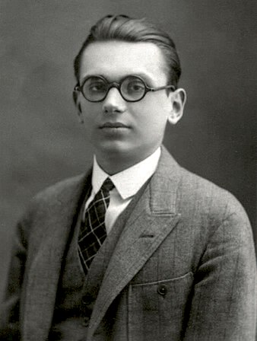
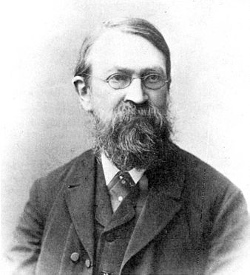
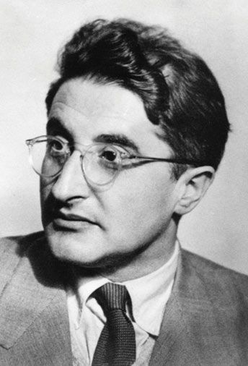
BRNO
Czech Republic
Kurt Friedrich Gödel
1906, Brno – 1978, Princeton
Ernst Mach
1838, Chrlice (Brno) – 1916,
Vaterstetten
George Placzek
1905, Brno – 1955, Zürich
LUND UNIVERSITY, Department of Mechanical Engineering Sciences, September 2024
Notes:
Throughout history, even sixty percent of the inhabitants of Brno were Germans, until the end of World War II. It was the so-called Brno language island. This community gave Brno several personalities who were born in Brno and became the most important scientists in the world. The most important is the brilliant logician and mathematician Kurt Godel, or the famous physicist Erns Mach or another physicist Georg Placzek, who participated in the development of the atomic bomb in Manhattan.

Slide 8
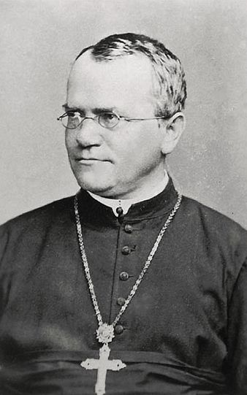
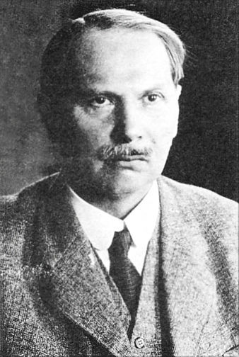
BRNO
Czech Republic
Gregor Johann Mendel
1822, Hynčice – 1884, Brno
Viktor Kaplan
1876, Mürzzuschlag – 1934, Unterach am Attersee
LUND UNIVERSITY, Department of Mechanical Engineering Sciences, September 2024
Notes:
Other scientists working in Brno were Gregor Mendel, who founded genetics, and the brilliant engineer Victor Kaplan.

Slide 9
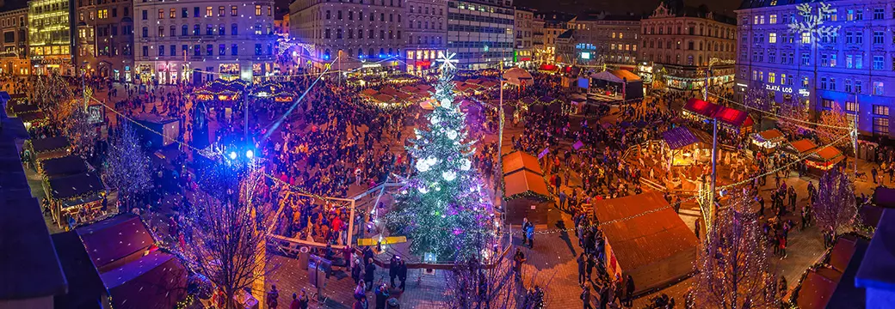
BRNO
Czech Republic
Brno became the European capital of Christmas 2024
LUND UNIVERSITY, Department of Mechanical Engineering Sciences, September 2024
Notes:
And finally, Brno became the European capital of Christmas 2024. My opinion is that Christmas in Brno is nice for all the years I remember it. Even although Brno is in many ways the second in Czech Republic and hard to find on maps, you are welcome.

