Slide 1
6th International Conference on Crack Paths (CP 2018), Verona, Italy, 19-21 September 2018
Microcrack interaction with circular inclusion and interfacial zone
Tomas Profant¹, Miroslav Hrstka¹ and J. Klusak²
¹ Brno University of Technology, Technická 2896/2, 616 69 Brno, Czech Republic
² CEITEC IPM, Institute of Physics of Materials; Zižkova 22, 616 62, Brno, Czech Republic

Slide 2
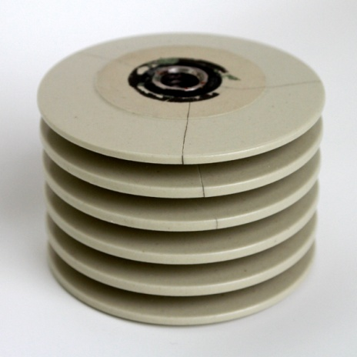
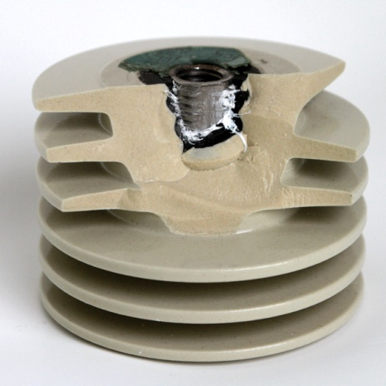
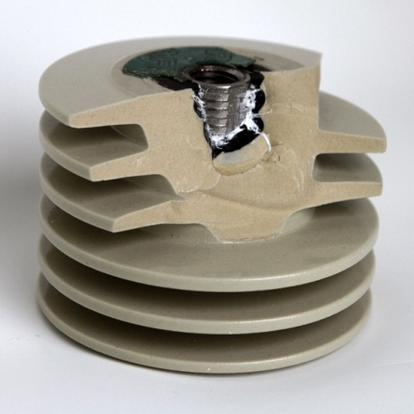
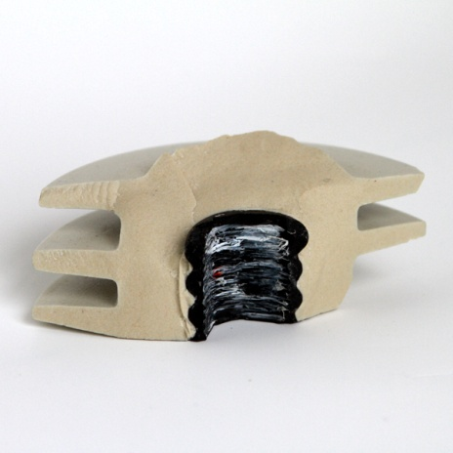
6th International Conference on Crack Paths (CP 2018), Verona, Italy, 19-21 September 2018
INTRODUCTION
Joints of different materials occur in practical engineering structures or in parts of electronic devices(e.g. layered composite materials, constructions with protective surface layers, thermal barriers). They enable achievement of properties which could not be attained by means of homogeneous materials.

Slide 3
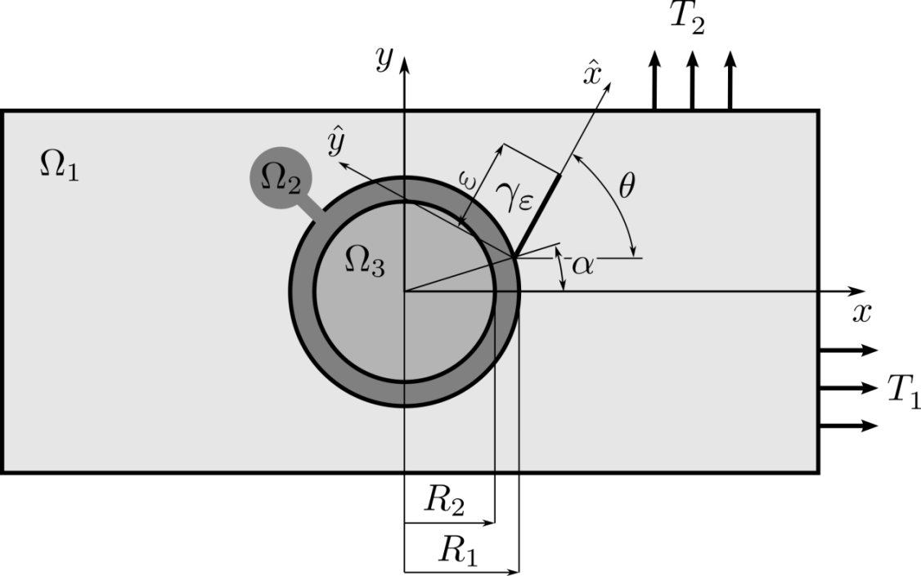
6th International Conference on Crack Paths (CP 2018), Verona, Italy, 19-21 September 2018
PROBLEM FORMULATION
A plane elasticity problem with the simplified geometry
The ideal interfaces between the matrix $Ω_{1}$, interfacial zone $Ω_{2}$ and inclusion $Ω_{3}$
An initiated crack $γ_{ε}$ of the finite length $ε$from the interface between $Ω_{2}$ and $Ω_{3}$
The crack length $ε$ is small with respect to the radii $R_{1}$ or $R_{2}$
The dimensions of the matrix $Ω_{1}$ are finite and are to be under the external loads $T_{1}$ and $T_{2}$ which are statically equilibrated
The study of the influence of the inclusion $Ω_{3}$, interfacial zone $Ω_{2}$, outer loads $T_{1}$ and $T_{2}$ and crack position $α$ and $θ$ to the crack growth in a view of their dimensions and material properties
Notes:
The analytical treatment is conditioned by the various stages of simplification. Usually the geometry of the domain on which the solution should be found is simplified. Because the following model is based on the analytical description of the stresses and displacements around the inclusion via the fundamental solution, the plane elasticity problem is considered, where the shape of the inclusion Ω3 is reduced to the circular one of the radius R2. In the same way the interfacial zone Ω2 with radius R1 is modelled. The ideal interfaces between the inclusion Ω3, interfacial zone Ω2 and matrix Ω1 are supposed. Also it is supposed that there is a initiated crack γε of the finite length ε from the interface between the interfacial zone Ω2 and the matrix Ω1. The crack length ε is small with respect to the radii R1 or R2, respectively, and the crack γε grows from the interface between the matrix and interfacial zone into the matrix Ω1 at the point given by the angle $α$ and orientation represented by the angle $θ.$ The dimensions of the matrix Ω1 are finite and are to be under the external loads T1 and T2, which are statically equilibrated. The interest of the study is the influence of the inclusion Ω3, interfacial zone Ω2, outer loads T1, T2 and crack position α, $θ$ to the crack growth in a view of their dimensions and material properties.

Slide 4
6th International Conference on Crack Paths (CP 2018), Verona, Italy, 19-21 September 2018
ASYMPTOTIC ANALYSIS
Governing partial differential equation
$∇⋅T\left(x,ε\right)=0$ $x∈Ω_{ε}$
Boundary conditions
$T\left(x,ε\right)⋅m=0$ $x∈γ_{ε}$
$T\left(x,ε\right)⋅n=t^{P}$ $x∈∂Ω_{ε}$
Compatibility conditions $\left\|x\right\|∈R_{1}$
$$u_{1}\left(x\right)=u_{2}\left(x\right)$$
$$t_{1}\left(x\right)=t_{2}\left(x\right)$$
Compatibility conditions $\left\|x\right\|∈R_{2}$
$$u_{2}\left(x\right)=u_{3}\left(x\right)$$
$$t_{2}\left(x\right)=t_{3}\left(x\right)$$
$$t^{P}=\left\{\begin{aligned}\left(T_{1},0\right) for n=(±1,0) \\ \left(0,T_{2}\right) for n=(0,±1)\end{aligned}\right.$$
$Ω=Ω_{1}⋃Ω_{2}⋃Ω_{3}$ $Ω_{ε}=$ $Ω∖γ_{ε}$
Notes:
The purpose of using the methods analyzing the influence of the thin interfacial zone Ω2 on the crack behavior initiated from the interface between the domains Ω1 and Ω2 follows from the stress composite expansion applied at the point of crack initiation represented by the parameter α. The composite expansion is introduced under the assumption that the crack γε is small with respect to the dimensions R1 and R2 of the inclusion Ω3 and interfacial zone Ω2. The problem can be mathematically rewritten as follows, viz slajd. The symbol m is the outward normal to the crack faces, n is the normal to the external boundary of the domain Ω1 and the continuity conditions, viz slajd, are fulfilled over the domains Ω1, Ω2 and Ω3. Without any loss of generality, the vector tP is either (T1,0) or (0,T2).

Slide 5
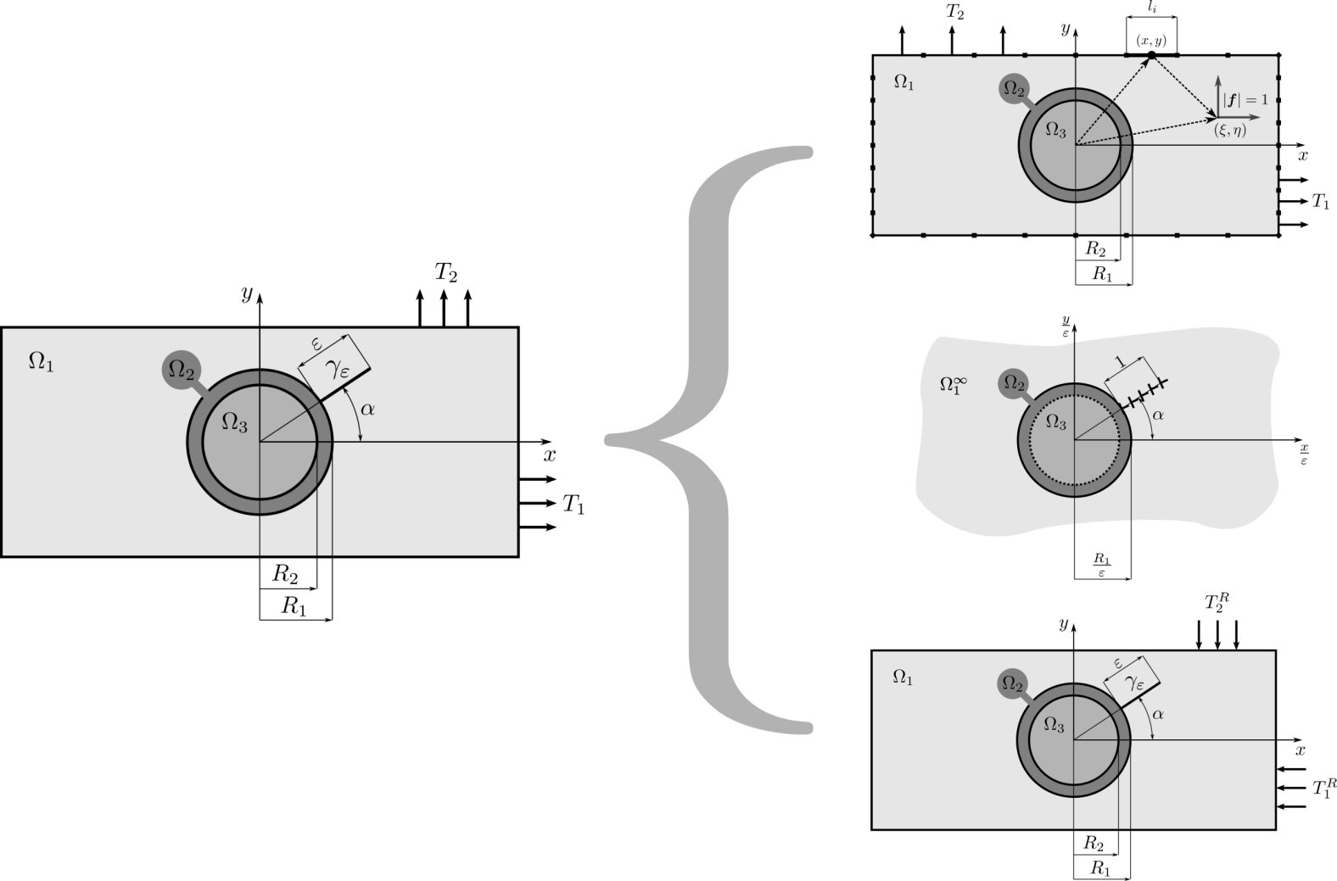
6th International Conference on Crack Paths (CP 2018), Verona, Italy, 19-21 September 2018
ASYMPTOTIC ANALYSIS
Outer solution
Inner solution
A solution in the form of the first element
of the asymptotic expansion
$T\left(x,ε\right)=T^{(0)}\left(x\right)+{\tilde{T}}^{(0)}\left(x/ε\right)+O\left(ε\right)$
Error
Outer solution
Inner solution
Error
Notes:
The stress tensor T(x,ε) is found in the form of the asymptotic expansion with respect to the crack length $ε$, where we focus on its first element corresponding to $ε^{0}$. The reason for this is the fact that From a mathematical point of view, the infinite asymptotic series may not converge, i.e. the sum of the series may not be the solution of the problem defined above. To get the solution which is the result of the convergent approximation, it should be found as a solution by means of boundary or finite elements. Practically, one can get a solution with any accuracy by using the finite series, viz slajd, instead of the infinite one. In the solution above, viz slajd, ${\tilde{T}}^{(0)}\left(x/ε\right)$ is the so called inner stress tensor (the boundary layer) and $T^{(0)}\left(x\right)$ is the outer stress tensor.

Slide 6
6th International Conference on Crack Paths (CP 2018), Verona, Italy, 19-21 September 2018
ASYMPTOTIC ANALYSIS
Outer solution
Governing partial differential equation
$∇⋅T^{(0)}\left(x\right)=0$ $x∈$ $Ω$
$$Ω=Ω_{1}⋃Ω_{2}⋃Ω_{3}$$
Compatibility conditions $\left\|x\right\|∈R_{1}$
$$u_{1}^{(0)}\left(x\right)=u_{2}^{(0)}\left(x\right)$$
$$t_{1}^{(0)}\left(x\right)=t_{2}^{(0)}\left(x\right)$$
Compatibility conditions $\left\|x\right\|∈R_{2}$
$$u_{2}^{(0)}\left(x\right)=u_{3}^{(0)}\left(x\right)$$
$$t_{2}^{(0)}\left(x\right)=t_{3}^{(0)}\left(x\right)$$
Boundary conditions
$T^{(0)}\left(x\right)⋅n=t^{P}$ $x∈∂Ω$
$$t^{P}=\left\{\begin{aligned}\left(T_{1},0\right) for n=(±1,0) \\ \left(0,T_{2}\right) for n=(0,±1)\end{aligned}\right.$$
Notes:
The boundary problem, viz slajd, can only be solved using some numerical methods - the boundary element method in this case. This method ensures that the boundary conditions, viz slajd, are fulfilled at discrete points along the boundary of the unpertubed (uncracked) domain Ω1. On the other hand, the conditions of the stress and displacement compatibility at the interfaces of Ω1, Ω2 and Ω3 are satisfied automatically via the fundamental solution described later.

Slide 7
6th International Conference on Crack Paths (CP 2018), Verona, Italy, 19-21 September 2018
ASYMPTOTIC ANALYSIS
Inner solution
Governing partial differential equation
$∇⋅{\tilde{T}}^{(0)}\left(X\right)=0$ $X=\frac{x}{ε}$ , $X∈Ω_{ε}^{∞}$
$Ω^{∞}=Ω_{1}^{∞}⋃Ω_{2}⋃Ω_{3}$ $Ω_{1}^{∞}=Ω_{ε}^{∞}∖γ_{ε}$
Compatibility conditions $\left\|x\right\|∈R_{1}$
$${\tilde{u}}_{1}^{(0)}\left(x\right)={\tilde{u}}_{2}^{(0)}\left(x\right)$$
$${\tilde{t}}_{1}^{(0)}\left(x\right)={\tilde{t}}_{2}^{(0)}\left(x\right)$$
Compatibility conditions $\left\|x\right\|∈R_{2}$
$${\tilde{u}}_{2}^{(0)}\left(x\right)={\tilde{u}}_{3}^{(0)}\left(x\right)$$
$${\tilde{t}}_{2}^{(0)}\left(x\right)={\tilde{t}}_{3}^{(0)}\left(x\right)$$
Boundary conditions
${\tilde{T}}^{(0)}\left(X\right)→0$ for $\left|X\right|→∞$
$\tilde{t}\left(X\right)=T^{(0)}\left(α,θ,εX\right)$ for $X∈γ_{1}$ or $εX∈γ_{ε}$
Notes:
Inner problem (boundary layer), represented by the stress tensor ${\tilde{T}}^{(0)}$(x/ε) must be independent of the crack length parameter ε. It is assumed that the dimensions of R1 and R2 are increased according to the relationship between internal and external coordinates X=x/ε, viz slajd. The later discussed fundamental solution for the inclusion with a thin interfacial zone and its subsequent enlargement according to X=x/ε, viz slajd, allows one to set the values of $T^{(0)}\left(α,θ,εX\right)$ for the points x at the crack γε as the boundary conditions for the points X=x/ε on the faces of the magnified crack γ1 to the unit size, viz slajd. If $Ω_{1}^{∞}$ is a domain Ω1 with an outer boundary extended to infinity, the inner problem can be formulated in such a way that a crack of the unit length γ1≡γε|ε=1 is initiated in the $Θ$ direction from the point represented by $α$ at the interface between the unloaded matrix $Ω_{1}^{∞}$ and the zone Ω2. The crack faces are loaded with radial and tangential stresses $T_{θθ}^{(0)}$ and $T_{rθ}^{(0)}$ from the outer problem given in the previous, which are generated in the uncracked matrix Ω1 points of the crack γε. It has to be emphasized that the inner problem is due to scaled coordinates X=x/ε independent of the parameter ε.

Slide 8
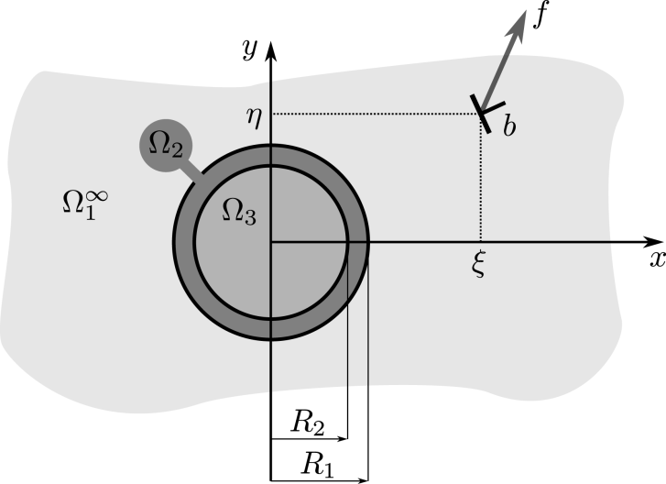
6th International Conference on Crack Paths (CP 2018), Verona, Italy, 19-21 September 2018
FUNDAMENTAL SOLUTION
Matrix $Ω_{1}^{∞}$
$$φ_{1}\left(z;ζ\right)=φ^{s}\left(z;ζ\right)+\sum_{n=0}^{∞}{h_{−n} \left(k,γ;ζ\right)z^{−n}}$$
$$ψ_{1}\left(z;ζ\right)=ψ^{s}\left(z;ζ\right)+\sum_{n=0}^{∞}{p_{−n}\left(k,γ;ζ\right)z^{−n}}$$
Interfacial zone $Ω_{2}$
$$φ_{2}\left(z;ζ\right)=\sum_{n=0}^{∞}{\left[q_{−n}\left(k,γ;ζ\right)z^{−n}+q_{n}\left(k,γ;ζ\right)z^{n}\right] }$$
$$ψ_{2}\left(z;ζ\right)=\sum_{n=0}^{∞}{\left[r_{−n}\left(k,γ;ζ\right)z^{−n}+r_{n}\left(k,γ;ζ\right)z^{n}\right]}$$
Inclusion $Ω_{3}$
$$φ_{3}\left(z;ζ\right)=\sum_{n=0}^{∞}{s_{n}\left(k,γ;ζ\right)z^{n}}$$
$$ψ_{3}\left(z;ζ\right)=\sum_{n=0}^{∞}{t_{n}\left(k,γ;ζ\right)z^{n}}$$
Dislocation (point force) in matrix $Ω_{∞}$
$$φ^{s}\left(z;ζ\right)=−γln\left(z−ζ\right)$$
$$ψ^{s}\left(z;ζ\right)=−k\overline{γ}ln\left(z−ζ\right)+γ\frac{\overline{ζ}}{z−ζ}$$
$$k=κ_{1}, γ=f/2π\left(κ_{1}+1\right)$$
$$k=1, γ=iμ_{1}b/\left(κ_{1}+1\right)$$
Notes:
The basis for the expression of the fundamental solution is the complex analysis in the plane elasticity represented by so-called Muskhelishvili's complex potentials. Since the fundamental solution is too complicated (it must describe the mutual interaction of the particle, the thin layer and the point force or dislocation singularity) it can not be found in a closed form. The power series, specically the Laurent series, has to be used to describe it. The coeficients hn, pn, qn, rn and sn, tn are determined from the conditions of the continuity of displacements and the resultants of the tractions along the interfaces among the matrix 11, interfacial zone 2 and inclusion 3.

Slide 9
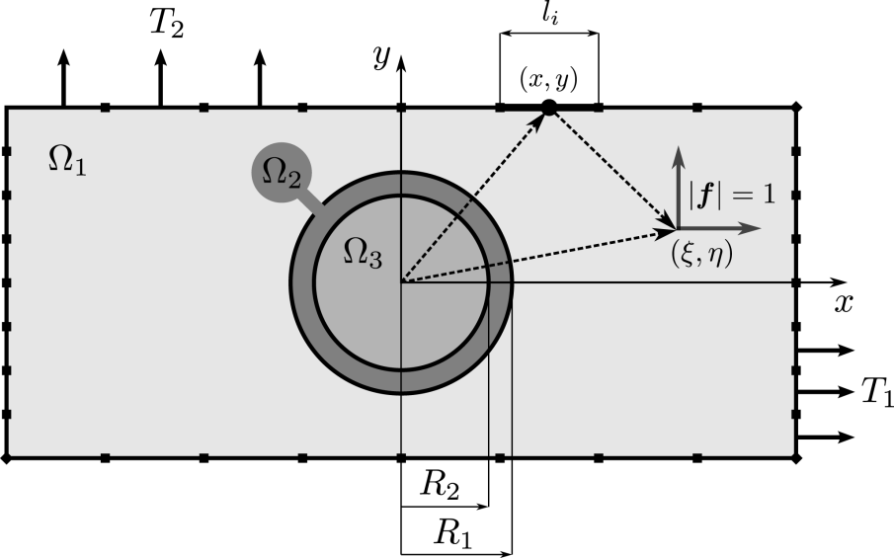
6th International Conference on Crack Paths (CP 2018), Verona, Italy, 19-21 September 2018
FUNDAMENTAL SOLUTION
Outer solution – boundary integral method
Boundary conditions
$$t\left(x\right)=T^{\left(0\right)}\left(x\right)⋅n=t^{P}, x∈∂Ω_{1}$$
$$t^{P}=\left\{\begin{aligned}\left(T_{1},0\right) for n=(±1,0) \\ \left(0,T_{2}\right) for n=(0,±1)\end{aligned}\right.$$
Somigliana’s identity
$$u\left(ξ,η\right)=\int_{∂Ω_{1}}{U^{∗}\left(ξ,η;x\right)t\left(x\right)d∂Ω_{1}\left(x\right)}−\int_{∂Ω_{1}}{T^{∗}\left(ξ,η;x\right)u\left(x\right)d∂Ω_{1}\left(x\right)}, \left(ξ,η\right)∈Ω_{1}$$
$$U^{∗}\left(ξ,η;x\right)=U^{s}\left(ξ,η;x\right)+\sum_{n=0}^{∞}{U^{n}\left(ξ,η;x\right)}$$
$$T^{∗}\left(ξ,η;x\right)=T^{s}\left(ξ,η;x\right)+\sum_{n=0}^{∞}{T^{n}\left(ξ,η;x\right)}$$
Fundamental solutions derived from $φ_{1}$ and $ψ_{1}$ setting up $f_{ξ}≡f=1$ or $f_{η}≡f=i$
Notes:
The outer stress $T^{\left(0\right)}(x)$ is evaluated along the crack position in the uncracked matrix $Ω_{1}$. Except the analytical approach, there are several ways of describing the outer solution. The most common and practical is the finite element method, but due to the simply shaped boundary $Ω_{1}$ and the knowledge of the fundamental solution, the boundary integral method was chosen to solve this problem. The procedure of the stress evaluation is widely commented in literature. From the point of view of the boundary integral method, the stress $T^{\left(0\right)}(x)$ is given by the expression corresponding to the stresses at internal points $\left(ξ,η\right)∈Ω_{1}$ resulting from Hooke's law and the displacement solution, well known as Somigliana's identity for displacements.

Slide 10
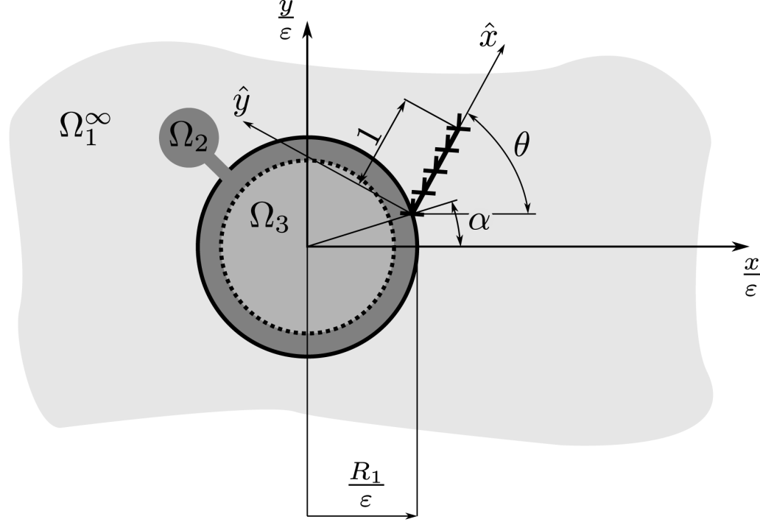
6th International Conference on Crack Paths (CP 2018), Verona, Italy, 19-21 September 2018
FUNDAMENTAL SOLUTION
Inner solution – continuously distributed dislocation technique
Outer solution
Non-singular kernels
Cauchy type singular kernels
$$T_{\hat{y}\hat{y}}^{(0)}\left(ε\hat{X}\right)=\frac{μ_{1}}{π\left(κ_{1}+1\right)}\int_{−1}^{1}{\left[B_{\hat{x}}\left(\hat{Θ}\right)H_{\hat{x}\hat{y}\hat{y}}\left(\hat{X},\hat{Θ};h_{−k},p_{−k}\right) +B_{\hat{y}}\left(\hat{Θ}\right)\left(\frac{2}{\hat{X}−\hat{Θ}}+H_{\hat{y}\hat{y}\hat{y}}\left(\hat{X},\hat{Θ};h_{−k},p_{−k}\right)\right)\right]dΘ}$$
$$T_{\hat{x}\hat{y}}^{(0)}\left(ε\hat{X}\right)=\frac{μ_{1}}{π\left(κ_{1}+1\right)}\int_{−1}^{1}{\left[B_{\hat{x}}\left(\hat{Θ}\right)\left(\frac{2}{\hat{X}−\hat{Θ}}+H_{\hat{x}\hat{x}\hat{y}}\left(\hat{X},\hat{Θ};h_{−k},p_{−k}\right)\right) +B_{\hat{y}}\left(\hat{Θ}\right)H_{\hat{y}\hat{x}\hat{y}}\left(\hat{X},\hat{Θ};h_{−k},p_{−k}\right)\right]dΘ}$$
Notes:
The inner problem is due to the scaled coordinates $X=x/ε$ and $Θ=θ/ε$ independent of the parameter $ε$. The crack is modelled using the continuously distributed dislocation technique. Applying this technique, the boundary conditions in the inner problem formulation lead to the solution of the following system of the singular integral equations, viz slajd. $H_{\hat{i}\hat{j}\hat{k}}$ are non-singular kernels, which are developed from complex potentials of the fundamental solution discussed above and transformed with respect to the local coordinate system $(\hat{x},\hat{y})$. The outer stresses $T_{\hat{i}\hat{j}}^{(0)}$ are the solution of the outer problem at the points of the crack in the case of the loaded but uncracked matrix and also linearly transformed with respect to the local coordinate system.

Slide 11
6th International Conference on Crack Paths (CP 2018), Verona, Italy, 19-21 September 2018
FUNDAMENTAL SOLUTION
Inner solution – continuously distributed dislocation technique
Jacobi polynomials
Unknown densities of Burger’s vectors
$$B_{\hat{x}}\left(\hat{Θ}\right)={\hat{Θ}}^{λ}{\left(1−\hat{Θ}\right)}^{−1/2}χ_{\hat{x}}\left(\hat{Θ}\right)$$
$$B_{\hat{y}}\left(\hat{Θ}\right)={\hat{Θ}}^{λ}{\left(1−\hat{Θ}\right)}^{−1/2}χ_{\hat{y}}\left(\hat{Θ}\right)$$
Local stress intensity factors at the crack tip in the matrix $Ω_{1}^{∞}$
$$K_{I}=2^{\frac{1}{2}+λ}\sqrt{π}\frac{μ_{1}}{κ_{1}+1}χ_{\hat{y}}\left(1\right) K_{II}=2^{\frac{1}{2}+λ}\sqrt{π}\frac{μ_{1}}{κ_{1}+1}χ_{\hat{x}}\left(1\right)$$
Notes:
The unknown Burger’s vector densities $B_{\hat{x}}$ and $B_{\hat{y}}$ are found in the form of product of the weight function and corresponding series of Jacobi polynomials. The value of the exponent $λ$ is different from the value -0.5 due to the mismatch of the materials of the matrix $Ω_{1}^{∞}$ and interfacial zone $Ω_{2}^{}$. The functions $χ_{\hat{x}}$ and $χ_{\hat{y}}$ are continuous in the interval (-1,1) and approximated by Jacobi polynomials. The stress intensity factors KI and KII at the crack tip lying in the matrix can be evaluated from the dislocation densities as follows, viz slajd.

Slide 12
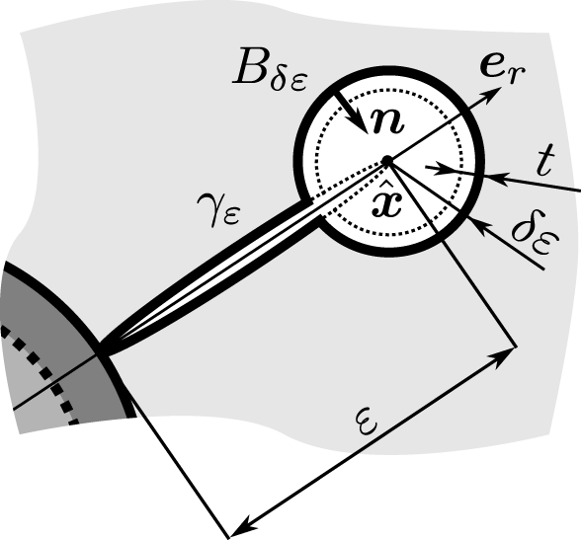
6th International Conference on Crack Paths (CP 2018), Verona, Italy, 19-21 September 2018
ENERGY RELEASE RATE EVALUATION
Topological derivative
Change of shape functional with respect $δε$
$$ψ\left(Ω_{ε+δε}\right)=ψ\left(Ω_{ε}\right)+f\left(δε\right)J\left(\hat{x}\right)+R\left(f\left(δε\right)\right)$$
potential energy $ψ\left(Ω_{ε}\right)=\frac{1}{2}\int_{Ω_{ε}}{∇^{s}u:TdV−\int_{∂Ω_{ε}}{t^{P}⋅udS}}$
Topological derivative
$$J\left(\hat{x}\right)=\lim_{δε→0}{\frac{1}{f^{′}\left(δε\right)}\frac{d}{dδε}ψ\left(Ω_{ε+δε}\left(\hat{x}\right)\right)}$$
Shape derivative of$ψ\left(Ω_{ε+δε}\right)$ with respect to $δε$
Notes:
The goal of the following is to establish the conditions, when a crack is initiated at the interface between the matrix $Ω_{1}$ and the interfacial zone $Ω_{2}$. For this purpose, the knowledge of the stress intensity factors at the tips of the just existing crack is insufficient and the change of the energy state of the unit crack advance is necessary. It is possible to express the potential energy explicitly depending on the crack length $ε$ in simple two-dimensional elastic fracture problems, such as the problem discussed in this paper. The energy release rate can then be evaluated in the direct form. However, the complexity of the geometry causes the impossibility to generalize this procedure. The shape optimization methods tender an interesting way to eliminate this problem. An important role in the following method is played by the so-called shape functional $ψ\left(Ω_{ε}\right)$, which represents the potential energy of the formulated fracture problem, viz slajd. The change of the shape functional $ψ\left(Ω_{ε+δε}\right)$ with respect to the small perturbation $δε$ of the crack $γ_{ε}$ at its tip $\hat{x}$ can be expressed by its asymptotic expansion, viz slajd. $J\left(\hat{x}\right)$ is the topological derivative of $ψ\left(Ω_{ε}\right)$. It is supposed that $f\left(δε\right)$ is the positive function such that $f\left(δε\right)=o\left(δε\right)$. $R\left(f\left(δε\right)\right)=o\left(f\left(δε\right)\right)$ is a remainder. Since the
topological derivative can be written as viz slajd, where $\frac{d}{dδε}ψ\left(Ω_{ε+δε}\left(\hat{x}\right)\right)$ is the shape derivative of $ψ\left(Ω_{ε+δε}\right).$

Slide 13
6th International Conference on Crack Paths (CP 2018), Verona, Italy, 19-21 September 2018
ENERGY RELEASE RATE EVALUATION
Topological-shape sensitivity method
Shape derivative with respect to $δε$
$$\frac{d}{dδε}ψ\left(Ω_{ε+δε}\left(\hat{x}\right)\right)=\lim_{t→0}{\frac{ψ\left(Ω_{ε+δε+t}\left(\hat{x}\right)\right)−ψ\left(Ω_{ε+δε}\left(\hat{x}\right)\right)}{t}}$$
$$\frac{d}{dδε}ψ\left(Ω_{ε+δε}\left(\hat{x}\right)\right)=−\int_{∂B_{δε}}{\left(Σ_{ε}⋅n\right)⋅e_{r}dS}$$
Eshelby’s energy momentum tensor
$$Σ_{ε}=\frac{1}{2}\left(∇^{s}u : T\right)I−∇^{s}u^{T}⋅T$$
Energy release rate
$$G_{ε}\left(\hat{x}\right)=J\left(Σ_{ε}\right)=−\lim_{δε→0}{\int_{∂B_{δε}}{\left(Σ_{ε}⋅n\right)⋅e_{r}dS}}=\frac{ε}{{\overline{E}}_{1}}\left[K_{I}^{2}\left(\hat{x}\right)+K_{II}^{2}\left(\hat{x}\right)\right]$$
J - integral
$${\overline{E}}_{1}=\left\{\begin{aligned}{E_{1}}/{\left(1−ν_{1}^{2}\right)}for plane strain \\ E_{1} for plane stress\end{aligned}\right.$$
Notes:
It can be shown that the shape derivative can be calculated in the sense to the domain variation produced by an uniform expansion of some perturbation, viz slajd. This method, the so-called topological-shape sensitivity method, uses the concept of shape sensitivity analysis as an intermediate step in the topological derivative calculation. Hence, if the domain perturbation has the stress-free circular shape $B_{δε}\left(\hat{x}\right)$ as it is shown in Figure, the shape derivative can be evaluated as viz slajd. The symbol $Σ_{ε}$ represents Eshelby's energy momentum tensor. In the case of the crack tip singularity appearing inside the $B_{δε}\left(\hat{x}\right)$, Eshelby shows
that the integral on the right-hand side of, viz slajd, is Rice's J-integral. Hence, from the stress distribution at the crack tip $\hat{x}$, one can get the expression of the energy release rate, viz slajd

Slide 14
6th International Conference on Crack Paths (CP 2018), Verona, Italy, 19-21 September 2018
CRACK INITIATION CRITERION
Finite fracture mechanics
Average tangential stress along the crack length – upper bound of admissible crack jump length
$${\overline{T}}_{\hat{y}\hat{y}}^{(0)}\left(α,θ\right)=\frac{1}{ε}\int_{R_{1}}^{R_{1}+ε}{T_{\hat{y}\hat{y}}^{(0)}\left(r,α,θ\right)dr}≥T_{C}$$
Critical value of $T_{\hat{y}\hat{y}}^{(0)}$
Griffith incremental criterion – lower bound of admissible crack jump length
$$\frac{1}{ε}G_{ε}\left(α,θ\right)=\frac{1}{\overline{E}}\left[K_{I}^{2}\left(α,θ\right)+K_{II}^{2}\left(α,θ\right)\right]≥G_{C}$$
Toughness of $Ω_{1}^{}$
Notes:
The establishing of the crack length $ε$ in the previous analysis must be taken into account. The crack length $ε$ can be assessed form the stress and energy requirements in the crack position $(α,θ)$. First, it is expected that the crack is initiated in $Ω_{1}$ when the average tangential stress ${\overline{T}}_{\hat{y}\hat{y}}^{(0)}\left(α,θ\right)$ along the crack length $ε$ in the supposed crack growing direction, the vector $e_{r}≡dir_{\hat{x}}$. Second, it is supposed that a failure of the matrix $Ω_{1}$ at the interface with $Ω_{2}$ occurs if there is sufficient energy available to allow a finite amount of crack growth, equal to any finite step, where this finite step is assumed to be a material constant. The position of the perturbed crack $γ_{ε}$ can be assessed from the maximum value of $G_{ε}\left(α,θ\right)$ with respect to the polar coordinate $θ$. The expression for $G_{ε}\left(α,θ\right)$ gives only positive or negative information about the possibility of a fracture
process from the thermodynamic point of view. But no crack might occur if there is not enough stress to break atomic bonds in the relevant region near the interface between $Ω_{1}$ and $Ω_{2}$. Thus it seems that both criteria are necessary conditions for fracture, but even their parallel fulfilment is sufficient. The Grifith incremental criterion can be received in the form, viz slajd. This gives the lower bound of an admissible crack jump length. On the other hand, the averaged tension acting along the distance $ε$ from the interface between the matrix $Ω_{1}$ and interfacial zone $Ω_{2}$ associated with the strength criterion, viz slajd, gives after resolving with respect to $ε$ the upper bound for the crack jump length. It is not possible to express $ε$ from these inequalities explicitly due to the complexity of the stress distribution at the crack tip $\hat{x}$ and along the
inclusion $Ω_{3}$ with the interfacial zone $Ω_{2}$.

Slide 15
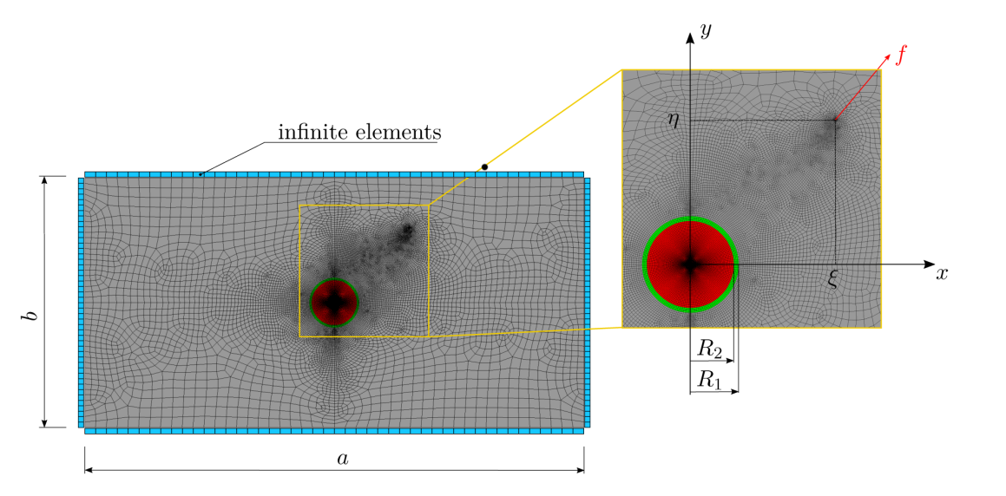
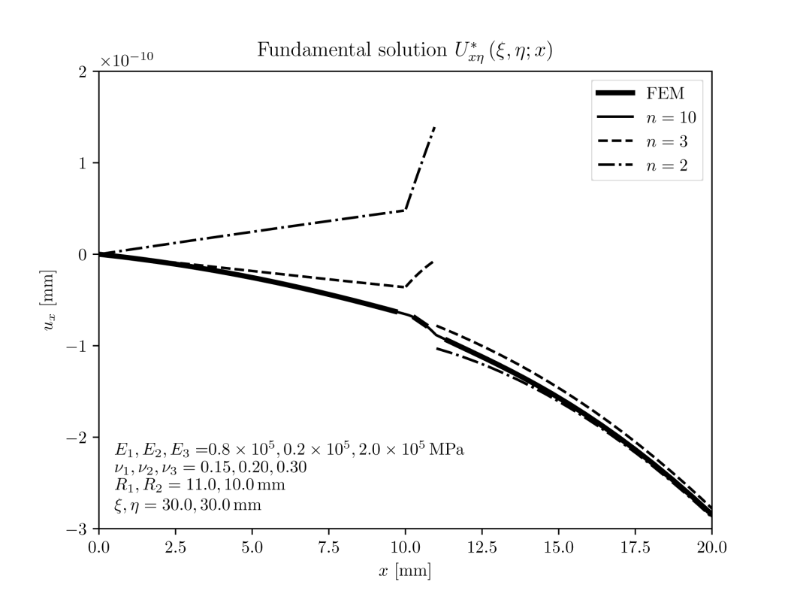
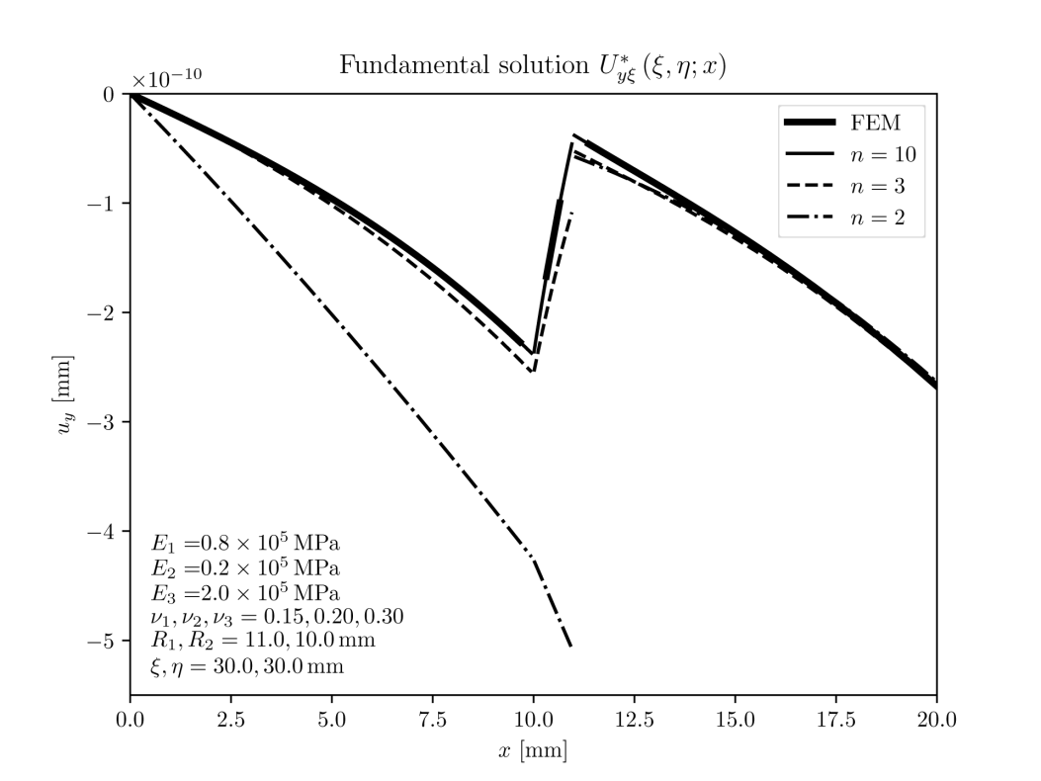
6th International Conference on Crack Paths (CP 2018), Verona, Italy, 19-21 September 2018
NUMERICAL RESULTS

Slide 16
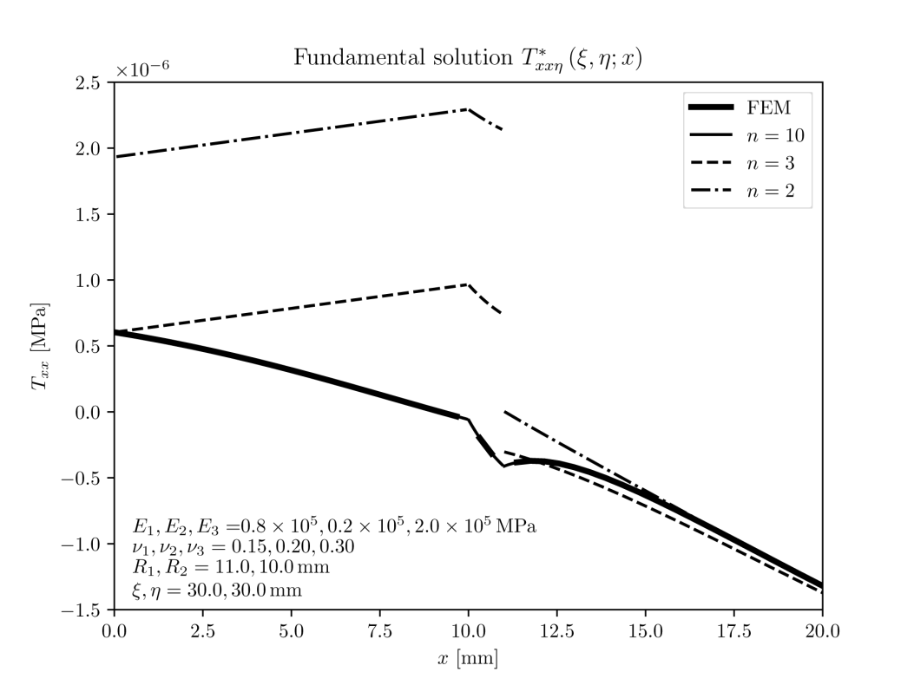
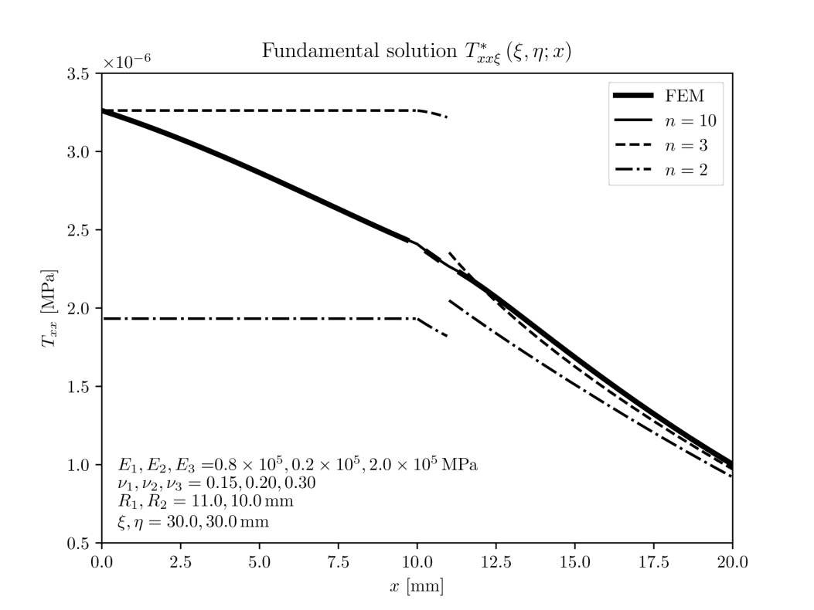
6th International Conference on Crack Paths (CP 2018), Verona, Italy, 19-21 September 2018
NUMERICAL RESULTS

Slide 17
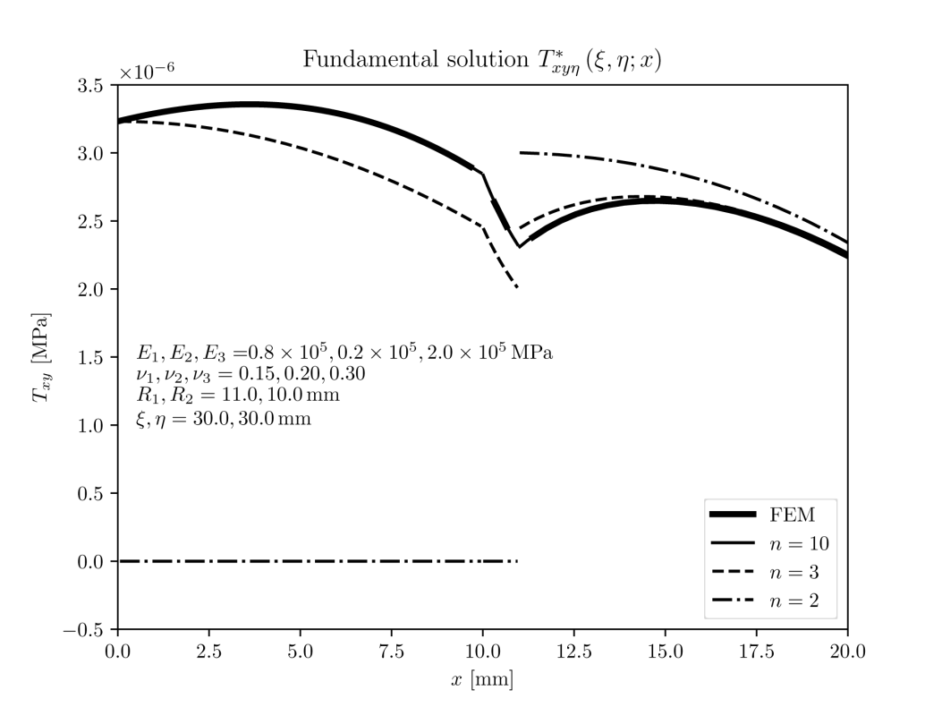
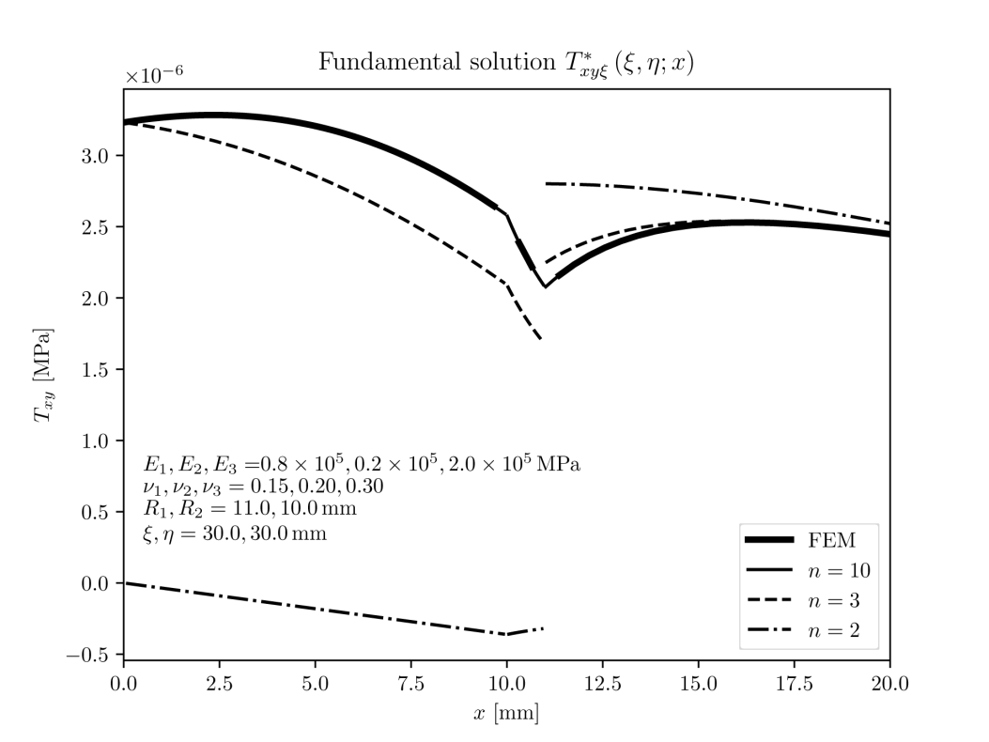
6th International Conference on Crack Paths (CP 2018), Verona, Italy, 19-21 September 2018
NUMERICAL RESULTS

Slide 18
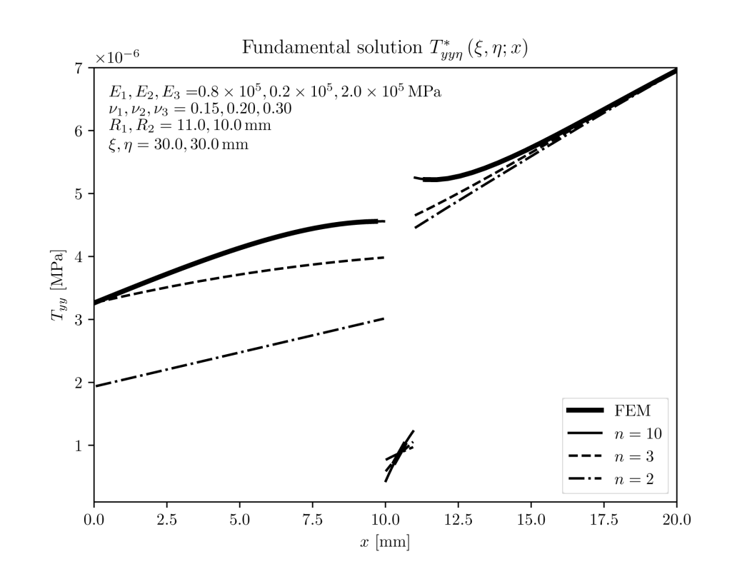
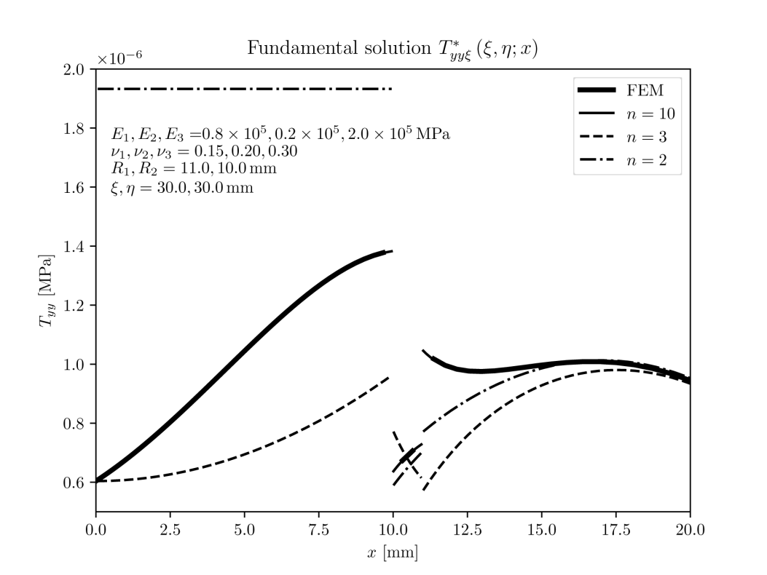
6th International Conference on Crack Paths (CP 2018), Verona, Italy, 19-21 September 2018
NUMERICAL RESULTS

Slide 19
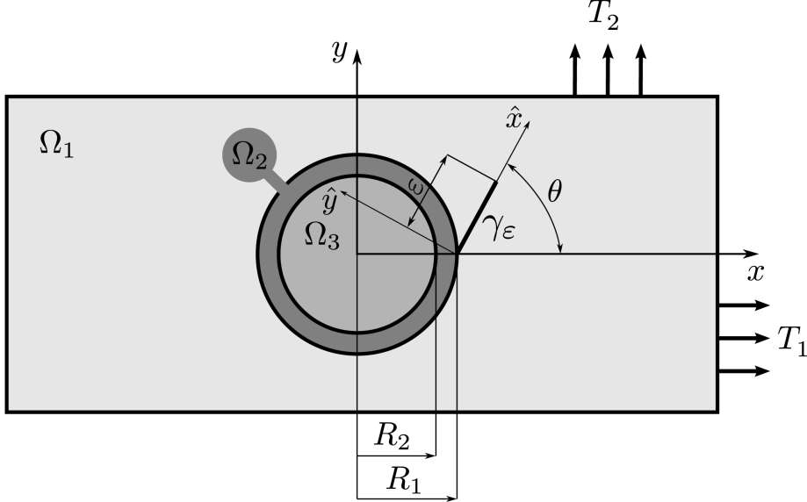
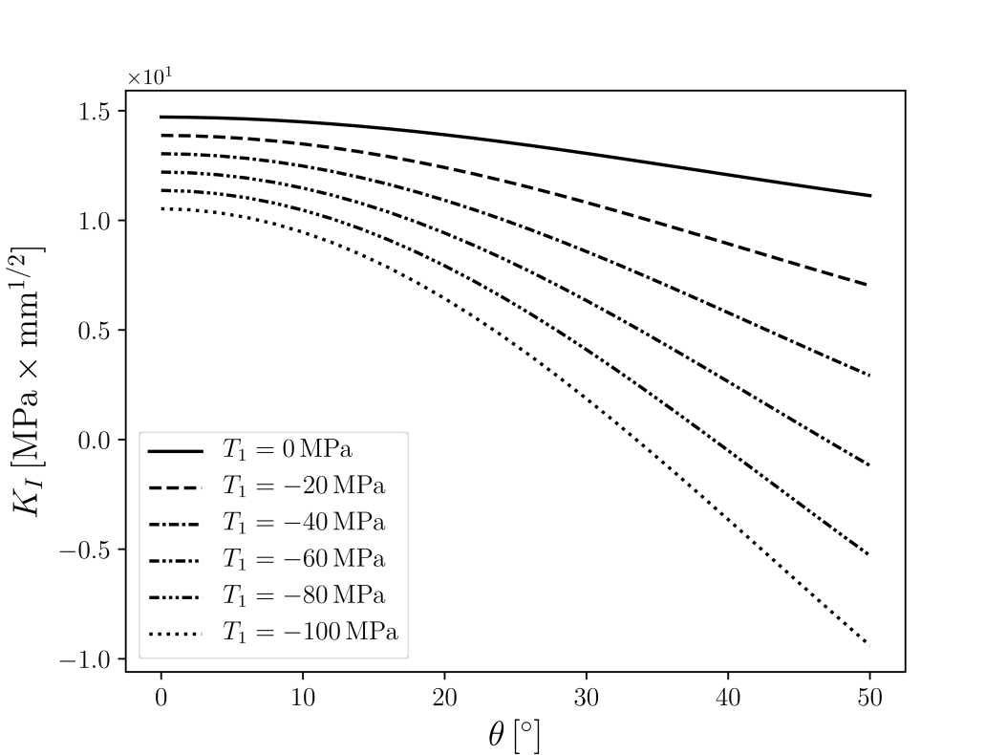
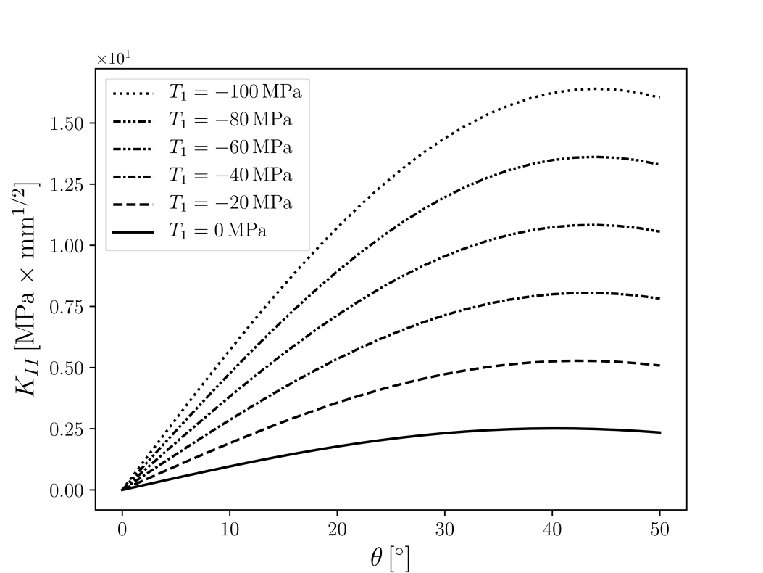
6th International Conference on Crack Paths (CP 2018), Verona, Italy, 19-21 September 2018
NUMERICAL RESULTS
$$n_{L},n_{b}=10,20$$
$$R_{1},R_{2}=5.0,4.9 mm$$
$$T_{2}=100 MPa$$
$$ε=0.1 mm$$
$$ν_{1},ν_{2},ν_{3}=0.20,0.20,0.25$$
$$E_{1},E_{2},E_{3}=0.20×{10}^{5},0.45×{10}^{5},0.60×{10}^{5} \text{MPa}$$

Slide 20
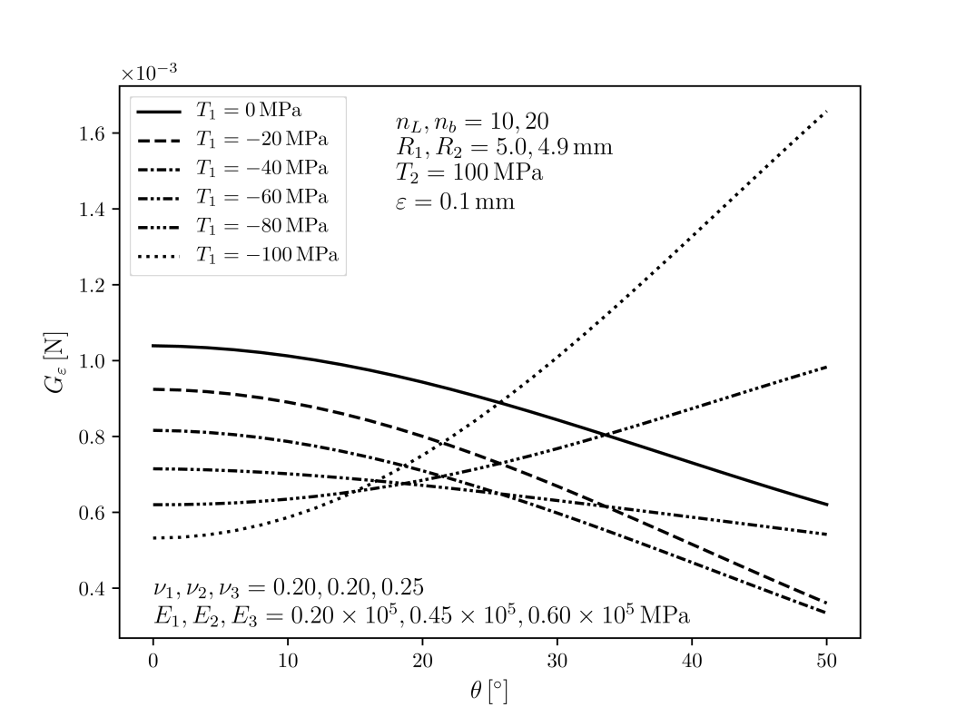
6th International Conference on Crack Paths (CP 2018), Verona, Italy, 19-21 September 2018
NUMERICAL RESULTS

Slide 21
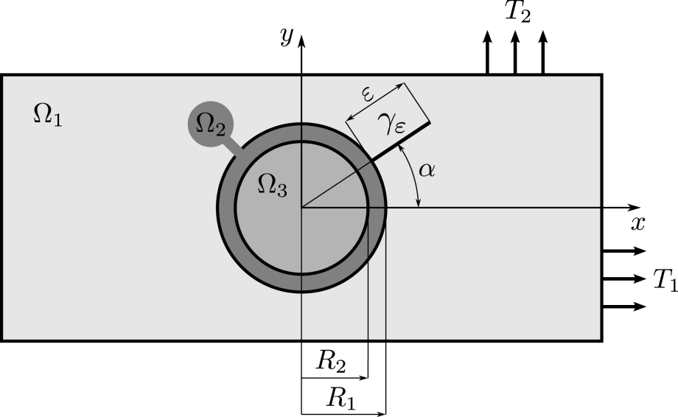
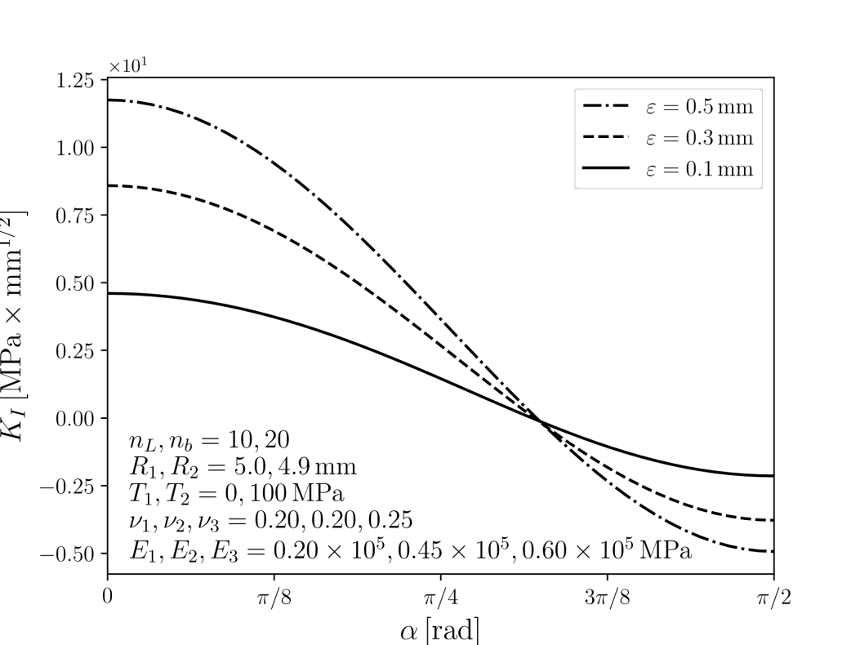
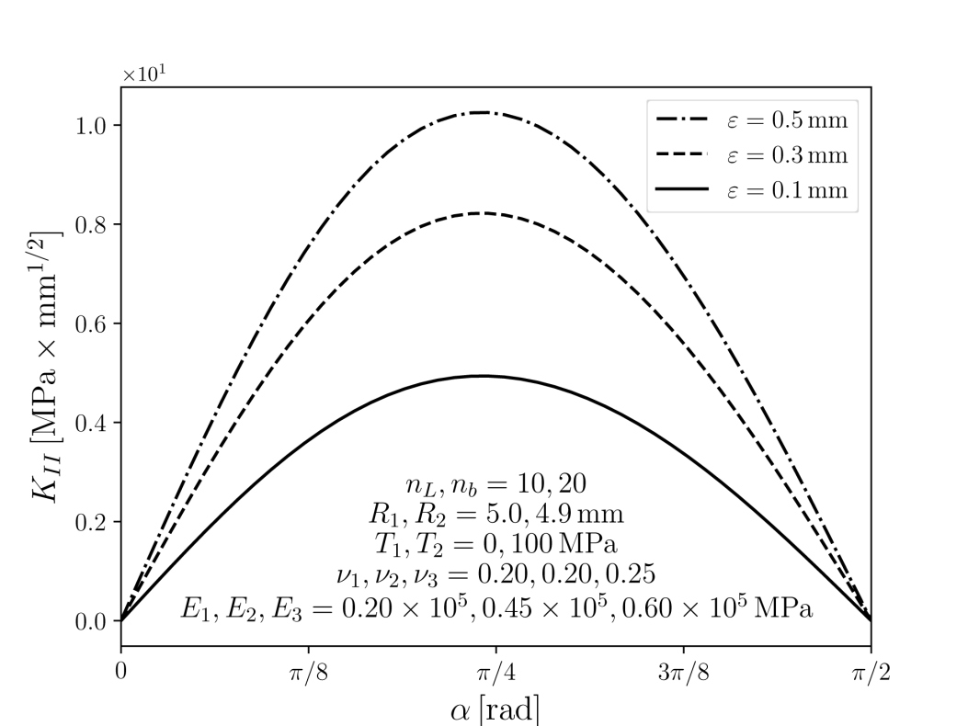
6th International Conference on Crack Paths (CP 2018), Verona, Italy, 19-21 September 2018
NUMERICAL RESULTS

Slide 22
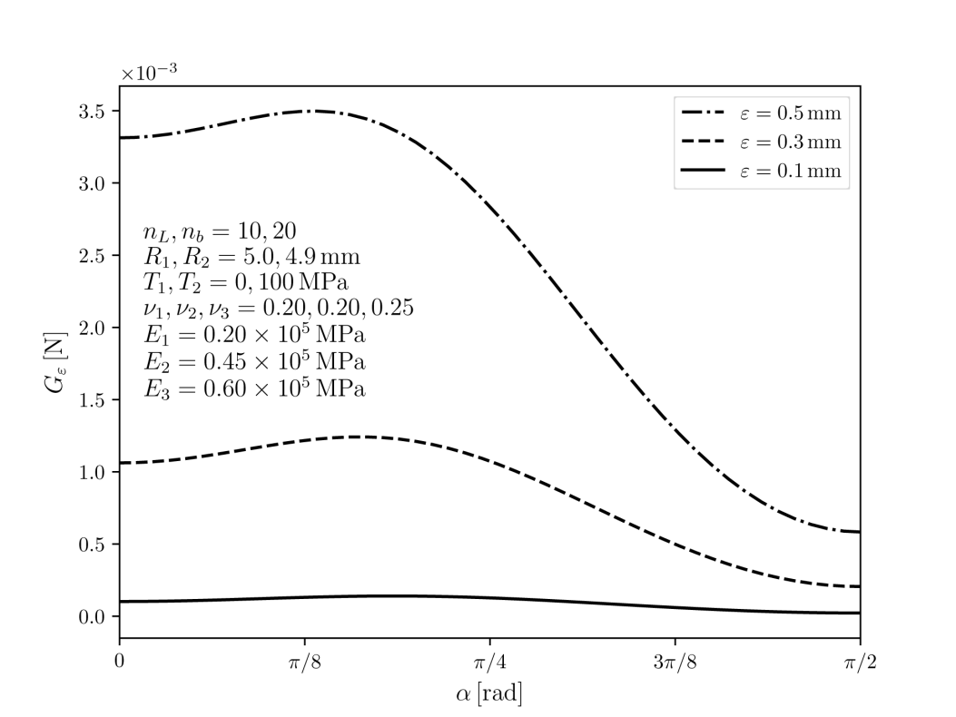
6th International Conference on Crack Paths (CP 2018), Verona, Italy, 19-21 September 2018
NUMERICAL RESULTS

Slide 23
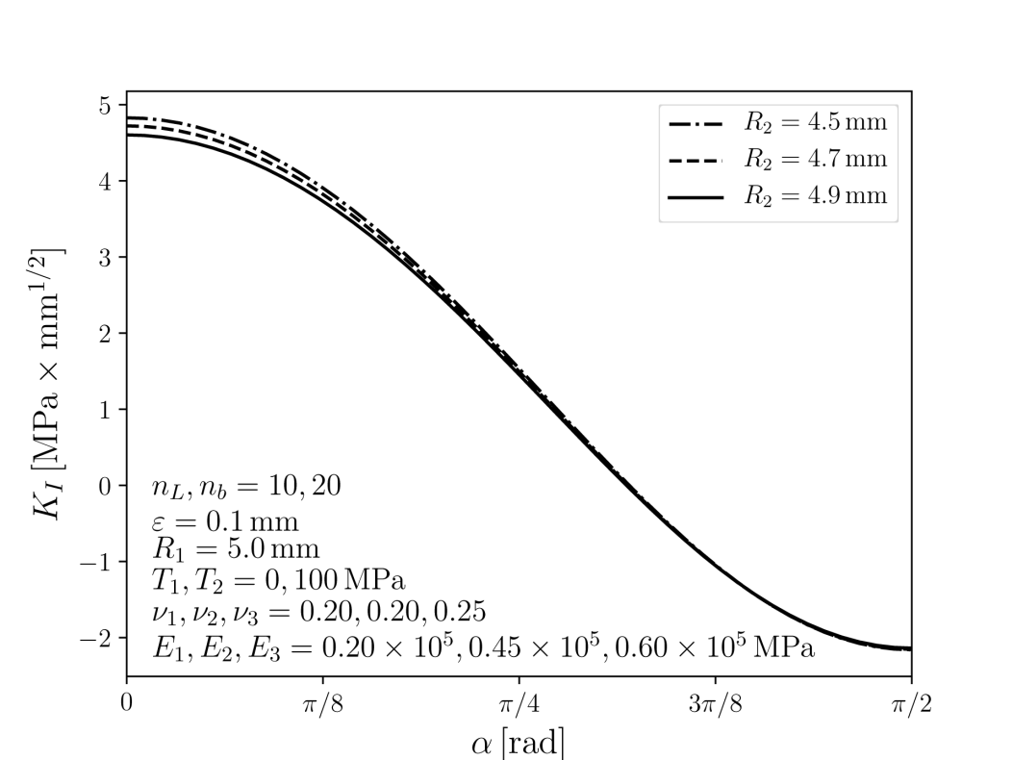
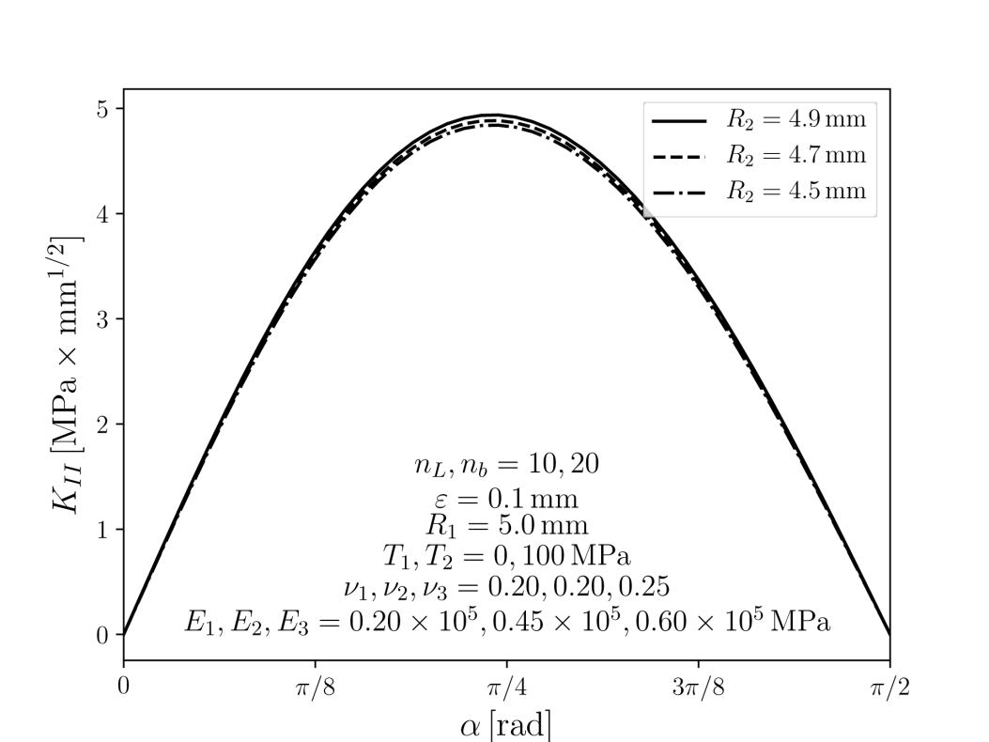
6th International Conference on Crack Paths (CP 2018), Verona, Italy, 19-21 September 2018
NUMERICAL RESULTS

Slide 24
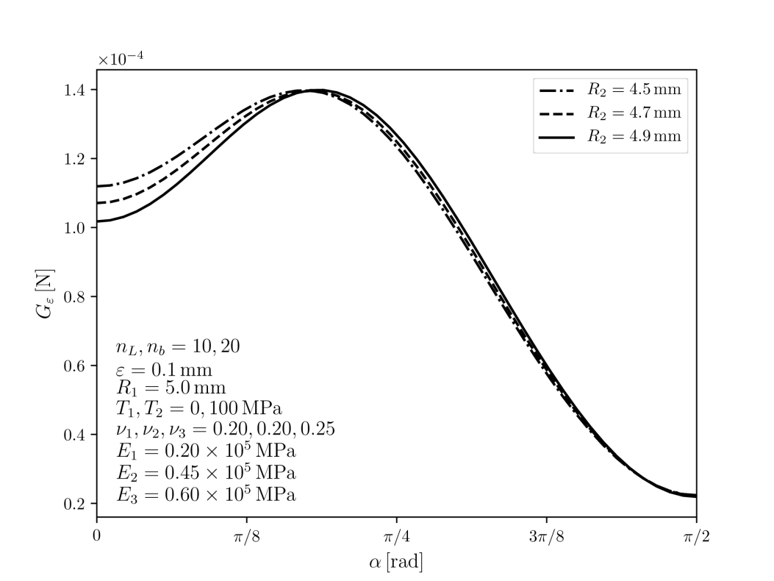
6th International Conference on Crack Paths (CP 2018), Verona, Italy, 19-21 September 2018
NUMERICAL RESULTS

Slide 25
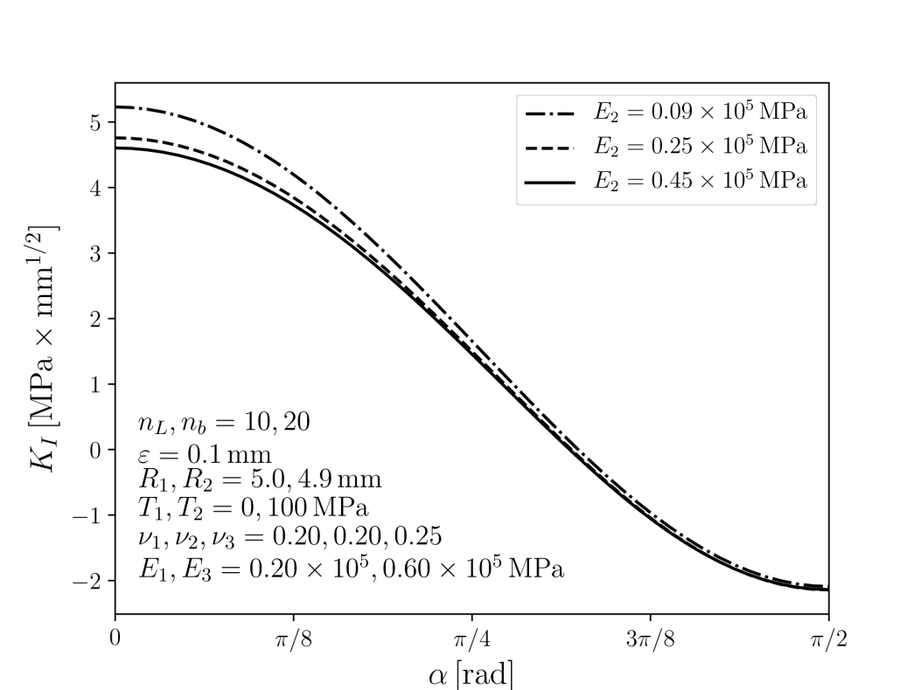
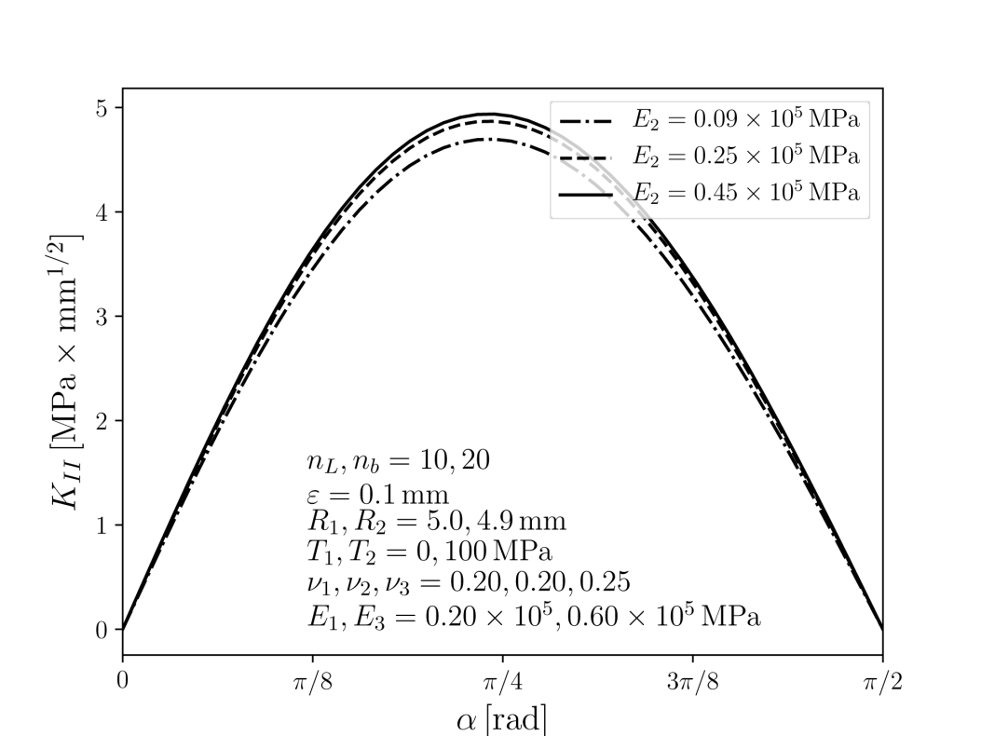
6th International Conference on Crack Paths (CP 2018), Verona, Italy, 19-21 September 2018
NUMERICAL RESULTS

Slide 26
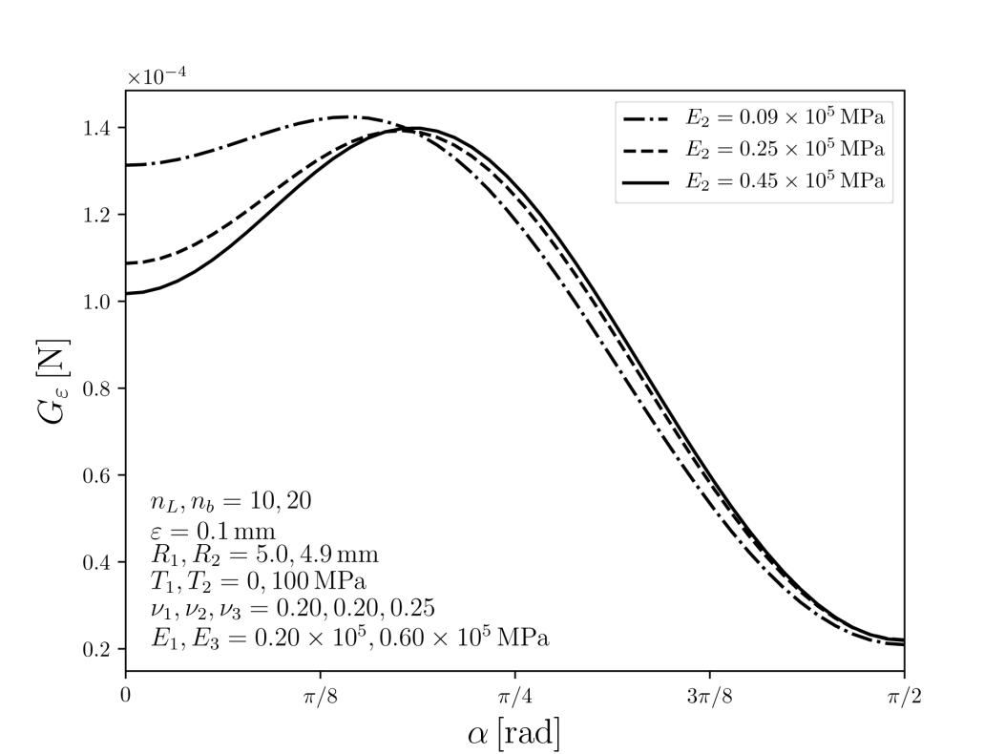
6th International Conference on Crack Paths (CP 2018), Verona, Italy, 19-21 September 2018
NUMERICAL RESULTS

Slide 27
6th International Conference on Crack Paths (CP 2018), Verona, Italy, 19-21 September 2018
Acknowledgements
This research has been financially supported by
the Czech Science Foundation through the Grant 16/18702S
and
by the Ministry of Education, Youth and Sports of the Czech Republic under
the project CEITEC 2020 [LQ1601].

