Slide 1
ASSESSMENT OF AMPLITUDE FACTORS OF ASYMPTOTIC EXPANSION AT CRACK TIP IN FLEXOELECTRIC SOLID UNDER MODE I LOADINGS
Profant T., Sládek J., Sládek V., Kotoul M.
Slovak Academy of Sciences, Slovak Republic
Brno University of Technology, Czech Republic

Slide 2
Motivation
Is there a way how to determine the asymptotic solution of the fracture problem in the flexoelectric solid from the characteristics of LEFM?
If yes, what method and assumptions should be used to achieve adequate results, and which are their limitations?
Outline
The flexoelectricity in solids
The outer and inner asymptotic solution in the flexoelectric solid
The singular matched asymptotic expansion method
Numerical results

Slide 3
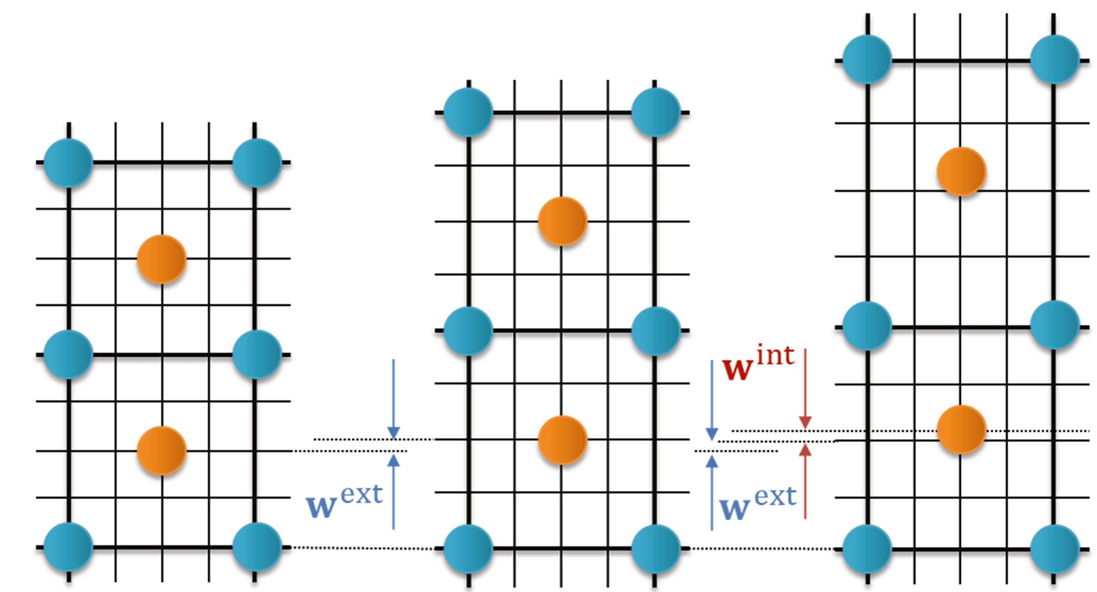
The flexoelectricity in solids
Wang et. al., Progress in Materials Science, 106, 2019
The flexoelectric effect is the consequence of the coupling of the strain gradients and the electric polarization in dielectric materials.
The flexoelectric effect is the size dependent material property.
The strain gradients usually occur near the crack tip and therefore it is relevant to suppose that the crack formation and propagation is affected by the flexoelectricity in the dielectric materials.

Slide 4
The flexoelectricity in solids
flexoelectric parameters
Governing equations
$$∇⋅\left(σ−∇⋅τ\right)=0$$
$$−ε_{0}∇^{2}φ+∇⋅P=0$$
$$E+∇φ=0$$
Constitutive equations
$$σ=λTr\left(ε\right)I+2με$$
$$P=a^{−1}\left[E−f_{1}∇Tr\left(ε\right)−2f_{2}∇⋅ε\right]$$
$$τ=l^{2}∇σ+f_{1}\left(Pe_{i}e_{i}+Pe_{j}e_{j}\right)$$
$$+f_{2}\left(e_{i}e_{i}P+e_{j}e_{j}P\right)$$
$$+f_{2}\left(e_{i}Pe_{i}+e_{j}Pe_{j}\right)$$
Boundary conditions
$$u=\overline{u},$$
$$ν=n⋅\left(∇u\right)=\overline{ν}$$
$$t=n⋅\left(σ−∇⋅τ\right)−\tilde{∇}⋅\left(n⋅τ\right)+\left(\tilde{∇}⋅n\right)n⋅\left(n⋅τ\right)=\overline{t}$$
$$r=n⋅\left(n⋅τ\right)=\overline{r}$$
$$φ=\overline{φ}$$
$$ω=n⋅\left(ε_{0}E+P\right)=\overline{ω}$$
double stress
material length scale parameter

Slide 5
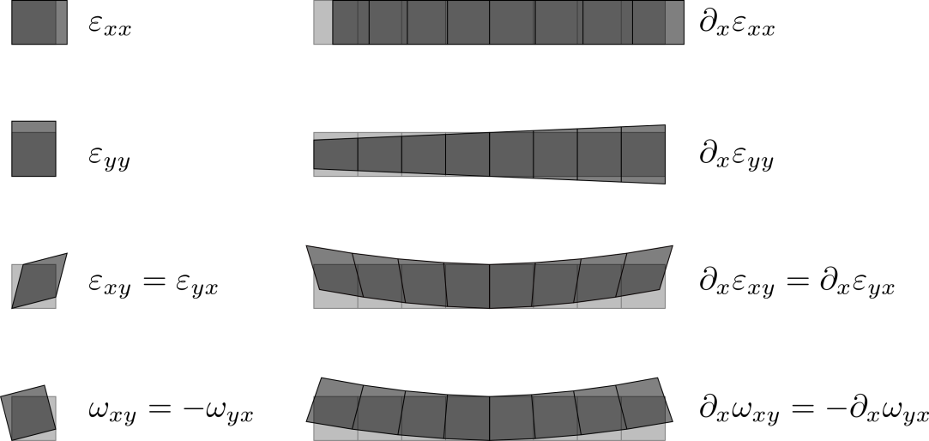
local
The flexoelectricity in solids
nonlocal
classical elasticity
$$σ_{ij}=∂_{ε_{ij}}U\left(ε_{ij}\right)$$
$$τ_{kij}=∂_{\left(∂_{k}ε_{ij}\right)}U\left(ε_{ij},∂_{k}ε_{ij},P_{i}\right)$$
flexo

Slide 6
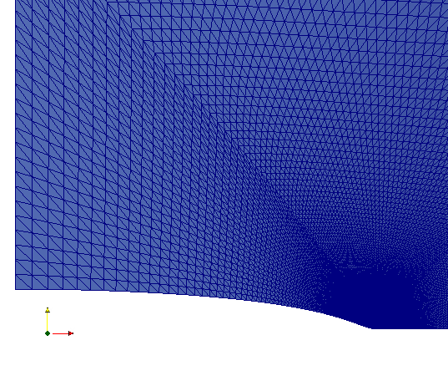
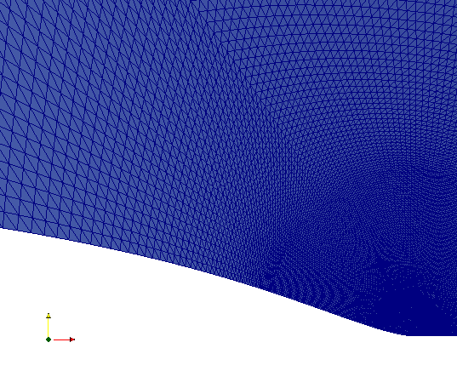
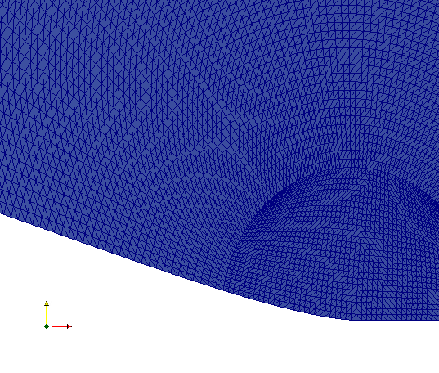
The outer and inner asymptotic solution in the flexoelectric solid
flexo FEM: Sládek & Sládek et. al., International Journal of Solids and Structures, 2021
SGET FEM: Kotoul et . al., Fatigue & Fracture of Engineering Materials & Structures, 2020
FEM study: $a_{c}=5.25 nm$, $l=0.25 nm$
$$a_{c}$$
$$l$$
$$l$$
$$a_{c}$$
outer solution
inner solution

Slide 7
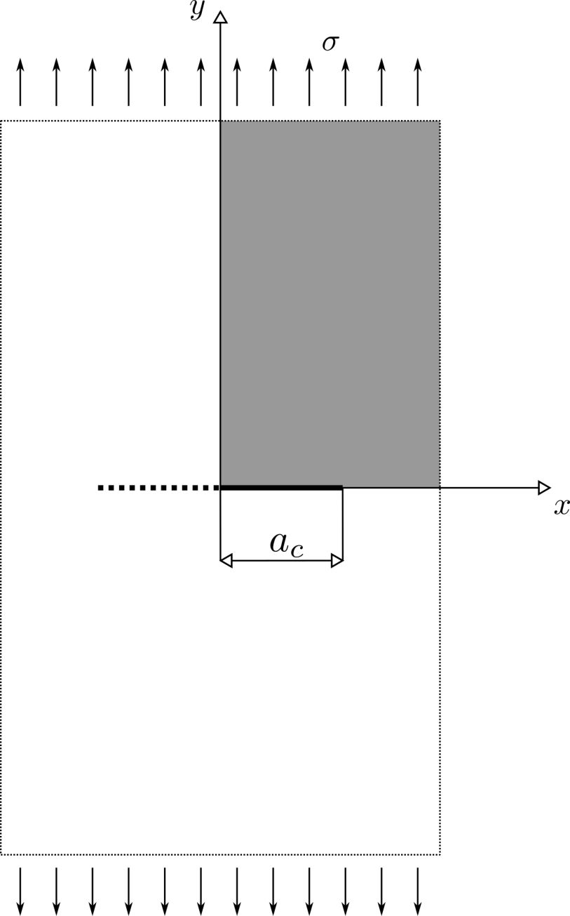
The outer and inner asymptotic solution in the flexoelectric solid
INPUT
$K_{I}$, $E$, $ν$, $l$, $a_{c}$, $ε$, $f_{1}$, $f_{2}$
outer asymptotic
solution
4th-order differential equations
symmetry
OUTPUT
$u_{i}^{in}$ , $σ_{ij}^{in}$, $φ^{in}$
$u_{i}^{out}$ , $σ_{ij}^{out}$, $φ^{out}$
crack
isolated and traction free crack faces
inner asymptotic solution
Analytical solution:
Mao & Purohit, Journal of the Mechanics and Physics of Solids, 2015

Slide 8
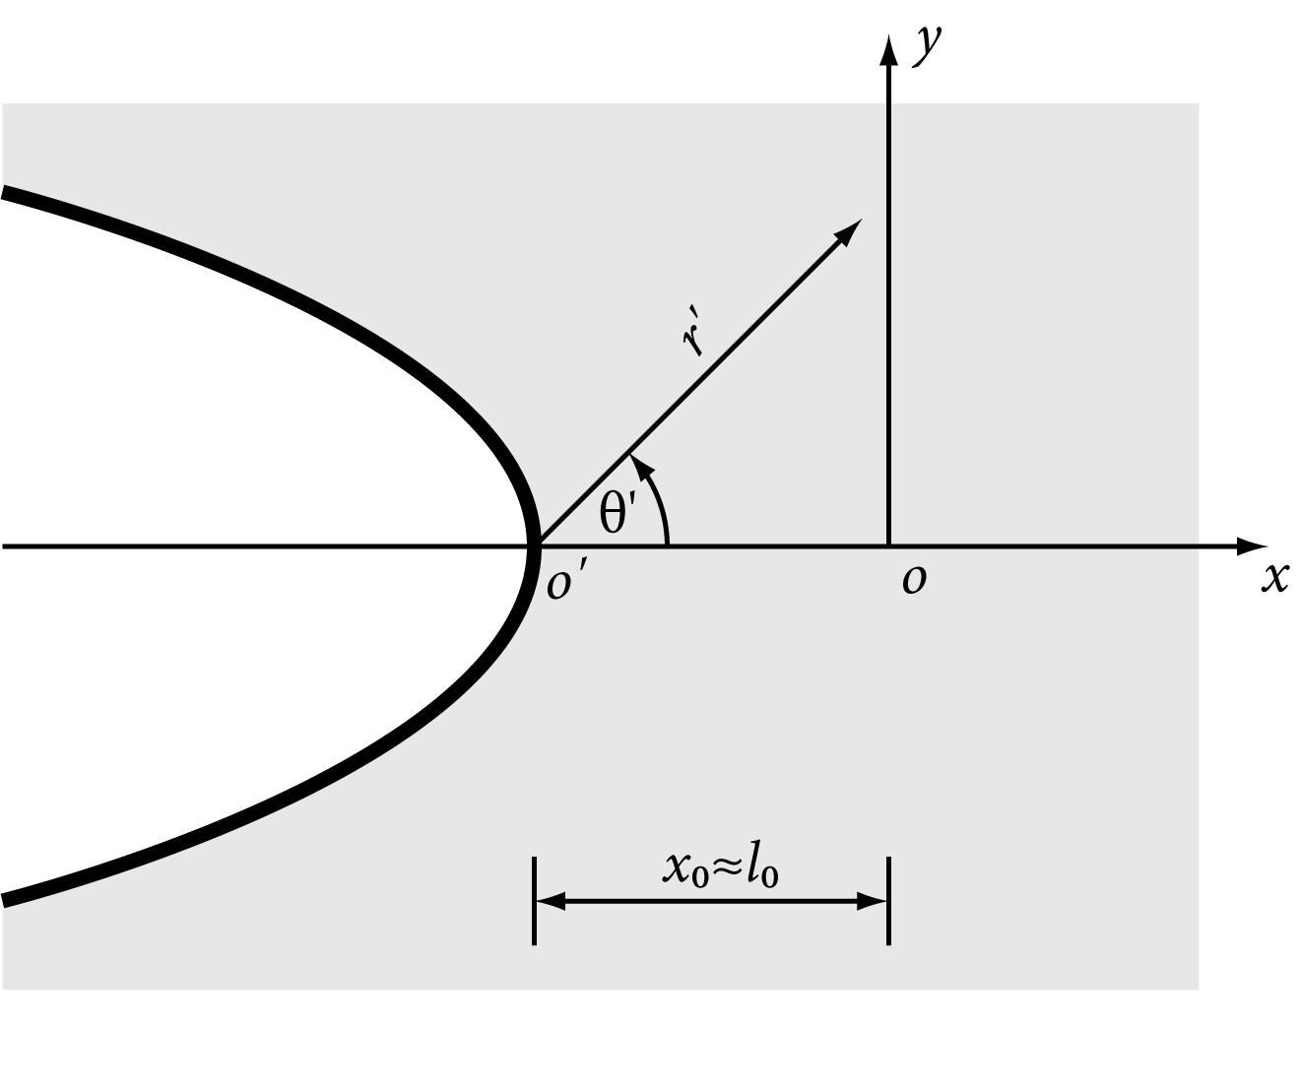
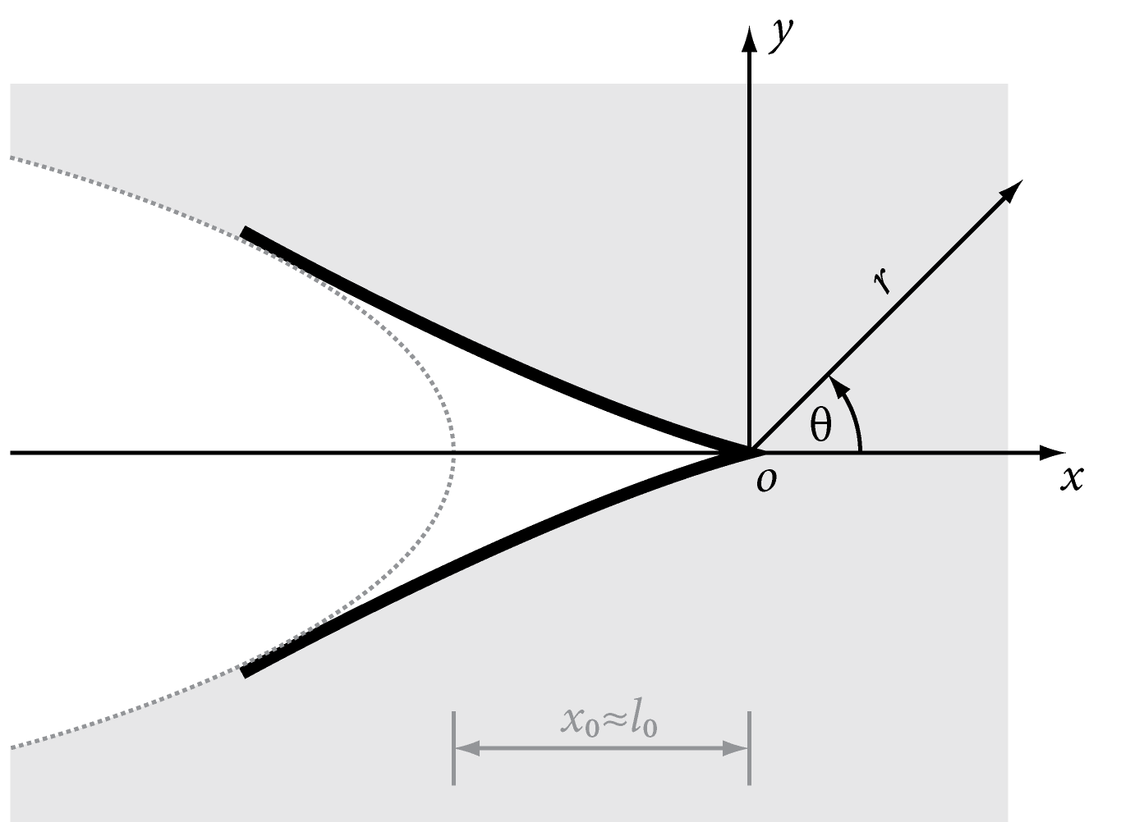
The outer and inner asymptotic solution in the flexoelectric solid
Outer solution:
$$∇⋅\left(σ−∇⋅τ\right)=0, −ε_{0}∇^{2}φ+∇⋅P=0, E+∇φ=0$$
$$l_{0}≈l≪a_{c}$$
$$u_{r^{′}}^{out,I}={\left(r^{′}\right)}^{\frac{1}{2}}\frac{K_{I}}{4μ}{\left(2π\right)}^{−\frac{1}{2}}\left[\left(5−8ν\right)\cos{\frac{1}{2}θ^{′}}−\cos{\frac{3}{2}θ^{′}}\right],$$
$$u_{θ^{′}}^{out,I}={\left(r^{′}\right)}^{\frac{1}{2}}\frac{K_{I}}{4μ}{\left(2π\right)}^{−\frac{1}{2}}\left[−\left(7−8ν\right)\sin{\frac{1}{2}θ^{′}}+\sin{\frac{3}{2}θ^{′}}\right],$$
$$φ^{out,I}=0.$$
$$t^{out}=ω^{out}=0$$
gauge $δ=l/{a_{c}}$
Inner solution:
$$∇⋅\left(σ−∇⋅τ\right)=0, −ε_{0}∇^{2}φ+∇⋅P=0, E+∇φ=0$$
$$l_{0}δ^{−1}<lδ^{−1}≈a_{c}, R=rδ^{−1}, δ≪1$$
$$u_{r}^{in,ID}=δR\left\{Γ_{1}+Γ_{2}\cos{2θ}\right\}+δ^{\frac{3}{2}}R^{\frac{3}{2}}\left\{A_{1}\cos{\frac{1}{2}θ}+A_{2}\cos{\frac{5}{2}θ}\right\},$$
$$u_{θ}^{in,ID}=−δRΓ_{2}\sin{2θ}+δ^{\frac{3}{2}} R^{\frac{3}{2}}\left\{A_{4}\sin{\frac{1}{2}θ}−A_{2}\sin{\frac{5}{2}θ}\right\},$$
$$φ^{in,ID}=C^{0}+δ^{\frac{1}{2}}R^{\frac{1}{2}}C_{1}\left(A_{1},A_{2},A_{4}\right)\cos{\frac{1}{2}θ}−δ^{−1}\frac{f}{aε}∇⋅u^{in,ID}.$$
$$t^{in}=ω^{in}=0$$

Slide 9
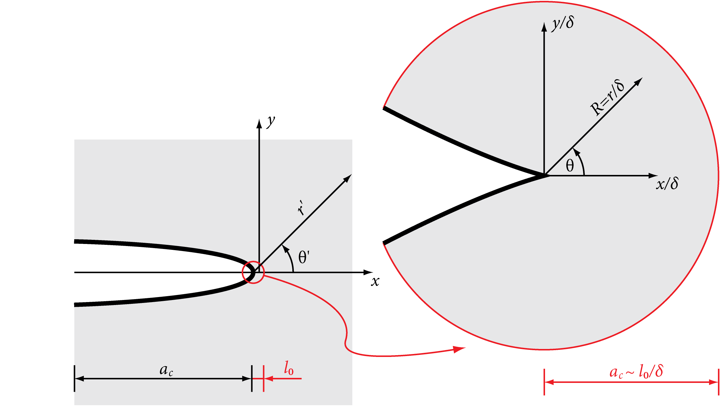
The singular matched asymptotic expansion method
${\left.σ_{r^{′}r^{′}}^{out}\right|}_{r^{′}=l_{0}}≈−{\left.σ_{rr}^{in}\right|}_{R={l_{0}}/δ}$ and ${\left.σ_{r^{′}θ^{′}}^{out}\right|}_{r^{′}=l_{0}}≈−{\left.σ_{rθ}^{in}\right|}_{R={l_{0}}/δ}$ for $θ^{′}≈θ.$
${\left.t^{out}\right|}_{r^{′}=l_{0}}≈{\left.t^{in}\right|}_{R={l_{0}}/δ}$ for $θ^{′}≈θ.$
in
out

Slide 10
The singular matched asymptotic expansion method
$$\frac{1}{4}K_{I}{\left(2πl_{0}\right)}^{−\frac{1}{2}}\left(5\cos{\frac{1}{2}θ^{′}}−\cos{\frac{3}{2}θ^{′}}\right)≈−l_{0}^{\frac{1}{2}}\left\{\left[A_{1}\left(\frac{5}{2}λ+3μ\right)+A_{4}\frac{1}{2}λ\right]\cos{\frac{1}{2}θ}+3A_{2}μ\cos{\frac{5}{2}θ}\right\}$$
$$\frac{1}{4}K_{I}{\left(2πl_{0}\right)}^{−\frac{1}{2}}\left(\sin{\frac{1}{2}θ^{′}}+\sin{\frac{3}{2}θ^{′}}\right)≈−l_{0}^{\frac{1}{2}}\left\{\frac{1}{2}μ\left(−A_{1}+A_{4}\right)\sin{\frac{1}{2}θ}−3A_{2}μ\sin{\frac{5}{2}θ}\right\}$$
$$\cos{\frac{5}{2}θ}≈\cos{\frac{3}{2}θ^{′}} and\sin{\frac{5}{2}θ}≈\sin{\frac{3}{2}θ^{′}}for θ,θ^{′}<1$$
$$A_{1}≈\frac{K_{I}}{12μl_{0}{\left(2π\right)}^{1/2}}\frac{λ−5μ}{λ+μ}=\frac{K_{I}}{6El_{0}{\left(2π\right)}^{1/2}}\left(12ν^{2}+7ν−5\right)$$
$$A_{2}≈\frac{K_{I}}{12μl_{0}{\left(2π\right)}^{1/2}}=\frac{K_{I}}{6El_{0}{\left(2π\right)}^{1/2}}\left(ν+1\right),$$
$$A_{4}≈−\frac{K_{I}}{12μl_{0}{\left(2π\right)}^{1/2}}\frac{5λ+11μ}{λ+μ}=\frac{K_{I}}{6El_{0}{\left(2π\right)}^{1/2}}\left(12ν^{2}+ν−11\right)$$

Slide 11
The singular matched asymptotic expansion method
$$l_{0}=???$$
$$J^{ID}=\frac{μπl}{16\left(1−ν\right)}\left[\frac{5−4ν−\left(7−6ν\right)α^{2}}{1−α^{2}}{\left(3C_{11}−2C_{12}\right)}^{2}+8C_{12}^{2}\right]$$
Mao & Purohit, Journal of the Mechanics and Physics of Solids, 2015
$$C_{11}=−\lim_{R→0}{{\left(\frac{l}{δR}\right)}^{\frac{3}{2}}u_{θ}^{in}\left(R,π\right)}, C_{12}=−\lim_{R→0}{{\left(\frac{l}{δR}\right)}^{\frac{3}{2}}Ω^{in}\left(R,π\right)}, α=\frac{f_{2}}{l\sqrt{aμ}}$$
$$J^{ID}=\frac{K_{I}^{2}}{E}\left(1−ν^{2}\right)$$
$$⟹$$
$$\frac{l_{0}^{ID}}{l}=\frac{1}{8}{\left[ \frac{9\left(8 ν^{3}−6ν^{2}−7ν+6\right)}{\left(1−ν^{2}\right)\left(1−ν\right)}+\frac{3α^{2}\left(2ν−1\right)+2ν^{2}−6ν+1}{\left(1−α^{2}\right)\left(1−ν^{2}\right)\left(1−ν\right)}\right]}^{1/2}$$

Slide 12
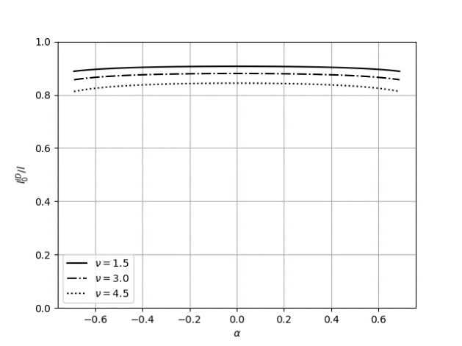
Numerical results
The influence of the flecoelectricity $α$ and Poisson ratio $ν$ on the parameter $l_{0}$
$δ=0.01$, $ε/{ε_{0}}=10$

Slide 13
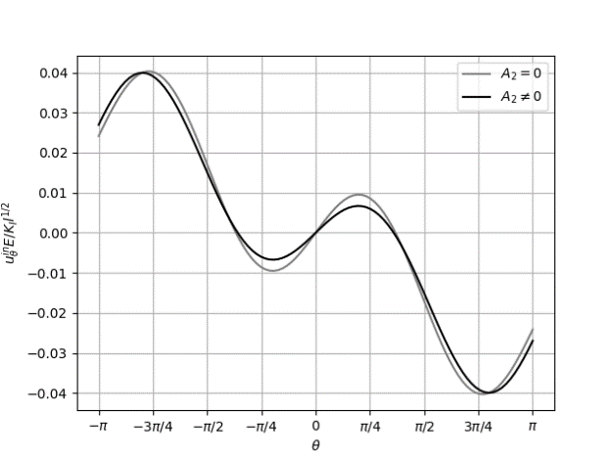
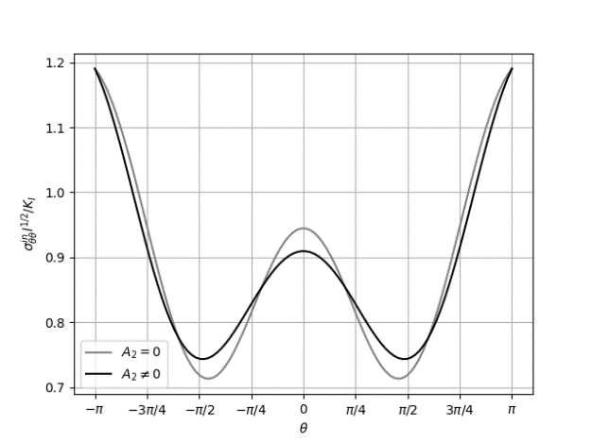
Numerical results
The influence of the component $A_{2}$ on the inner asymptotic solution
$R={0.1}/δ$, $δ=0.01$, $ν=0.2$, $ε/{ε_{0}}=10$, $α=$0.2

Slide 14
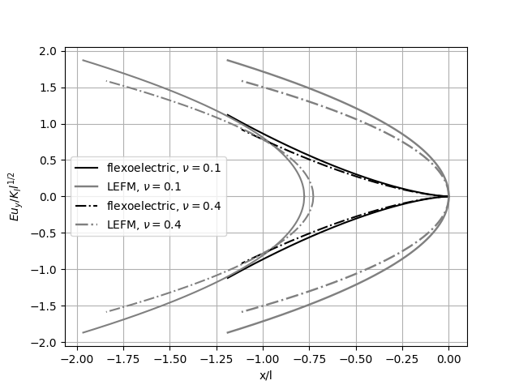
Numerical results
The crack opening displacement $u_{y}≡u_{θ}\left(r,±π\right)$
$δ=0.01$, $α=0.1$, $ε/{ε_{0}}=10$

Slide 15
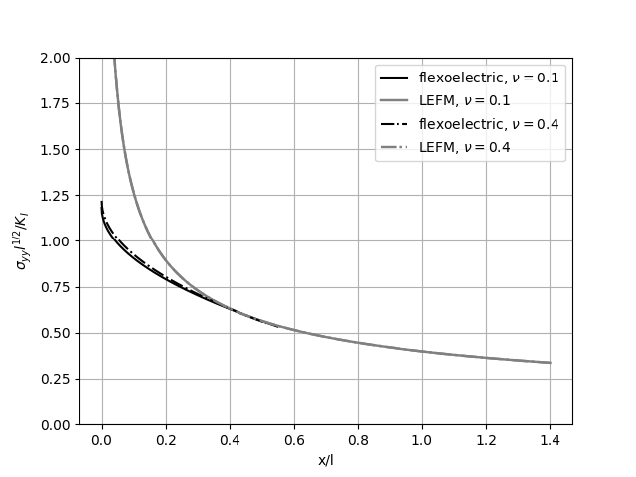
Numerical results
The Cauchy stress $σ_{yy}≡σ_{θθ}\left(r,0\right)$ in front of the crack tip
$δ=0.01$, $α=0.1$, $ε/{ε_{0}}=10$

Slide 16
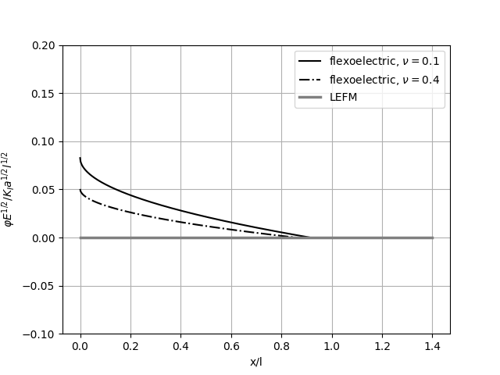
Numerical results
The electric potential $φ≡φ\left(r,0\right)$ in front of the crack tip
$δ=0.01$, $α=0.1$, $β=0$, $ε/{ε_{0}}=10$

Slide 17
Thank you for your attention
The authors acknowledge the supports by the Slovak Science and Technology Assistance Agency registered under number APVV-18-0004, VEGA-2/0061/20

