Slide 1
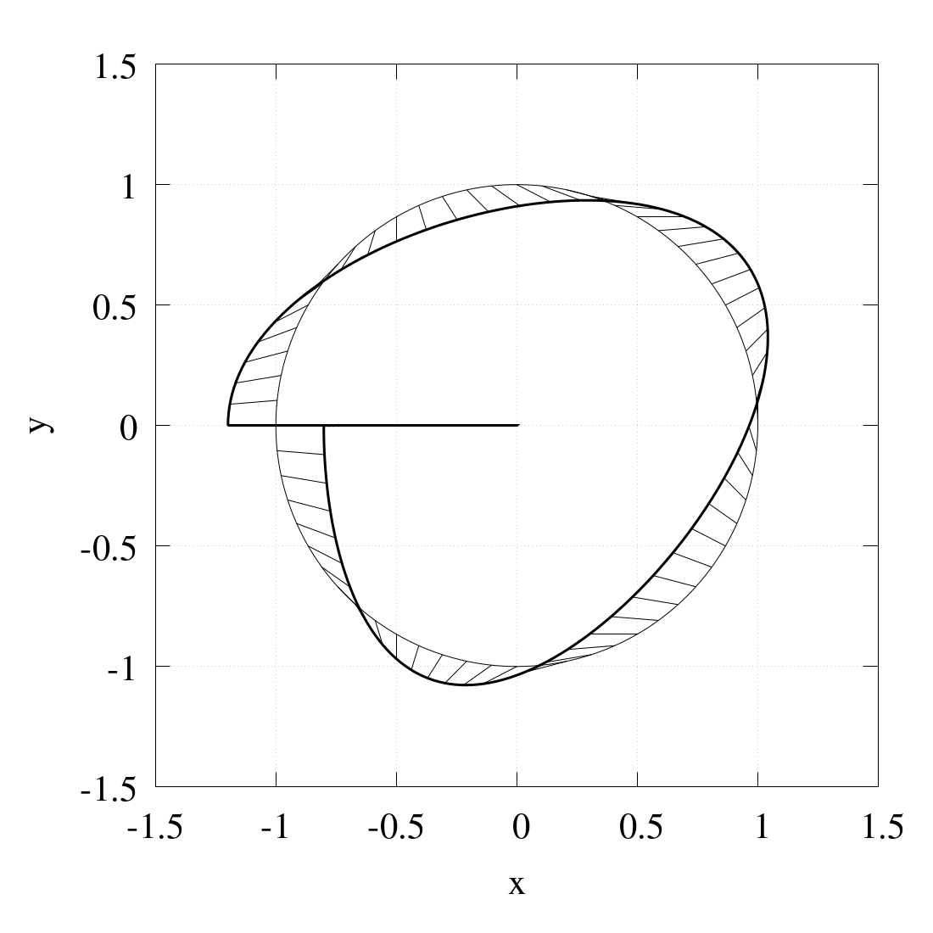
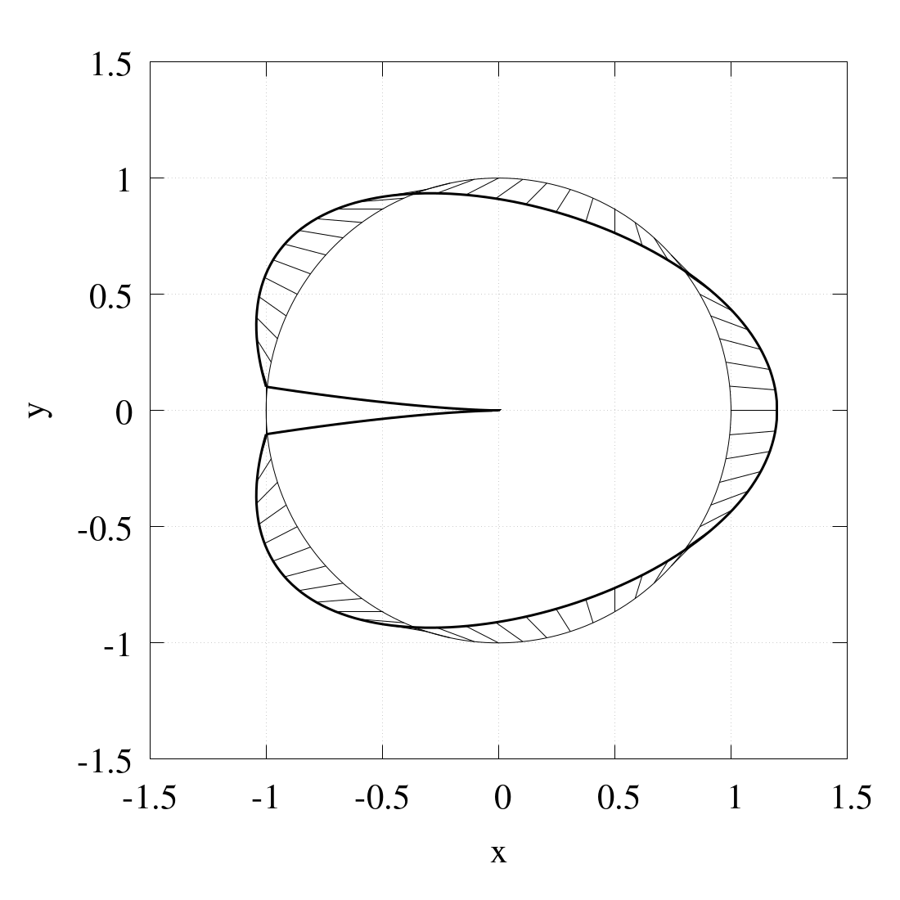
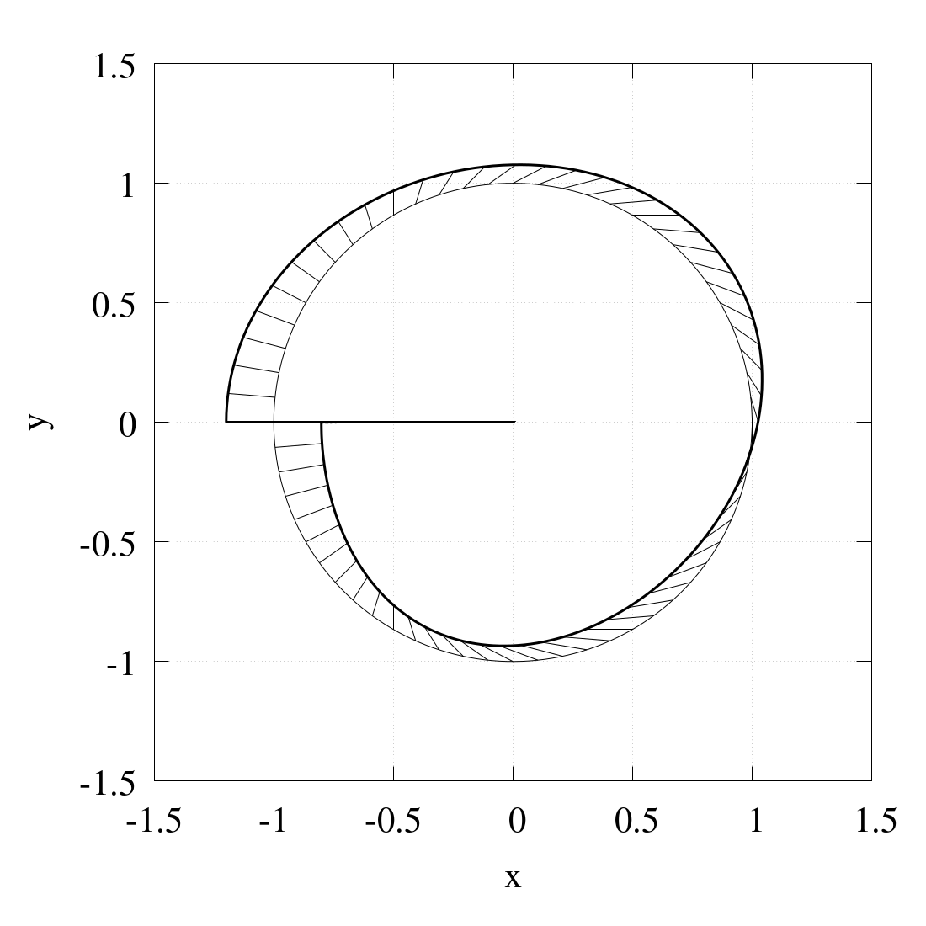
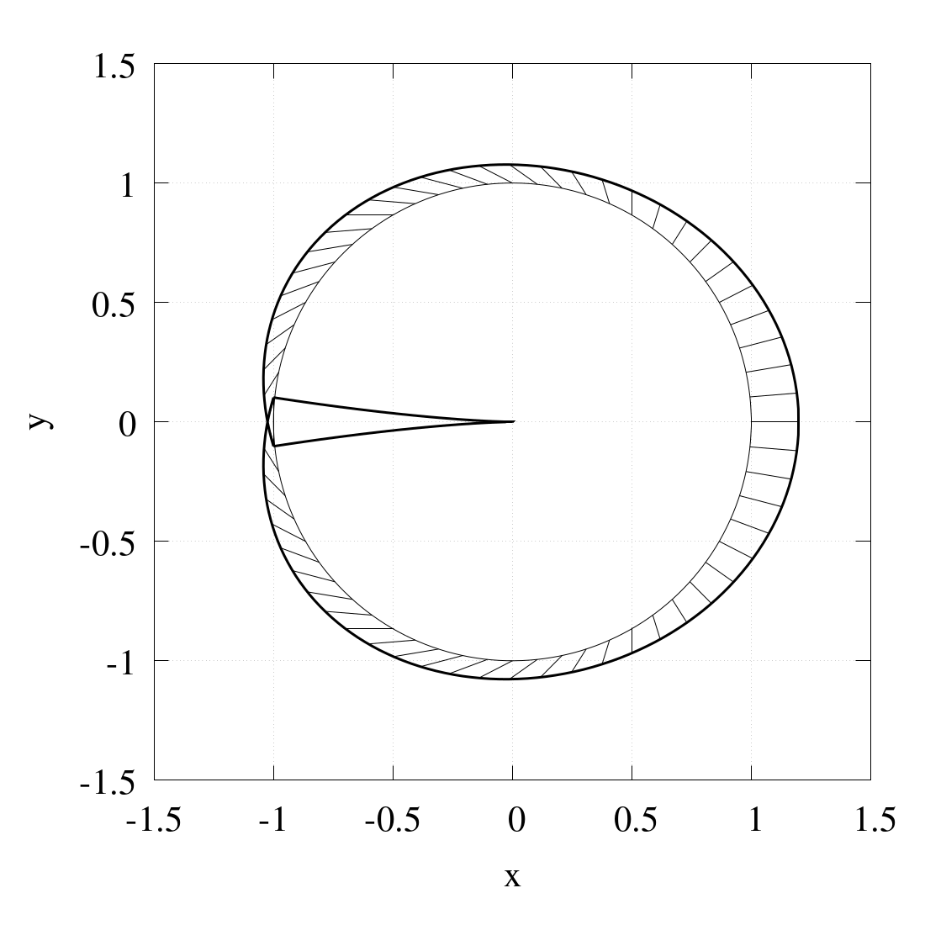
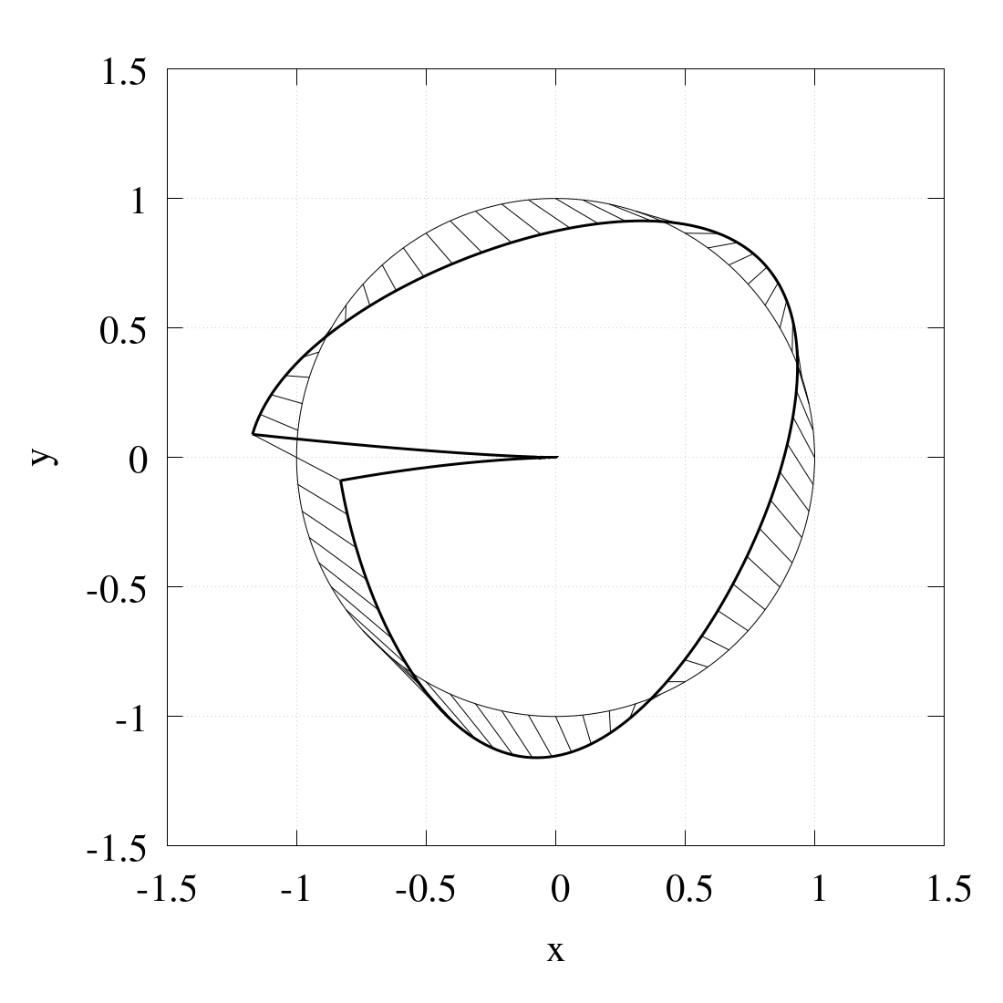
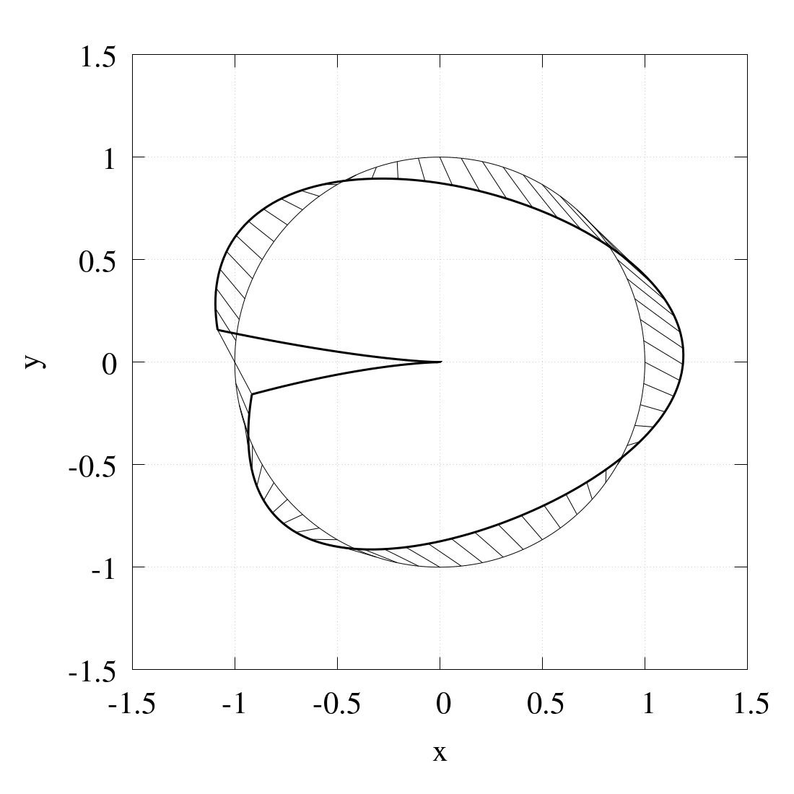
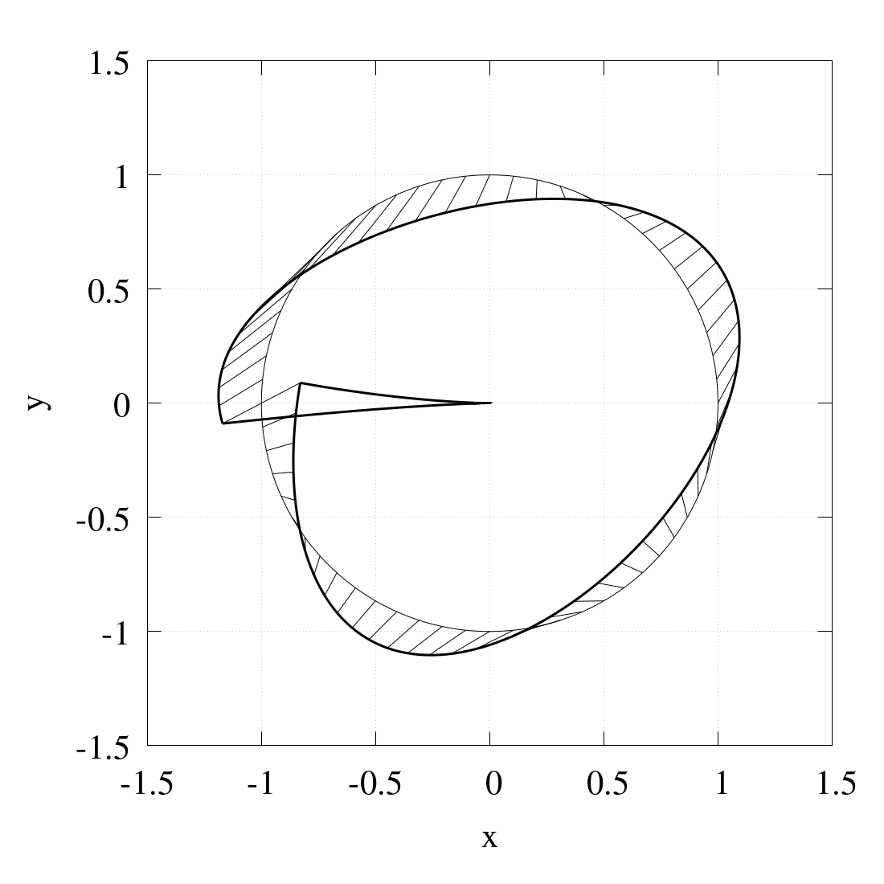
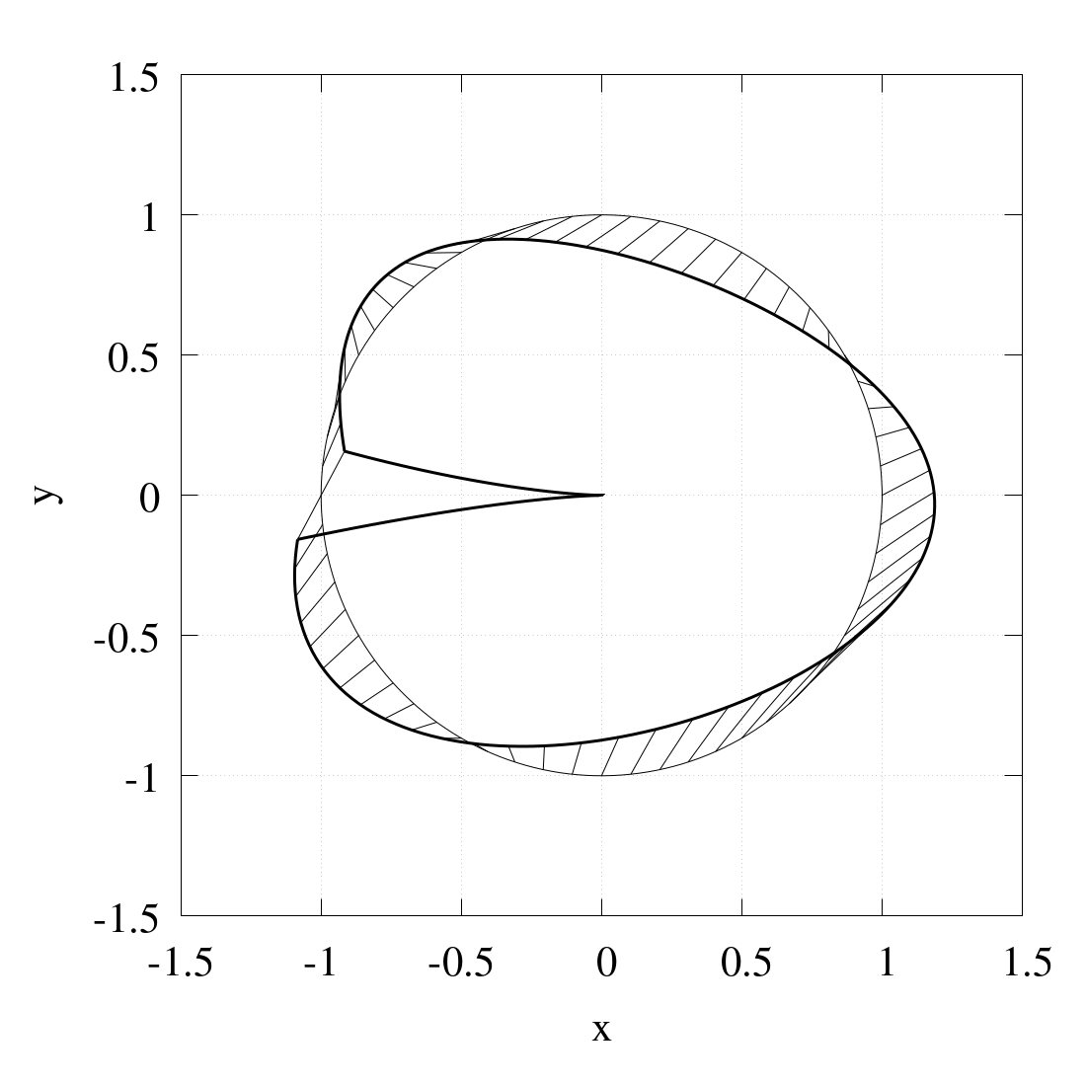
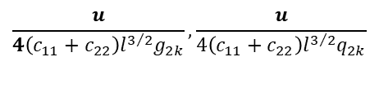
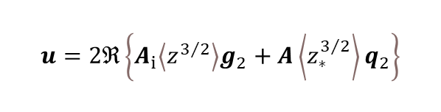
Molybden:
$c_{11},c_{12},c_{22},c_{44}=1.24×{10}^{5},4.10×{10}^{4},1.50×{10}^{5},6.80×{10}^{4} Mpa$, $l=\text{2.39}×{10}^{−10} m$
$$u=2ℜ\left\{A_{i}\left\langle z^{3/2}\right\rangle g_{2}+A\left\langle z_{∗}^{3/2}\right\rangle q_{2}\right\}$$
$$\frac{u}{4\left(c_{11}+c_{22}\right)l^{3/2}g_{2k}},\frac{u}{4\left(c_{11}+c_{22}\right)l^{3/2}q_{2k}}$$

