Slide 1
The ab-initio aided strain gradient elasticity theory a new concept in fracture nanomechanics
T. Profant and J. Pokluda
Brno University of Technology, Czech Republic

Slide 2
Motivation
The classical continuum fracture mechanics breaks down for nanoscale samples.
Can the strain-gradient elasticity theory (SGET) be extended to the nano scale?
If yes, SGET could address fracture problems in a computationally robust manner throughout macro–meso–micro–nano scales.
Outline
Breakdown of Continuum Mechanics at Nanoscale
Crack in SGET
Coupling of DFT and SGE approaches
Case study (tungsten):
Coupling of DFT and SGE approaches
Finite element approach for crack in SGET
Conclusion

Slide 3
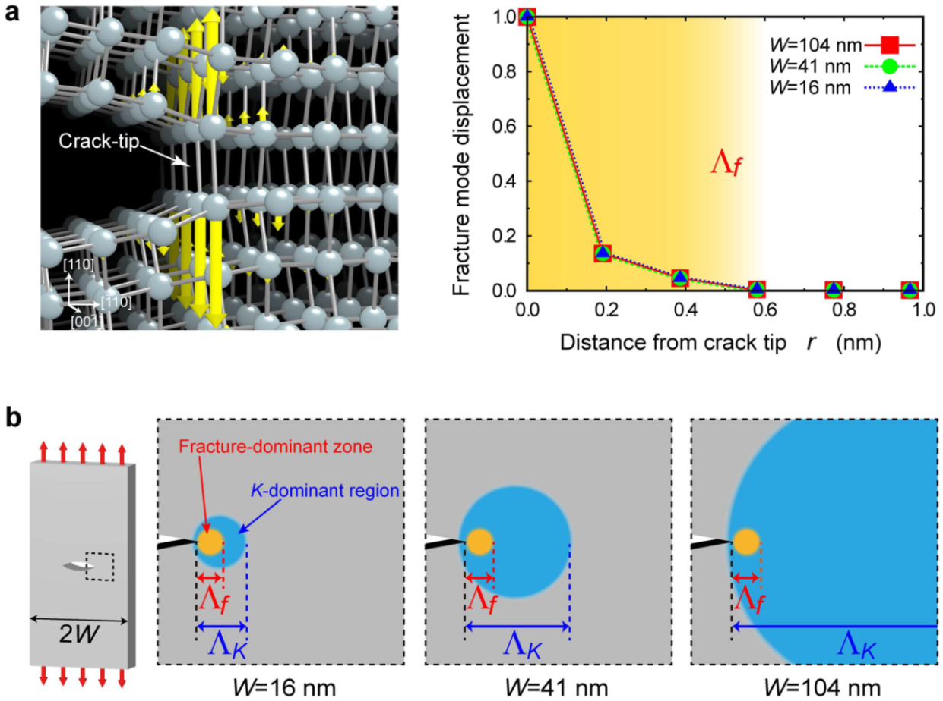
Breakdown of Continuum Mechanics at Nanoscale
The basic hypothesis of fracture mechanics: The $K$-dominant region at the crack tip must be geometrically much higher than the fracture process zone which incorporates inelastic deformation near the crack-tip, i.e. $Λ_{f}≪Λ_{K}$.
Ab initio and molecular dynamics ($K_{Ic}$ agrees with experimental value for $Si$)
Shimada et al., Scientific Reports 5, 2015

Slide 4
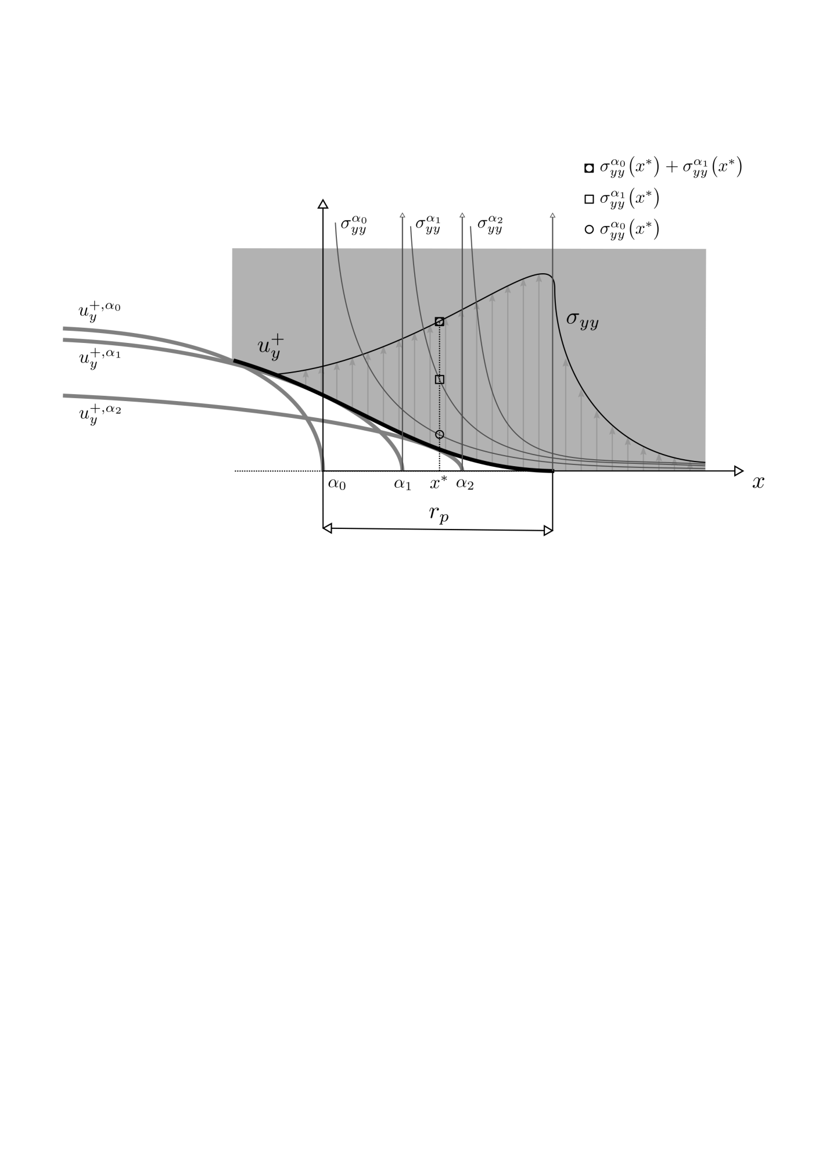
Crack in SGET
Classical vs. SGE solution $Λ_{K}/Λ_{f}<4, W<10 nm$
The fracture process starts to be dominated by far-stress field terms, $K$-factor becomes size dependent
(starts to increase) and the Griffith energy release rate rapidly decreases. No stress singularity
(non-linear elasticity and discrete atomic crack-tip vicinity)
Barenblatt model (1959)
removes the singular stress field at the crack tip (statics)
unknown stress density providing degreased character of cohesion-decohesion curve
cusp-like crack tip
$$ε≪1$$
$$\left(1−k^{2}\right)μu_{y}^{+}\left(r_{p}−εr_{p}\right)≈−\frac{2}{3π}\int_{0}^{1}{\frac{{\tilde{σ}}_{yy}\left(r_{p}−αr_{p}\right)}{\sqrt{α}}ε^{3/2}r_{p}dα}$$

Slide 5
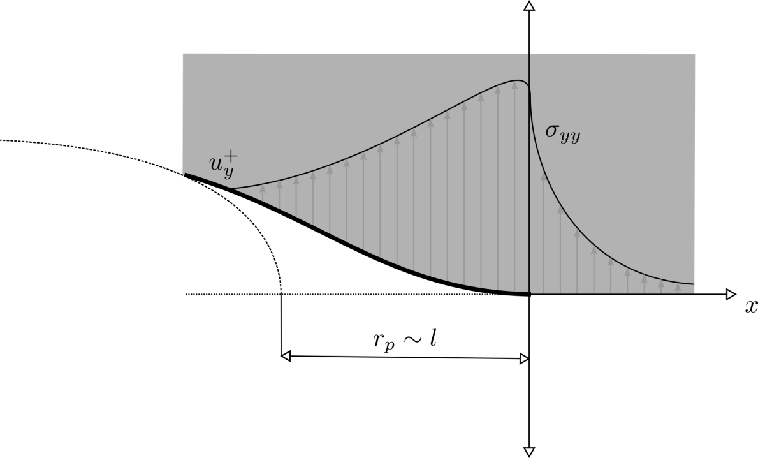
Crack in SGET
Classical vs. SGE solution $Λ_{K}/Λ_{f}<4, W<10 nm$
SGET
Mindlin, Arch. Rat. Mech.,1964
Gourgiotis & Georgiadis, Journal of the Mechanics and Physics of Solids., 2009
the most simple version of SGET - one length scale parameter $l$ and elastic constants $C_{ijkl}$
reproduces the wave dispersion relations effect (dynamics)
removes the singular stress field at the crack tip (statics)
energy density
unknown
scale parameter
$$W=\frac{1}{2}C_{ijkl}ε_{ij}ε_{kl}+\frac{1}{2}C_{ijkl}l^{2}∂_{r}ε_{ij}∂_{r}ε_{kl}$$

Slide 6
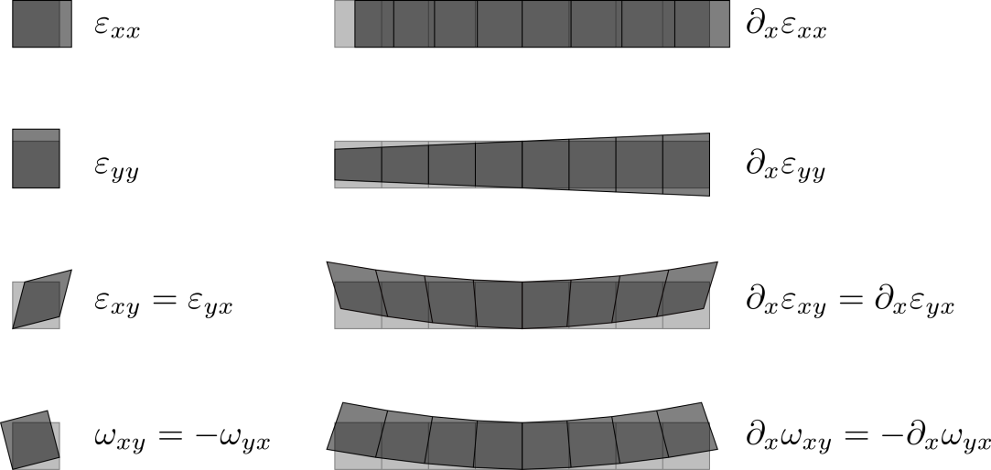
Crack in SGET
nonlocal
local
classical elasticity
$$σ_{ij}=∂_{ε_{ij}}W$$
$m_{kij}=∂_{\left(∂_{k}ε_{ij}\right)}$W
SGET

Slide 7
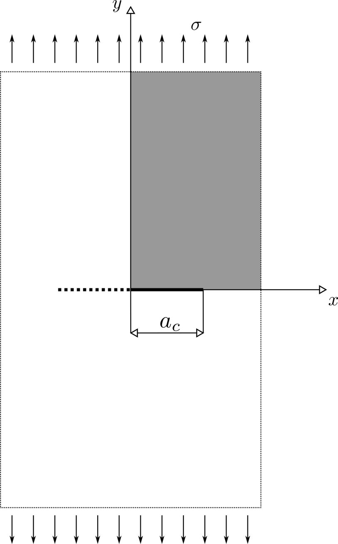
Crack in SGET
INPUT
boundary conditions
elastic coefficients $c_{11}$, $c_{12}$, $c_{44}$
length parameter $l$
FE
solution
symmetry
4th-order differential equations
OUTPUT
$u_{i}$, $σ_{ij}$, $m_{ijk}$
crack
stress and total stress free
Analytical solution:
Gourgiotis & Georgiadis, J. Mech. and Phys. Sol., 2009
analytical
solution
FE solution:
Shu at al., Int. J. Numer. Methods Eng., 1999
Phunpeng & Baiz, Finite Elem. Anal. Des., 2015

Slide 8
Crack in SGET
Equilibrium equation and boundary conditions prevailing at crack tip
$$l^{2}∇^{2}σ=0$$
$${\left.m_{yyy}^{±}\right|}_{x<0,y=0^{±}}={\left.m_{yyx}^{±}\right|}_{x<0,y=0^{±}}=0$$
so-called total stresses $t_{yx}$ and $t_{yy}$
$${\left.\left(τ_{yx}^{±}−∂_{x}m_{xyx}^{±}−∂_{y}m_{yyx}^{±}−∂_{x}m_{yxx}^{±}\right)\right|}_{x<0,y=0^{±}}=0$$
$${\left.\left(τ_{yy}^{±}−∂_{x}m_{xyy}^{±}−∂_{y}m_{yyy}^{±}−∂_{x}m_{yxy}^{±}\right)\right|}_{x<0,y=0^{±}}=0$$
Leading terms of the asymptotic expansion of the displacements at the crack tip
unknown scale parameter
cusp-like crack tip
$$u=l{\left(\frac{r}{l}\right)}^{3/2}\left[A_{1}U_{1}\left(θ;C_{ijkl}\right)+A_{2}U_{2}\left(θ;C_{ijkl}\right)\right]$$

Slide 9
Coupling of DFT and SGE Approaches
The crucial point: identification of $l$
Adjusting SGET predictions by atomistic (DFT) results on
Displacement field near the screw dislocation
Critical crack tip opening displacement.
Acoustic phonon dispersions
This calibration was already made for silicon, germanium and tungsten crystals.
Further illustration made for tungsten.
DFT also provides critical fracture-mechanical parameters (CTOD, $GIc$ ) for a given material (comparable with experimental values).

Slide 10
Coupling of DFT and SGE Approaches
The displacement field near the screw dislocation
The displacement field $w(x,y)$ near the screw dislocation along the $z$-axis in a crystal in frame of SGET.
isotropic material (tungsten)
$$w\left(x,y\right)=\frac{b_{z}}{2π}\left\{atan\left(\frac{y}{x}\right)+\frac{π}{2}sign\left(y\right)\left[1−sign\left(x\right)\right]+sign(y)\int_{0}^{∞}{\frac{sl^{2}sin(sx)}{1+s^{2}l^{2}}e^{−\frac{\left|y\right|}{l}\sqrt{1+s^{2}l^{2}}}ds}\right\}$$
Gutkin & Aifantis, Scripta Materialia, 1996
cubic material (silicon, germanium)
$$w\left(x,y\right)=\frac{b_{z}}{2π}\left\{atan\left(\sqrt{\frac{c_{55}}{c_{44}}}\frac{y}{x}\right)+\frac{π}{2}sign\left(y\right)\left[1−sign\left(x\right)\right]+sign(y)\int_{0}^{∞}{\frac{c_{55}sl^{2}sin(sx)}{c_{44}\left(1+s^{2}l^{2}\right)}e^{−\frac{\left|y\right|}{l}\sqrt{1+s^{2}l^{2}}}ds}\right\}$$

Slide 11
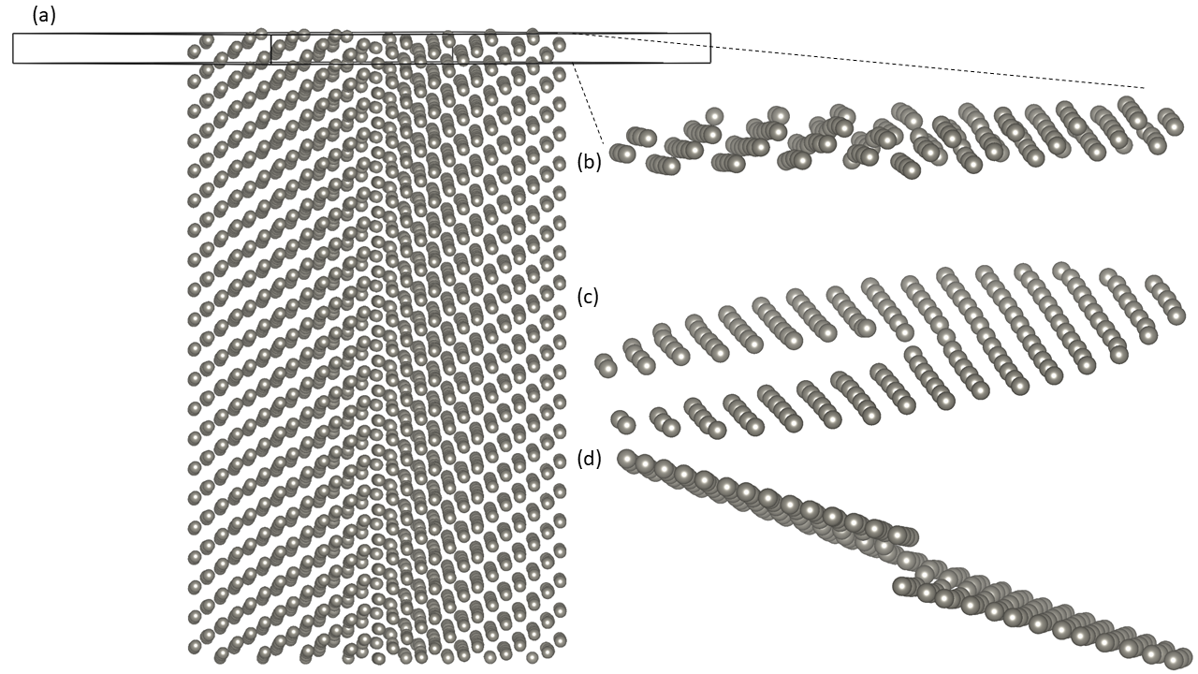
Case study: Coupling of DFT and SGE Approaches
The displacement field near the screw dislocation in tungsten
DFT calculations performed using the Vienna Ab initio Simulation Package (VASP) code and projector augmented wave pseudopotentials. The exchange and correlation energy treated in GGA.
slip plane (–1 1 0)
The simulation supercells contained 174 atoms and formed cylinders surrounded by vacuum (no spurious long-range interactions between the dislocation and its periodic images) – a), b).
displacements of atoms

Slide 12
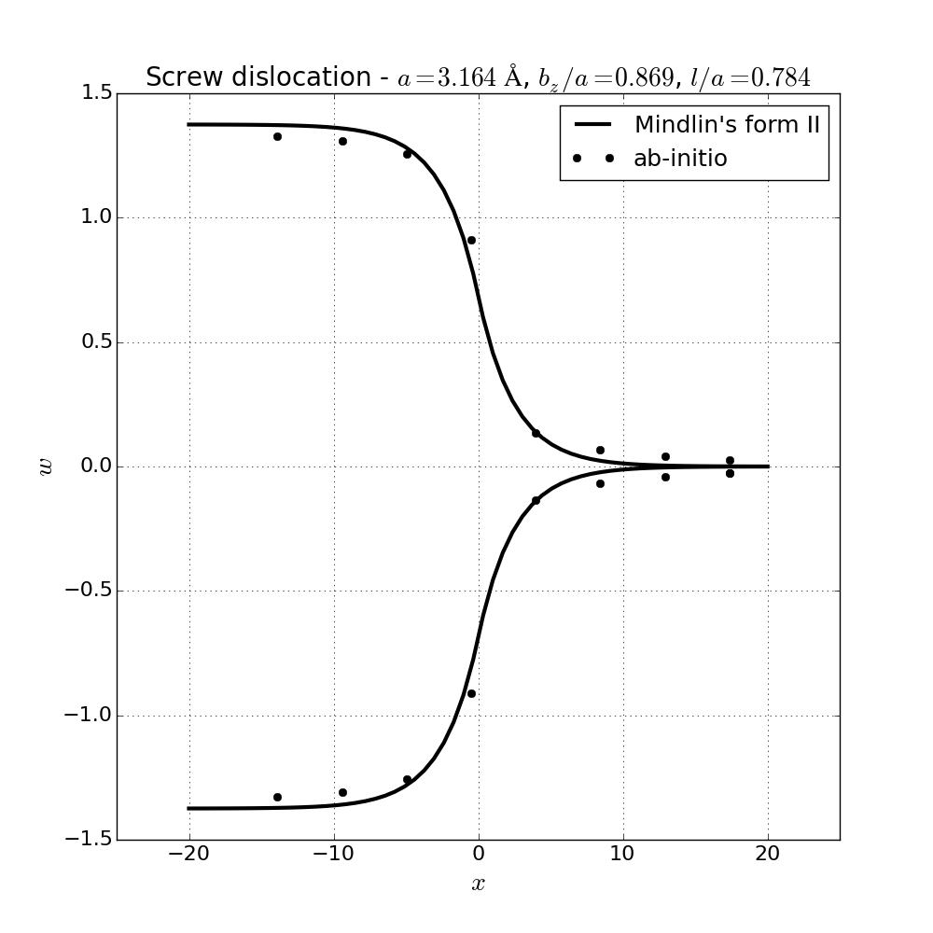
Coupling of DFT and SGE Approaches
The displacement field near the screw dislocation in tungsten
The atomic displacements were numerically fitted to the analytical solution to find out the parameter $l$.
The best fit was obtained
for Burgers vector $[111]$
$$a=0.32 nm$$
$b_{z}=0.27 nm$
$$l=0.25 nm$$
Identical result was obtained also by other calibration methods

Slide 13
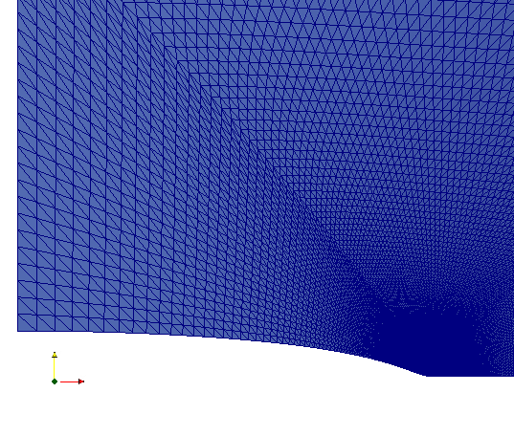
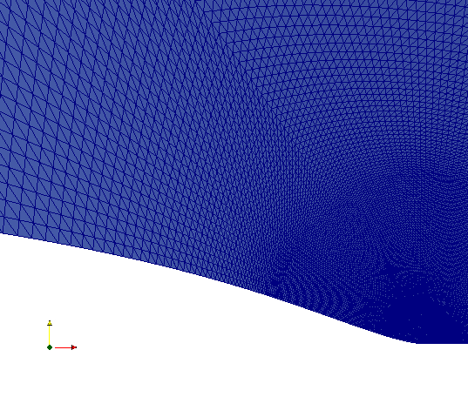
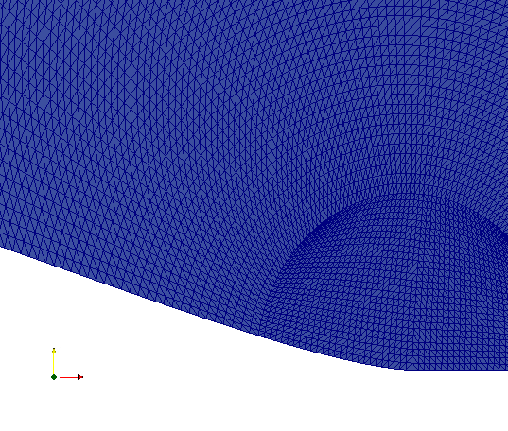
Case study: Finite Element Approach for Crack in SGE
Tungsten
$c_{11}=5.44×{10}^{5} MPa$, $c_{12}=2.08×{10}^{5} MPa$, $c_{44}=1.60×{10}^{5} MPa$
$a_{c}=5.25 nm$, $l=0.25 nm$
$$a_{c}$$
$$l$$
$$l$$
$$a_{c}$$
Very fine mesh and cusp-like crack tip

Slide 14
Numerical Approach for Crack in SGE - $ε_{xy}$, $ε_{yy}$
Tungsten
$c_{11}=5.44×{10}^{5} MPa$, $c_{12}=2.08×{10}^{5} MPa$, $c_{44}=1.60×{10}^{5} MPa$
$a_{c}=5.25 nm$, $l=0.25 nm$
finite value
$$a_{c}$$

Slide 15
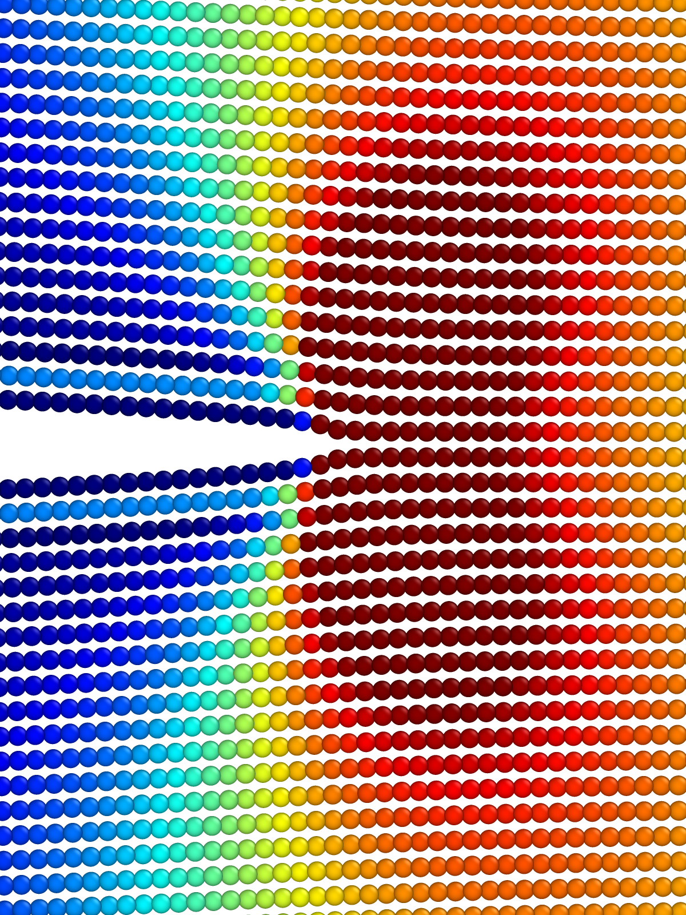
Numerical Approach for Crack in SGE – FE vs. molecular quasi-static simulations
Tungsten
$c_{11}=5.44×{10}^{5} MPa$, $c_{12}=2.08×{10}^{5} MPa$, $c_{44}=1.60×{10}^{5} MPa$
$a_{c}=5.25 nm$, $l=0.25 nm$
A central crack in the tungsten plate used in the molecular quasi-static simulations. The colors represent a scaling of the stress $σ_{yy}$ per atom just before the moment of unstable fracture.
4 3 2 1
finite value
$$l$$
inflection
strength
cusp-like crack tip
COD

Slide 16
Numerical Approach for Crack in SGE – FE vs. molecular quasi-static simulations
Tungsten
$c_{11}=5.44×{10}^{5} MPa$, $c_{12}=2.08×{10}^{5} MPa$, $c_{44}=1.60×{10}^{5} MPa$
$a_{c}=5.25 nm$, $l=0.25 nm$
$$l$$
$$a=5.25 nm$$
COD
$$l$$
$$a=64.27 nm$$
COD

Slide 17
Conclusions
Strain gradient elasticity removes the stress singularity at the crack tip, exhibits a reasonable form of the cohesion-decohesion stress distribution and provides size independent fracture characteristics down to nanoscale.
The parameter l in the simplest SGE can be determined by DFT (ab initio) methods applied to displacement field near the screw dislocation, critical crack tip opening displacement, acoustic phonon dispersions.
Ab initio adjusted SGE provides the stress values at the moment of crack instability, averaged over the process zone, in a reasonable agreement with the theoretical strength.
Ab initio adjusted SGE can give very good predictions of the crack instability in silicon, tungsten and germanium nanosamples.

Slide 18
Thank you for your attention !
Petrov cathedral in Brno
The work was supported by the Czech Science Foundation, project No. 17-18566S

