Slide 1
Advanced continuum models for crack analyses in nano-sized structures
Slovak Academy of Sciences, Slovak Republic

Slide 2
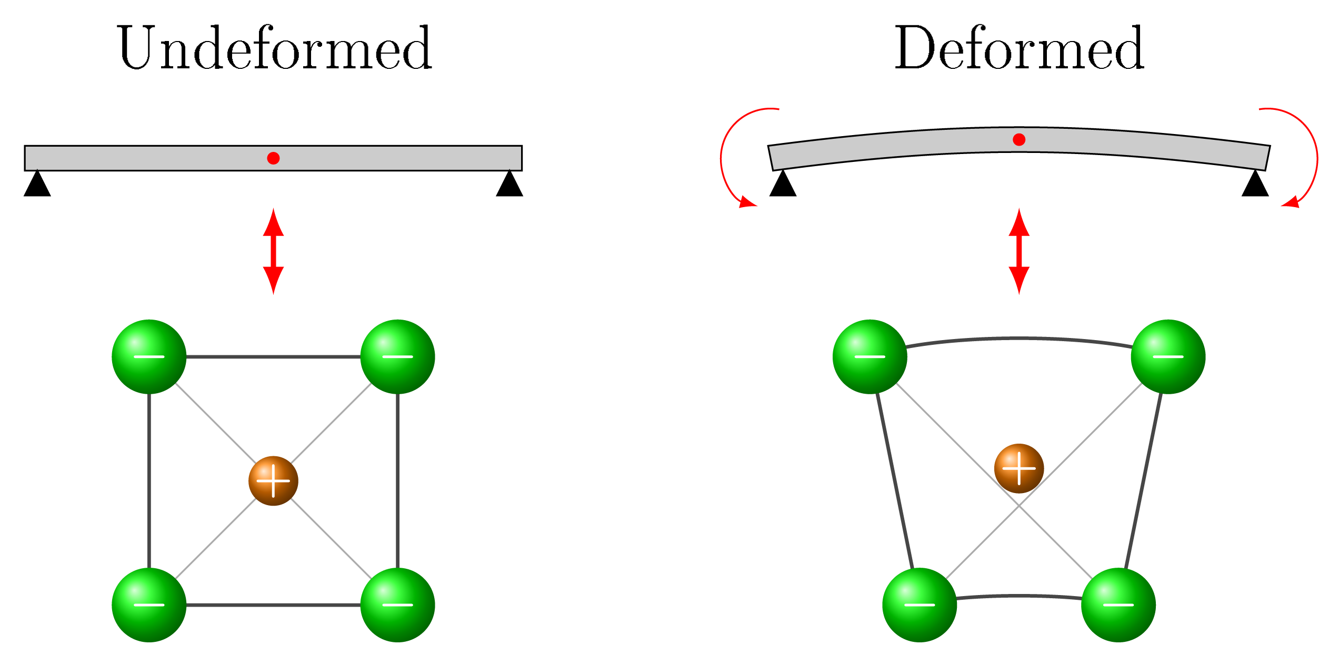
Flexoelectricity
$$ε_{jk,l}$$
$$P_{i}≈f_{ijkl}ε_{jk,l}$$
The presence of strain gradients may potentially break the inversion symmetry and induce polarization even in centrosymmetric crystals (direct effect).
The flexoelectric effect is the consequence of the coupling of the large strain gradients and the electric polarization in dielectric materials.
The flexoelectric effect is the size dependent material property.
The practical utilization of research results can be used, for example, in health monitoring structures (prevention of catastrophic accidents) or in the detection of microcracks in structural elements.

Slide 3
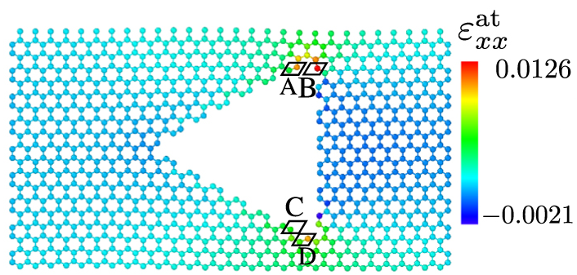
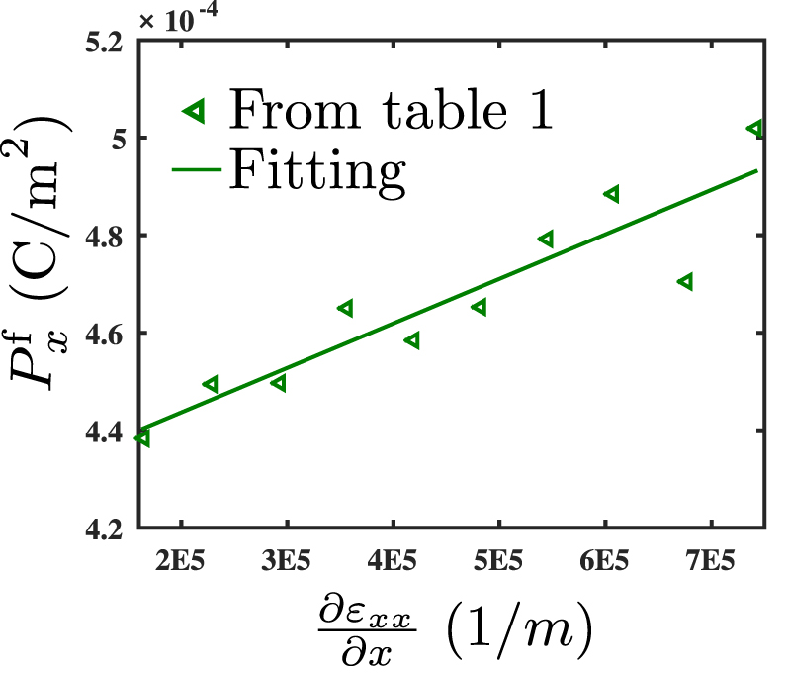
Flexoelectricity
Javvaji et al., Nanotechnology, 29, 2018 225702
The flexoelectric effect observed by the non-uniform straining of a graphene nanoribbon, which is a manifestly non-piezoelectric material
The variation of polarization $P_{x}^{f}$ with $ε_{xx,x}$ for graphene sheet with triangular defect. Solid lines represent the linear fitting between them.

Slide 4
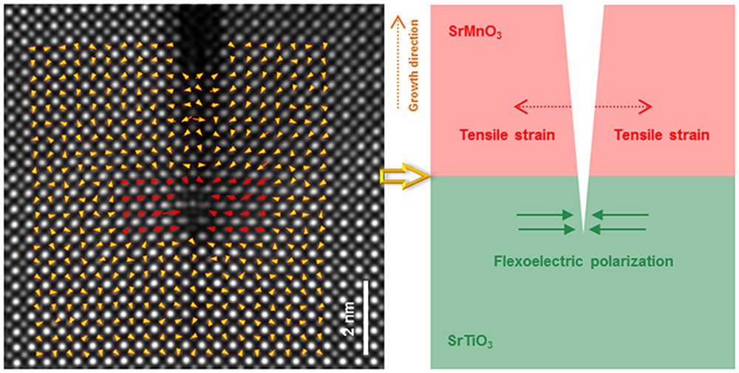
Flexoelectricity
2 nm
Wang et al., Nano Letters, 20, 1, 2020
The strain gradients usually occur near the crack tip and therefore it is relevant to suppose that the crack formation and propagation is affected by the flexoelectricity in the dielectric materials.
Displacement vector map between the TiO and Sr columns overlaid with the scanning transmission electron microscopy.
The big yellow arrow highlights the interfacial SrO plane between SrMnO₃ and SrTiO₃
The red arrows highlights polarization observed in a region about 3–4 unit cells surrounding the crack tip.

Slide 5
Flexoelectricity
The constitutive equations
flexo ($∇E−ε$ coupling)
indirect piezo ($E−ε$ coupling)
$$σ_{ij}=c_{ijkl}ε_{kl}−e_{kij}E_{k}−b_{klij}E_{k,l}$$
strain gradient elasticity
$$μ_{ijk}=−f_{ijkl}E_{i}+g_{jklmni}η_{nmi}$$
$$D_{k}=a_{kl}E_{l}+e_{kij}ε_{ij}+f_{klmn}η_{lmn}$$
direct piezo ($E−ε$ coupling)
flexo ($∇ε−E$ coupling)
$$Q_{ij}=b_{ijkl}ε_{kl}+h_{ijkl}E_{k,l}$$
higher-grade polarization
It is well-known that classical continuum mechanics neglects the interaction of material microstructure, and the results are size-independent.
It is necessary to employ a more appropriate and reliable size-dependent theory of piezoelectricity in which higher gradients of deformation and electric intensity vector are considered.

Slide 6
Results
Publications
J. Sladek, V. Sladek, X.Tian, Q. Deng: Mixed FEM for flexoelectric effect analyses in a viscoelastic material. International Journal of Solids and Structures, 234-235 (2022) 111269.
J. Sladek, V. Sladek, S.M. Hosseini: Analysis of a curved Timoshenko nano-beam with flexoelectricity, Acta Mechanica 232 (2021) 1563-1581.
X. Tian, J. Sladek, V. Sladek, Q. Deng, Q. Li: A collocation mixed finite element method for the analysis of flexoelectric solids. International Journal of Solids and Structures, 217-218 (2021) 27-39.
J. Sladek, S. Hocker, H. Lipp, V. Sladek, Q. Deng: Atomistic approach for the evaluation of direct flexoelectric coefficients in gradient theory, Ferroelectrics 569 (2020) 182-195.
X. Tian, M. Xu, Q. Deng, J. Sladek, V. Sladek, M. Repka, Q. Li: Size-dependent direct and converse flexoelectricity around a micro-hole. Acta Mechanica 231 (2020) 4851-4865.
J. Sladek, V. Sladek, M. Wunsche, Ch. Zhang: Effects of electric field and strain gradients on cracks in piezoelectric solids. European Journal of Mechanics/A Solids 71 (2018) 187–198.
J. Sladek, V. Sladek, M. Repka, E. Pan: Size effect in piezoelectric semiconductor nanostructures. Journal of Intelligent Materials Systems and Structures 33 (2022) 1351-1363.
J. Sladek, V. Sladek, X.Tian, Q. Deng: Mixed FEM for flexoelectric effect analyses in a viscoelastic material. International Journal of Solids and Structures, 234-235 (2022) 111269.
X. Tian, M. Xu, H. Zhou, Q. Li, J. Sladek, V. Sladek: Analytical studies on mode III fracture in flexoelectric solids. ASME Journal of Applied Mechanics 89(4) (2022) 041006.
T. Profant, J. Sladek, V. Sladek, M. Kotoul, Asymptotic solution for interface crack between two materials governed by dipolar gradient elasticity: Amplitude factor evaluation. Theoretical and Applied Fracture Mechanics 120(8) (2022) 103378.

Slide 7
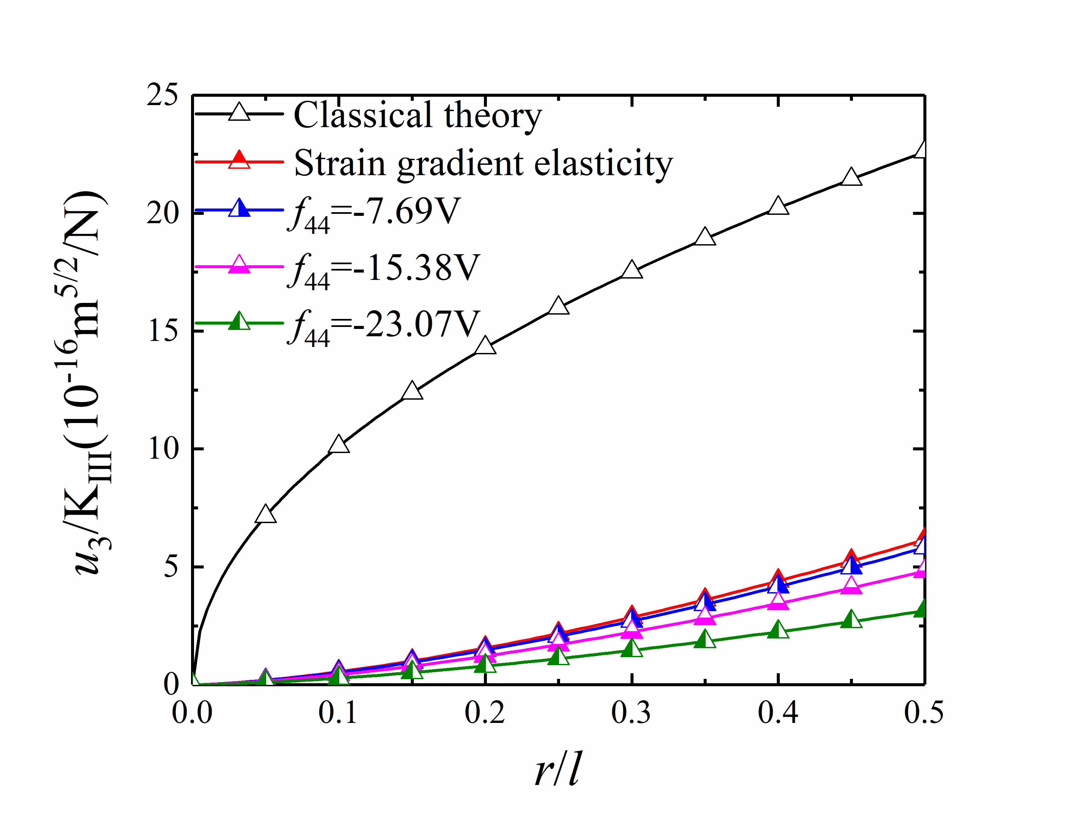
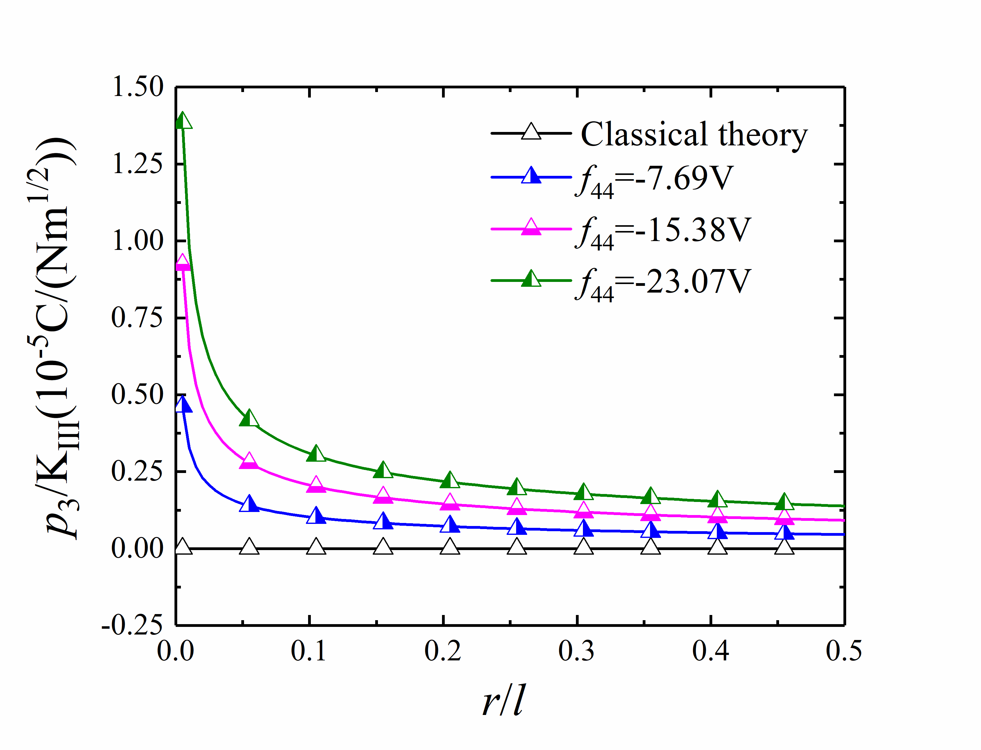
Results
Examples
Variation of the out-of-plane displacement on the upper crack surface ($θ=π$) of Mode III cracks.
Variation of the out-of-plane electric polarization on the upper crack surface ($θ=π$) of Mode III cracks..

