Slide 1
Assessment of amplitude factors of asymptotic expansion at crack tip in flexoelectric solid
under mode I and II loadings
Profant T., Sládek J., Sládek V., Kotoul M.
International Journal of Solids and Structures, 269, 2023, 112194
Brno University of Technology, Czech Republic
Slovak Academy of Sciences, Slovak Republic
LUND UNIVERSITY, Department of Mechanical Engineering Sciences, September 2024
Notes:
The last presentation is about another physical phenomenon into which can be implemented gradient elasticity. It the flexoelectric effect in the dielectrics, more precisely, I am going to talk about the direct formulation of the flexoelectric effect. I am going to present the results published in this article. It is the particular result of the project I was able to participate and similarly to the previous one, it was a big experience and enjoy for me, because it was a project managed by brothers Jan and Vladimir Sladek from Slovak Academy of Science.

Slide 2
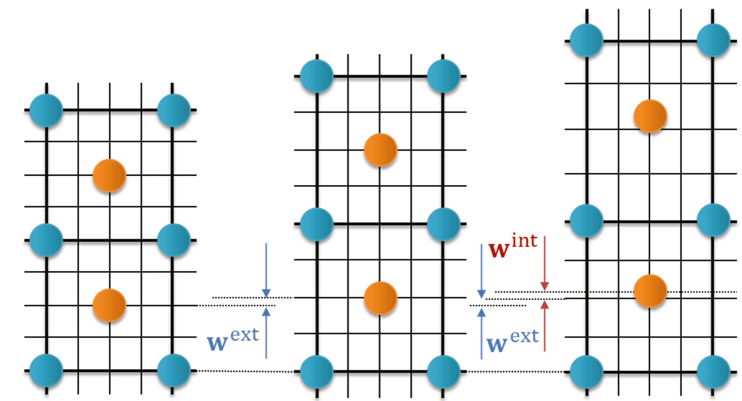
The flexoelectricity in solids
Wang et. al., Progress in Materials Science, 106, 2019
The flexoelectric effect is the consequence of the coupling of the strain gradients and the electric polarization in dielectric materials.
The flexoelectric effect is the size dependent material property.
The strain gradients usually occur near the crack tip and therefore it is relevant to suppose that the crack formation and propagation is affected by the flexoelectricity in the dielectric materials.
LUND UNIVERSITY, Department of Mechanical Engineering Sciences, September 2024
Notes:
The flexoelectric effect is the consequence of the coupling of the strain gradients and the electric polarization in dielectric materials. The flexoelectric effect is the size dependent material property. The strain gradients usually occur near the crack tip and therefore it is relevant to suppose that the crack formation and propagation is affected by the flexoelectricity in the dielectric materials. In the third figure, there are displaced by w_int the orange atoms from their equilibrium positions due to the strain gradients.

Slide 3
Basic equations
$$\left(λ+μ\right)\left(1−l_{1}^{2}∇^{2}\right)∇\left(∇⋅u\right)+μ\left(1−l_{2}^{2}∇^{2}\right)∇^{2}u=0$$
$$∇^{2}\left(aεφ+f∇⋅u\right)=0$$
Electric potential
Displacement vector
Permittivity of the vacuum
Material length scale parameter
$$l_{1}^{2}=l^{2}−\frac{ε_{0}f^{2}}{\left(λ+μ\right)aε}+\frac{f_{2}^{2}}{\left(λ+μ\right)a}$$
$$l_{2}^{2}=l^{2}−\frac{f_{2}^{2}}{aμ}$$
$$f=f_{1}+2f_{2}$$
Lamé coefficients
Reciprocal susceptibility constant
Flexoelectric constants
LUND UNIVERSITY, Department of Mechanical Engineering Sciences, September 2024
Notes:
As I have just mentioned we will talk about the so-called direct flexoelectricity, which is characterized by Navier-type equation for displacements of the fourth order, which can be derived from the equilibrium and constitutive equations. This equation is accompanied by equation for the electric potential derived from the Maxwell equation. Similarly to the gradient elasticity, also here can be found internal length parameter l, other parameters are ….

Slide 4
Constitutive equations
Cauchy stress
$$σ=λTr\left(ε\right)I+2με$$
$$P=a^{−1}\left[E−f_{1}∇Tr\left(ε\right)−2f_{2}∇⋅ε\right]$$
$τ=l^{2}∇σ+f_{1}\left(Pe_{i}e_{i}+Pe_{j}e_{j}\right)+f_{2}\left(e_{i}e_{i}P+e_{j}e_{j}P+e_{i}Pe_{i}+e_{j}Pe_{j}\right)$
Polarization vector field
Double stress
Material length scale parameter
Basis vectors
$$ε=\frac{1}{2}\left(∇u+u∇\right)$$
$$E=−∇φ$$
Electric field
Deformation
LUND UNIVERSITY, Department of Mechanical Engineering Sciences, September 2024
Notes:
Except these parameters, the isotropic flexoelectric solid is characterized by the Lamé coefficients $λ$ and $μ$ and the dependence of the polarization vector field $P$ on the strain gradients $∇ε$. The constitutive equations describe all these circumstances. The reciprocal magnitudes to the strain gradient is the so-called double stress tensor, including the influence of the internal material length parameter.

Slide 5
Boundary conditions
$$u=\overline{u} on ∂V_{u},$$
$$ν=n⋅\left(∇u\right)=\overline{ν} on ∂V_{ν},$$
$$t=n⋅\left(σ−∇⋅τ\right)−\tilde{∇}⋅\left(n⋅τ\right)+\left(\tilde{∇}⋅n\right)n⋅\left(n⋅τ\right)=\overline{t} on ∂V_{t},$$
$$r=n⋅\left(n⋅τ\right)=\overline{r} on ∂V_{r},$$
$$φ=\overline{φ} on ∂V_{φ},$$
$$ω=n⋅\left(ε_{0}E+P\right)=\overline{ω} on ∂V_{D},$$
Auxiliary force tractions
Double force tractions
Basis vectors
Surface charge
$$\tilde{∇}=\left(I−nn\right)⋅∇$$
External unit normal to the smooth boundary $∂V$
LUND UNIVERSITY, Department of Mechanical Engineering Sciences, September 2024
Notes:
The governing equations admit the following boundary conditions. There are more boundary conditions then in the classical elasticity as well as gradient elasticity. Most important in fracture mechanics are Auxiliary force tractions, in the special case along the crack faces called as total stresses. They are generalization of the tractions in classical elasticity. Another result of the strain gradients are double force tractions and due to the polarization of the material, there are also electric potential and surface charge.

Slide 6
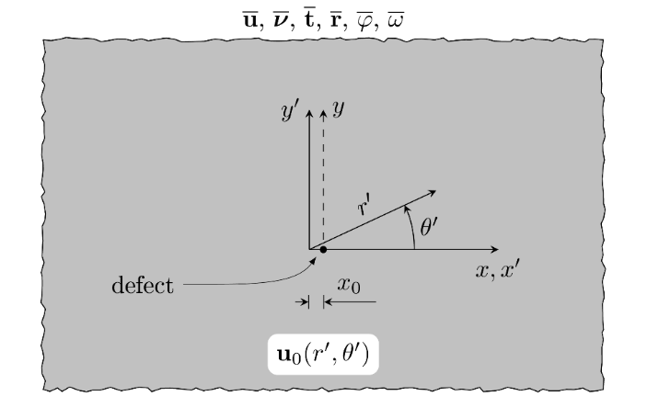
General form of outer solution
Assumption: $l_{3}≡l_{1}≈l_{2}$, ${l_{3}}/L≪1$, $x_{0}=l_{3}$
$$u\left(r,θ\right)=u_{0}\left(r^{′},θ^{′}\right)+x_{0}^{2}u_{1}\left(r^{′},θ^{′}\right)+x_{0}^{4}u_{2}\left(r^{′},θ^{′}\right)+…$$
$$\left(λ+μ\right)∇\left(∇⋅u_{k}\right)+μ∇^{2}u_{k}=0 \left(k=0,1,2,…\right)$$
$$\left(1−l_{3}^{2}∇^{2}\right)\left[\left(λ+μ\right)∇\left(∇⋅u\right)+μ∇^{2}u\right]=0.$$
$$\left\{\left(λ+μ\right)∇\left(∇⋅u_{0}\right)+μ∇^{2}u_{0}\right\}+l_{3}^{2}∇^{2}\left\{−\left(λ+μ\right)∇\left(∇⋅u_{0}\right)−μ∇^{2}u_{0}+\left(λ+μ\right)∇\left(∇⋅u_{1}\right)+μ∇^{2}u_{1}\right\}+O\left(l_{3}^{4}\right)=0.$$
Shifted polar coordinate system $\left(r^{′},θ^{′}\right)$ by $x_{0}$ of the outer solution $u^{out}≡u_{0}\left(r^{′},θ^{′}\right)$.
$$u\left(r,θ\right)=u_{0}\left(r^{′},θ^{′}\right)+O\left(l_{3}^{2}\right).$$
Outer solution $u^{out}$
LUND UNIVERSITY, Department of Mechanical Engineering Sciences, September 2024

Slide 7
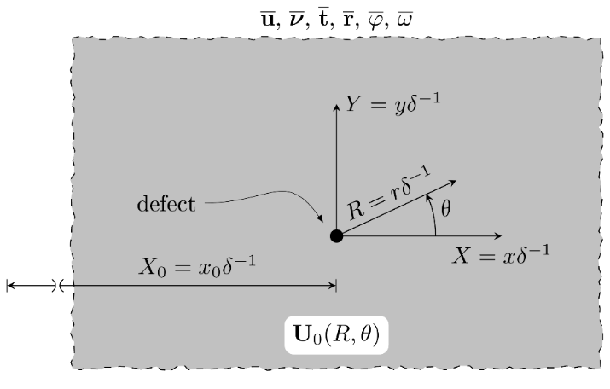
General form of inner solution
Assumption: $δ={l_{3}}/L$, $δ≪1$ $⇒$ $R=δ^{−1}r$, $X_{0}=δ^{−1}x_{0}$
$$U\left(R^{′},θ^{′}\right)=U_{0}\left(R,θ\right)+X_{0}^{2}U_{1}\left(R,θ\right)+…,$$
$∇^{2}\left[\left(λ+μ\right)∇\left(∇⋅U_{k}\right)+μ∇^{2}U_{k}\right]=0$ $\left(k=0,1,2,…\right)$
$$\left(δ^{2}−L^{2}∇^{2}\right)\left[\left(λ+μ\right)∇\left(∇⋅U\right)+μ∇^{2}U\right]=0.$$
Scaled-up polar coordinate system $(R,θ)$ of the inner solution $u^{in}≡U_{0}(R,θ)$.
$$\left\{−L∇^{2}\left[\left(λ+μ\right)∇\left(∇⋅U_{0}\right)+μ∇^{2}U_{0}\right]\right\}+δ^{2}\left\{\left[\left(λ+μ\right)∇\left(∇⋅U_{0}\right)+μ∇^{2}U_{0}\right]−L∇^{2}\left[\left(λ+μ\right)∇\left(∇⋅U_{1}\right)+U_{1}\right]\right\}+O\left(δ^{4}\right)=0.$$
$$U\left(R^{′},θ^{′}\right)=U_{0}\left(R,θ\right)+O\left(δ^{2}\right).$$
Inner solution $u^{in}$
LUND UNIVERSITY, Department of Mechanical Engineering Sciences, September 2024

Slide 8
General form of outer and inner solution
$$φ^{out}≡{\left(r^{′}\right)}^{p^{out} −1}\left\{c_{1}\cos\left(p^{out}−1\right)θ^{′}+d_{1}\sin\left(p^{out}−1\right)θ^{′}\right\}−\frac{f}{aε}∇⋅u_{0}\left(r^{′},θ^{′}\right)$$
Unknown complex exponents
Unknown complex coefficients
$$φ^{in}≡R^{p^{in}−1}\left\{C_{1}\cos\left(p^{in}−1\right)θ+D_{1}\sin\left(p^{in}−1\right)θ\right\}−\frac{f}{aεδ}∇⋅U_{0}\left(R,θ\right)$$
LUND UNIVERSITY, Department of Mechanical Engineering Sciences, September 2024

Slide 9
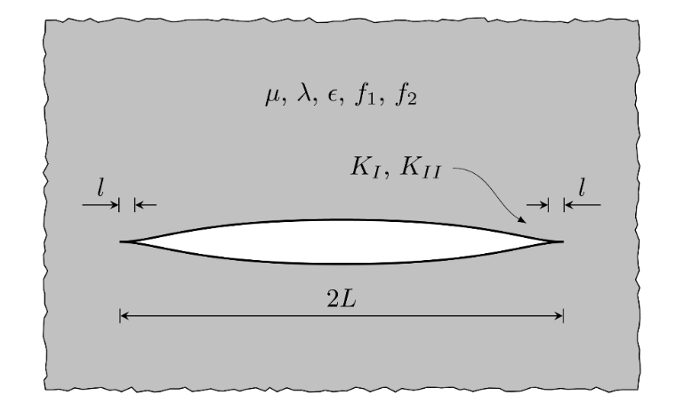
Problem formulation
Material characteristics,
isotropic dielectric solid
Process zone with cusp-like crack tip
The geometry of the crack with finite length $2L$ and the process zones with dimension $l≪L$ in the flexoelectric material under mode I or II loadings.
LUND UNIVERSITY, Department of Mechanical Engineering Sciences, September 2024
Notes:
The crack of finite length $2L$ is considered in the infinitesimal isotropic dielectric solid, which is governed by the equilibrium equations of direct flexoelectricity and the constitutive laws. There are the process zones at the crack tips whose dimensions are proportional to the internal material length parameter $l$. The all assumptions of the validity of LEFM are expected and the external load of the crack is characterized by the SIFs KI and KII. Our goal is to describe the stresses, displacements and electric potential inside of the process zone under the condition of the knowledge of material characteristics and SIFs.

Slide 10
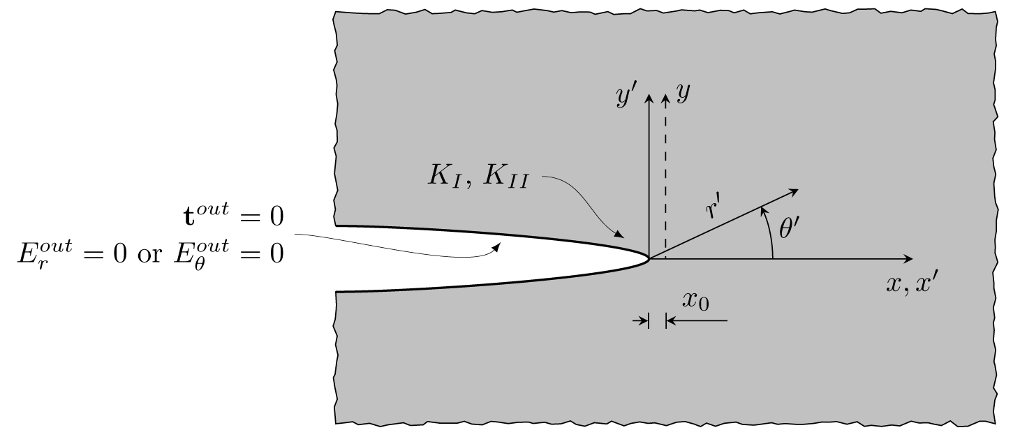
Outer solution for crack
$$\left(λ+μ\right)\left(1−l_{1}^{2}∇^{2}\right)∇\left(∇⋅u\right)+μ\left(1−l_{2}^{2}∇^{2}\right)∇^{2}u=0$$
$$∇^{2}\left(aεφ+f∇⋅u\right)=0$$
Classical elasticity,
neglecting strain gradients out of the process zone
Boundary layer
LUND UNIVERSITY, Department of Mechanical Engineering Sciences, September 2024
Notes:
The parameter $l$ is supposed to be negligibly small with respect to the half-length $L$ of the crack. The domain with the dimension of the internal material length parameter l can be understand as the so called boundary layer known from the singular asymptotic analysis. If the polar coordinate system $\left(r^{′},θ^{′}\right)$ is introduced at the point $x_{0}$ inside or near the process zone as shown in figure, then following the asymptotic analysis, the strain gradients can be neglected in the governing equation and the boundary conditions of the flexoelectricity, and the so-called outer solution for the right-hand crack tip can be derived. The outer solution is valid outside the zone $r^{′}>\left|x_{0}\right|$, where the strain gradients $∇ε$ are negligible small with respect to the magnitudes of the strains $ε$ and it can be proved that the maximum error in the governing equilibrium equations of the flexoelectric problem is of the order $O\left(l^{4}\right)$ for $\left|x_{0}\right|≈l$.

Slide 11
Outer solution for crack
$$\left(λ+μ\right)\left(1−l_{1}^{2}∇^{2}\right)∇\left(∇⋅u\right)+μ\left(1−l_{2}^{2}∇^{2}\right)∇^{2}u=0$$
$$∇^{2}\left(aεφ+f∇⋅u\right)=0$$
$$t^{out}=n⋅σ^{out}=0 for r^{′}>\left|x_{0}\right| and θ^{′}=±π,$$
$$\left.\begin{matrix}E_{θ}^{out}=0 \\ E_{r}^{out}=0\end{matrix}\right\} for r^{′}>\left|x_{0}\right| and θ^{′}=±π,$$
Asymptotic analysis out of the process zone $r^{′}>\left|x_{0}\right|$
$$u_{r^{′}}^{out,I}={\left(r^{′}\right)}^{\frac{1}{2}}\frac{K_{I}}{4μ}{\left(2π\right)}^{−\frac{1}{2}}\left[\left(5−8ν\right)\cos{\frac{1}{2}θ^{′}}−\cos{\frac{3}{2}θ^{′}}\right]$$
$$u_{θ^{′}}^{out,I}={\left(r^{′}\right)}^{\frac{1}{2}}\frac{K_{I}}{4μ}{\left(2π\right)}^{−\frac{1}{2}}\left[−\left(7−8ν\right)\sin{\frac{1}{2}θ^{′}}+\sin{\frac{3}{2}θ^{′}}\right]$$
$$φ^{out,I}=0$$
LUND UNIVERSITY, Department of Mechanical Engineering Sciences, September 2024
Notes:
The outer solution obeying the boundary conditions see above is equivalent to the solution describing the crack tip field in the classical elasticity under the plain strain conditions with exponent $p^{out}=1/2$, there is expressed solution for KI mode loading only, due to the brevity. Moreover the outer electric potential is zero valued for both mode of loading.

Slide 12
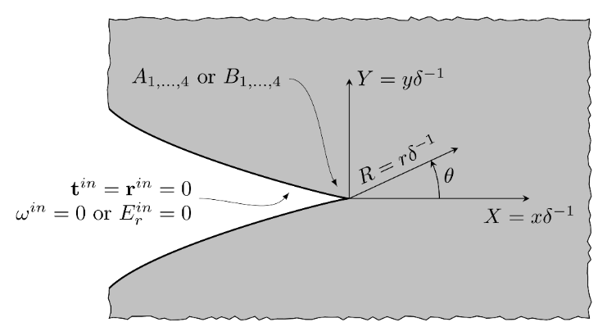
Inner solution for crack
$$\left(λ+μ\right)\left(1−l_{1}^{2}∇^{2}\right)∇\left(∇⋅u\right)+μ\left(1−l_{2}^{2}∇^{2}\right)∇^{2}u=0$$
$$∇^{2}\left(aεφ+f∇⋅u\right)=0$$
$$δ=l/L$$
Gradient elasticity,
strain gradients prevail
The gauge $δ=l/L≪1$
Boundary layer
Scaled-up dimensions $≈δ^{−1}$
LUND UNIVERSITY, Department of Mechanical Engineering Sciences, September 2024
Notes:
The so-called inner solution is searched inside the boundary layer and requires the scaling-up of the coordinate system, because of the vanishingly small dimension of the region on which is defined. Hence, the gauge $δ=l/L$ is introduced as well as the scaled-up radius vector $R=r/δ$. From the asymptotic analysis at the crack tip then follows that the strain gradient prevails in this domain and in the governing equation of the flexoelectricity can be neglected expressions which are not associated with internal length material parameter l, that means the expressions associated with the classical elasticity. The error of the asymptotic solution is then of the order $O\left(δ^{2}\right)$ for R>0.

Slide 13
Inner solution for crack
$$\left(λ+μ\right)\left(1−l_{1}^{2}∇^{2}\right)∇\left(∇⋅u\right)+μ\left(1−l_{2}^{2}∇^{2}\right)∇^{2}u=0$$
$$∇^{2}\left(aεφ+f∇⋅u\right)=0$$
Gradient elasticity,
strain gradients prevail
$$δ=l/L$$
$$t=r=0 for R>0 and θ=±π,$$
P. A. Gourgiotis, H. G. Georgiadis, Journal of the Mechanics and Physics of Solids, 57(11), 1898-1920, 2009
$$ω=0 or E_{r}=0 for R>0 and θ=±π.$$
S. Mao, P. K. Purohit, Journal of the Mechanics and Physics of Solids, 84, 95-115, 2015
Asymptotic analysis in the process zone $R>0$
$$u_{r}^{in,I}=δR\left\{Γ_{1}+Γ_{2}\cos{2θ}\right\}+δ^{\frac{3}{2}}R^{\frac{3}{2}}\left\{A_{1}\cos{\frac{1}{2}θ}+A_{2}\cos{\frac{5}{2}θ}+A_{3}\cos{\frac{3}{2}θ}\right\}$$
$$u_{θ}^{in,I}=−δRΓ_{2}\sin{2θ}+δ^{\frac{3}{2}} R^{\frac{3}{2}}\left\{A_{4}\sin{\frac{1}{2}θ}−A_{2}\sin{\frac{5}{2}θ}−l_{12}A_{3}\sin{\frac{3}{2}θ}\right\}$$
$$φ^{in,I}=C^{0}+δ^{\frac{1}{2}}R^{\frac{1}{2}}Φ\left(f,ε,ε_{0},A_{1},A_{3},A_{4}\right)\cos{\frac{1}{2}θ}−δ^{−1}\frac{f}{aε}∇⋅u^{in,ID}$$
LUND UNIVERSITY, Department of Mechanical Engineering Sciences, September 2024
Notes:
Supposing the stress free and charge or electric field free crack surfaces, the fulfilling of the these boundary conditions leads to the asymptotic solution whose exponent of the dominant terms for the displacement field is $p^{in}=3/2$ associated with generally five independent amplitude factors. It is shown only the asymptotic solution for u and phi only for KI mode loading due to the brevity. The asymptotic solution can be derived using the standard Knein-Williams asymptotic technique, such as shown e.g. these articles. The amplitude factors $Γ_{1}$, $Γ_{2}$, $Γ_{3}$ and $C_{0}$ are associated with the so-called lower-order terms of the asymptotic solution and the Cauchy type stresses and electric potential at the crack tip. The amplitude factors $A_{1,…,4}$ and $B_{1,…,4}$ are the amplitude factors associated with the dominant terms of the asymptotic solution for the case of mode I and mode II loadings. The parameter $l_{12}$ depends on the flexoelectric constants and internal length material parameter l and function capital phi is a complicated expression and it is not shown here.

Slide 14
Composite solution for crack
$$K_{I}$$
$$K_{II}$$
$$A_{1}, A_{2}, A_{3}, A_{4}$$
$$B_{1}, B_{2}, B_{3}, B_{4}$$
?
LUND UNIVERSITY, Department of Mechanical Engineering Sciences, September 2024
Notes:
The outer solution and the inner solution represent the solution of the same problem in two regions of different dimensions. In addition, neither the outer nor inner solution offers its intermediate form, which would describe the transition between them. Consequently, it is very desirable to find the way how to put together both solutions. The way is the so-called matched asymptotic solution method and the result is the composite solution for crack. Practically it means, that matched asymptotic solution method allows us to evaluate eight amplitude factors A and B appearing in the gradient (inner) asymptotic solution as a function of the standard SIFs. It is worth to note, that the composite solution is not unique, and it may exist several ways to construct it. We chose that way, which is more appropriate for the stress, displacement and electric field in front of the crack tip.

Slide 15
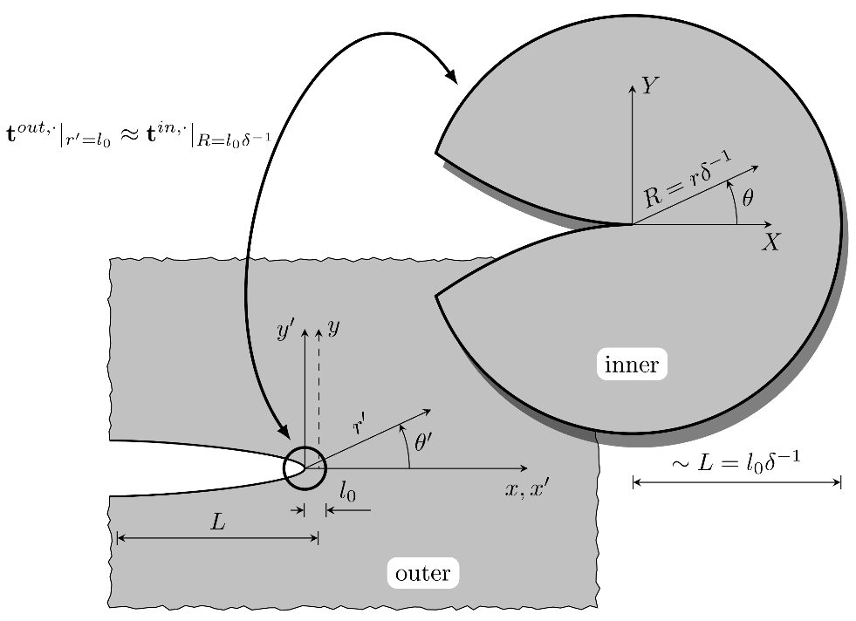
Matching of asymptotic solutions
Singular match condition
$l_{0}δ^{−1}$ is the upper limit of $R$
at which $\left|u^{in}−u\right|≪O\left(δ^{2}\right)$
$l_{0}$ is the lowest limit of $r′$
at which $\left|u^{out}−u\right|≪O(l^{4})$
LUND UNIVERSITY, Department of Mechanical Engineering Sciences, September 2024
Notes:
Let $l_{0}$ be the distance $r^{′}=l_{0}$ from the tip of the crack of the outer solution as the lowest limit value of the radius $r^{′}$, at which the outer solution error is still of the order $O\left(l^{4}\right)$. From this follows that the value of the shift of the coordinate system is $x_{0}≈−l_{0}$ and that the Cauchy stresses of the outer solution lose their dominancy in the domain $r^{′}<l_{0}$ because the higher-order stresses become leading quantities of the crack tip stress field. Similarly, the distance $R={l_{0}}/δ$ is the upper limit of the scaled-up radius vector size $R$ of the inner solution, at which the inner solution error is of the order $O\left(δ^{2}\right)$. It also means that the higher-order stresses and polarization vector in the auxiliary force tractions and electric potential are negligible small, contrary to the components of the Cauchy stress tensor and the singular match conditions is fulfilled. That is, the outer tractions along the radii l0 and comparable with the inner total stresses along the radii l0/delta.

Slide 16
Matching of asymptotic solutions
$l_{0}$ is the lowest limit of $r′$
at which $\left|u^{out}−u\right|≪O(l^{4})$
${\left.t^{out,I,II}\right|}_{r^{′}=l_{0}}≈{\left.t^{in,I,II}\right|}_{R={l_{0}}/δ}$ for $θ^{′}≈θ$
$l_{0}δ^{−1}$ is the upper limit of $R$
at which $\left|u^{in}−u\right|≪O\left(δ^{2}\right)$
${\left.σ_{r^{′}r^{′}}^{out,I,II}\right|}_{r^{′}=l_{0}}≈−{\left.σ_{rr}^{in,I,II}\right|}_{R={l_{0}}/δ}$ and ${\left.σ_{r^{′}θ^{′}}^{out,I,II}\right|}_{r^{′}=l_{0}}≈−{\left.σ_{rθ}^{in,I,II}\right|}_{R={l_{0}}/δ}$ for $θ^{′}≈θ$
Poisson ratio
$$A_{1}≈\frac{K_{I}}{6El_{0}{\left(2π\right)}^{1/2}}\left(12ν^{2}+7ν−5\right)$$
$$A_{2}≈−\frac{K_{I}}{6El_{0}{\left(2π\right)}^{1/2}}\frac{l_{12}\left(4ν^{2}+5ν+1\right)+4ν^{2}+7ν+3}{l_{12}(8ν−1)−8ν+9}$$
$$A_{3}≈−\frac{{2K}_{I}}{El_{0}{\left(2π\right)}^{1/2}}\frac{2ν^{2}+ν−1}{l_{12}\left(8ν−1\right)−8ν+9}$$
$$A_{4}≈\frac{K_{I}}{6El_{0}{\left(2π\right)}^{1/2}}\left(12ν^{2}+ν−11\right)$$
$$B_{1}≈−\frac{K_{II}}{6El_{0}{\left(2π\right)}^{1/2}}\left(12ν^{2}+7ν−5\right)$$
$$B_{2}≈−\frac{K_{II}}{2El_{0}{\left(2π\right)}^{1/2}}\frac{l_{12}\left(4ν^{2}+5ν+1\right)+4ν^{2}+7ν+3}{l_{12}\left(8ν−1\right)−8ν+9}$$
$$B_{3}≈−\frac{6K_{II}}{El_{0}{\left(2π\right)}^{1/{2 }}}\frac{2ν^{2}+ν−1}{l_{12}\left(8ν−1\right)−8ν+9}$$
$$B_{4}≈\frac{K_{II}}{6El_{0}{\left(2π\right)}^{1/2}}\left(12ν^{2}+ν−11\right),$$
Young’s modulus
LUND UNIVERSITY, Department of Mechanical Engineering Sciences, September 2024
Notes:
The singular match condition leads to the overdetermined system of algebraic equations with unknows $A_{1,…,4}$ or $B_{1,…,4}$ for loading modes I or II, respectively. If the most important domain in the front of the cack tip is taken into account, then the expressions assessing the amplitude factors $A_{1,…,4}$ and $B_{1,…,4}$ can be written as follows. Unfortunately, there is still one unknown parameter l0.

Slide 17
$J$-integral ($l_{0}$ evaluation)
Classical elasticity
Gradient elasticity - flexoelectricity
$$J^{I}=\frac{K_{I}^{2}}{E}\left(1−ν^{2}\right)$$
$$J^{II}=\frac{K_{II}^{2}}{E}\left(1−ν^{2}\right)$$
$$J^{I}=\frac{μπl}{16\left(1−ν\right)}\left[\frac{5−4ν−\left(7−6ν\right)α^{2}}{1−α^{2}}{\left(3C_{11}−2C_{12}\right)}^{2}+8C_{12}^{2}\right]$$
$$J^{II}=μπl{\left(1−α\right)}^{2}\left[\frac{4\left(1−ν\right)\left[5−4ν−\left(7−6ν\right)α^{2}\right]}{{\left(2α^{2}ν−3α^{2}+1\right)}^{2}}C_{12}^{2}+\frac{1−α^{2}−{\left(α−β\right)}^{2}\left(1−2ν\right)}{\left(1−αβ\right)\left(1−2ν\right)}C_{22}^{2}\right]$$
S. Mao, P. K. Purohit, Journal of the Mechanics and Physics of Solids, 84, 95-115, 2015
$$l_{0}$$
LUND UNIVERSITY, Department of Mechanical Engineering Sciences, September 2024
Notes:
The parameter $l_{0}$ is known as the just above boundary layer in the matched asymptotic expansion analysis. There is no general rule how to establish its value, and it depends on the physical aspects of the solved problem. The fracture mechanics offers an interesting physical characteristic, the well-known $J$-integral, which is able to combine classical and gradient theory of elasticity. The path independency of the $J$-integral allows the parameter $l_{0}$ to be fixed. The expression of the $J$-integral for loading modes I and II of the flexoelectric material with the crack obeying the conducting and insulating boundary conditions can be found in this article and written as. The constants C can be simply evaluated from the displacements, strains and rotations of the inner solution. The J integral for the classical elasticity is well known. The combination of both solution of J integral results to the value of l0.

Slide 18
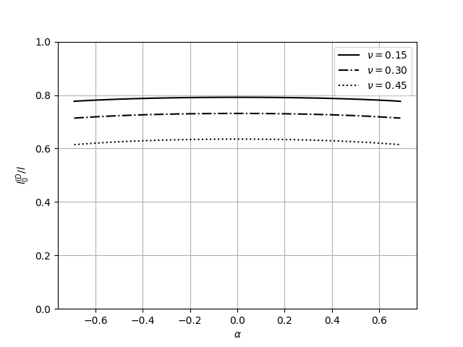
$l_{0}$ evaluation, mode I loading
$$α=\frac{f_{2}}{l\sqrt{aμ}}$$
$$β=\frac{f_{1}+2f_{2}}{l\sqrt{aμ}}$$
$$δ=0.01$$
$$ε/{ε_{0}}=1000$$
Non-dimensional flexoelectric parameters
Distance $l_{0}^{I}$ as a function of the flexoelectric parameter $α$ and $β=0$
LUND UNIVERSITY, Department of Mechanical Engineering Sciences, September 2024

Slide 19
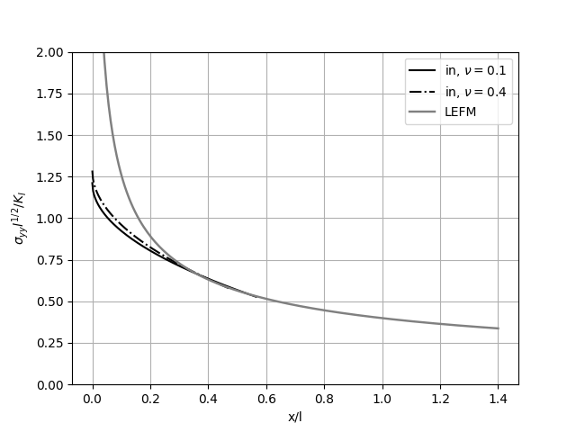
Composite solution , mode I loading
$$δ=0.01$$
$$ε/{ε_{0}}=1000$$
The stress $σ_{yy}$ in front of the crack tip under the mode I load for $ν=0.1, 0.4$, $α=0.1$ and $β=0$
LUND UNIVERSITY, Department of Mechanical Engineering Sciences, September 2024

Slide 20
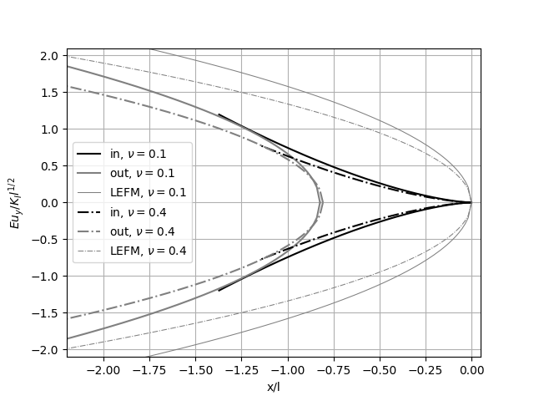
Composite solution, mode I loading
$$δ=0.01$$
$$ε/{ε_{0}}=1000$$
The crack tip opening displacement $u_{y}$ of the crack under the mode I loading for $ν=0.1, 0.4$, $α=0.1$ and $β=0$
LUND UNIVERSITY, Department of Mechanical Engineering Sciences, September 2024

Slide 21
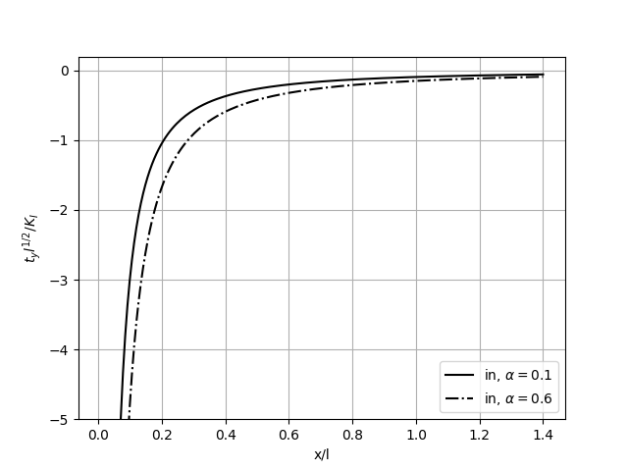
Composite solution, mode I loading
$$δ=0.01$$
$$ε/{ε_{0}}=1000$$
The auxiliary force traction $t_{y}^{in,I}$ in front of the crack tip under the mode I load for $ν=0.$3, $α=0.1, 0.6$ and $β=0$
LUND UNIVERSITY, Department of Mechanical Engineering Sciences, September 2024

Slide 22
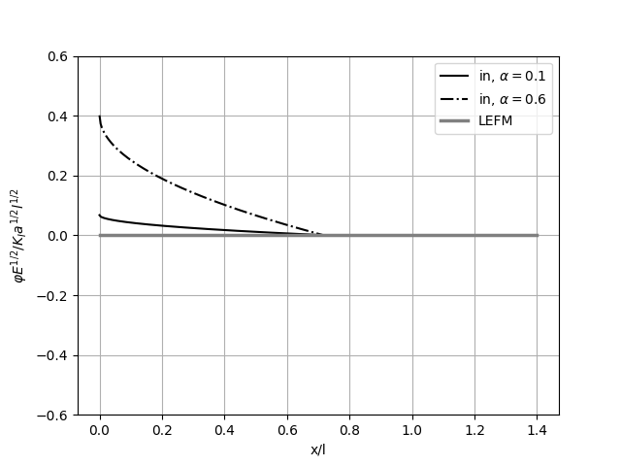
Composite solution, mode I loading
$$δ=0.01$$
$$ε/{ε_{0}}=1000$$
Electric potential $φ$ in front of the tip of the crack under the mode I loading for $ν=0.3$, $α=0.1, 0.6$ and $β=0$
LUND UNIVERSITY, Department of Mechanical Engineering Sciences, September 2024

Slide 23
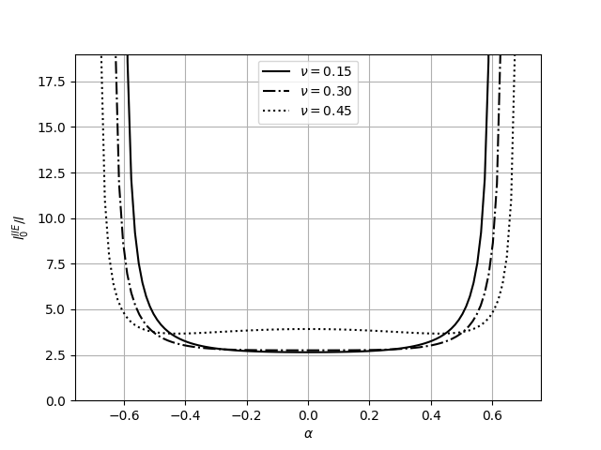
$l_{0}$ evaluation, mode II loading
$$δ=0.01$$
$$ε/{ε_{0}}=1000$$
Distance $l_{0}^{IIE}$ as a function of the flexoelectric parameter $α$ and $β=0$
LUND UNIVERSITY, Department of Mechanical Engineering Sciences, September 2024

Slide 24
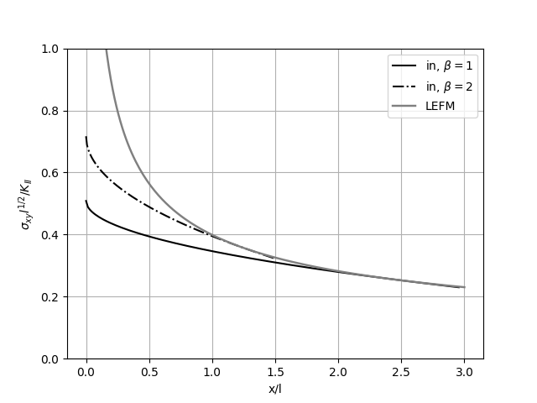
Composite solution , mode II loading
$$δ=0.01$$
$$ε/{ε_{0}}=1000$$
The stress $σ_{xy}$ ahead of the tip of the crack under mode II loading and for $ν=0.3$, $α=0$ and $β=1, 2$
LUND UNIVERSITY, Department of Mechanical Engineering Sciences, September 2024

Slide 25
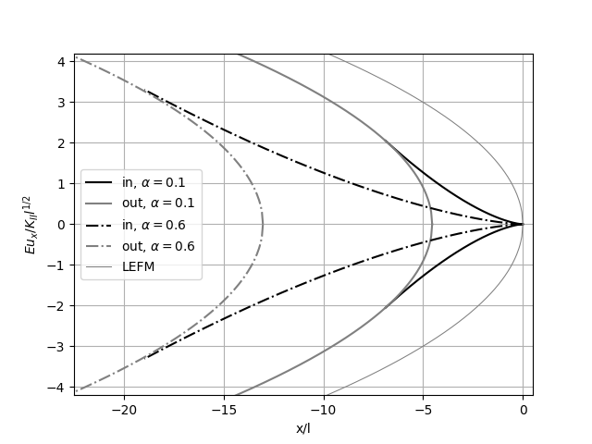
Composite solution, mode II loading
$$δ=0.01$$
$$ε/{ε_{0}}=1000$$
The displacement $u_{x}$ of the crack faces under mode II loading for $ν=0.$3, $α=0.1, 0.6$ and $β=0$
LUND UNIVERSITY, Department of Mechanical Engineering Sciences, September 2024

Slide 26
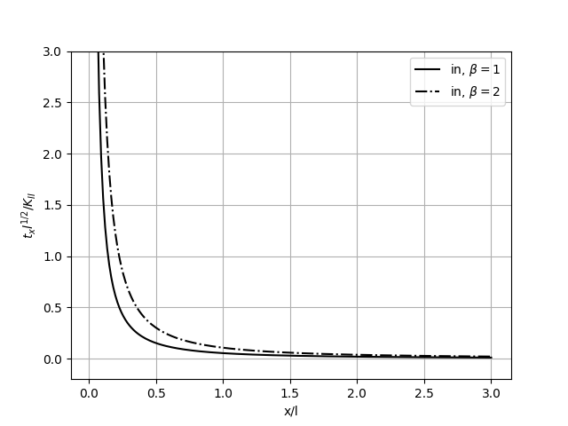
Composite solution, mode II loading
$$δ=0.01$$
$$ε/{ε_{0}}=1000$$
The auxiliary force traction $t_{x}^{in,II}$ ahead of the crack tip under the mode II loading for $ν=0.3$, $α=0$ and$β=1, 2$
LUND UNIVERSITY, Department of Mechanical Engineering Sciences, September 2024

Slide 27
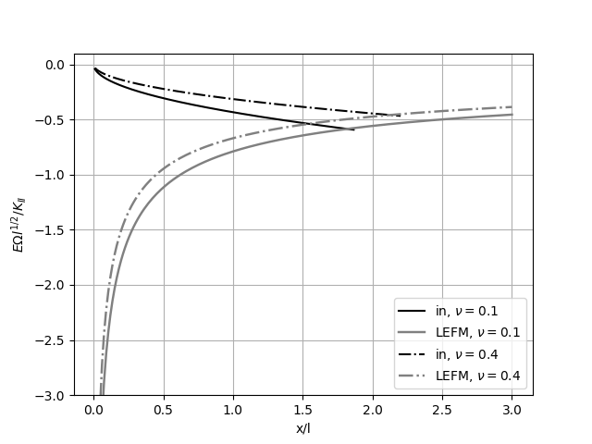
Composite solution, mode II loading
$$δ=0.01$$
$$ε/{ε_{0}}=1000$$
The rotation $Ω=∂_{x}u_{y}−∂_{y}u_{x}$ in the front of the tip of the crack under mode II loading for $ν=0.1, 0.4$, $α=0.1$ and $β=0$
LUND UNIVERSITY, Department of Mechanical Engineering Sciences, September 2024

Slide 28
Thank you for your attention
LUND UNIVERSITY, Department of Mechanical Engineering Sciences, September 2024

